Slide 1









SS8H12d

Slide 2





In 1996, Atlanta hosted the Centennial Summer
Olympic Games. Largest event since Cotton Expo
The festivities not only honored the hundredth anniversary of the modern Olympics but also brought recognition and investment to Georgia from all over the world.
With the opening of the Games, Atlanta welcomed 197 nations, as well as countless spectators to the city.

Slide 3


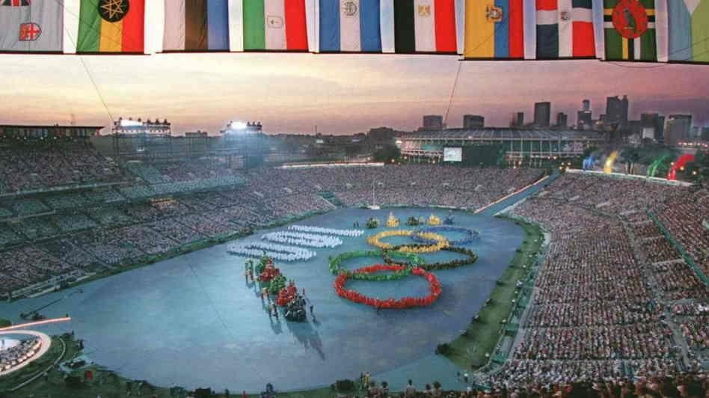


Slide 4
Existing sports venues were expanded and additional venues were constructed not only throughout the city, but also throughout the state and other surrounding states.
Downtown Atlanta was revamped with new sidewalks, trees, and lights, and the 21-acre Centennial Park was developed in the heart of the city.
The Olympic Stadium became the new home for the Atlanta
Braves.
New dormitories were built for Olympic athletes and are now used by state universities.

Slide 5

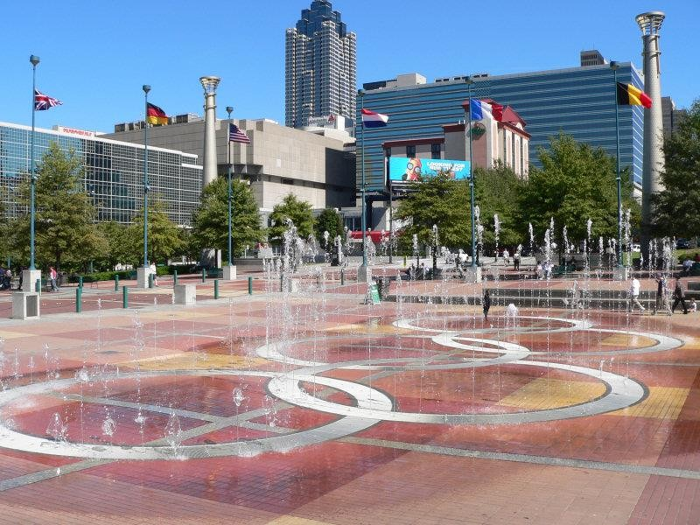
Centennial Olympic Park

Slide 6

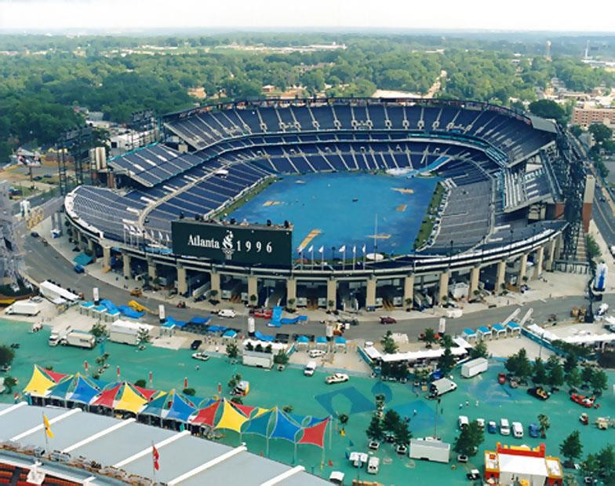
Atlanta Olympic Stadium

Slide 7



The city of Atlanta and the entire state of Georgia
benefitted economically from hosting the Olympics.
The estimated impact of the Olympics on Atlanta was over five billion dollars, and much of Georgia’s economic fortune today is a result of the Centennial Olympic games.
The Olympics also established Atlanta’s reputation as a excellent place for tourism, commerce, and sports.

Slide 8

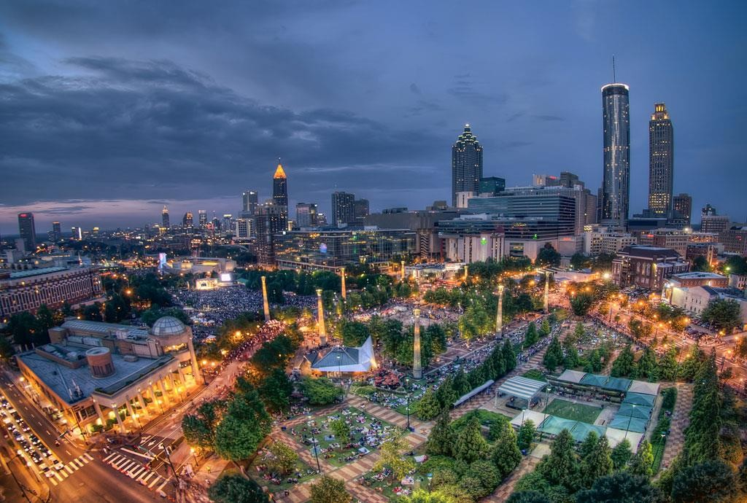

Slide 9



New jobs and facilities were created
throughout the state for the Olympics.
The government increased its revenue through taxes, which was then spent on providing services and programs for Georgia’s citizens.
Since the Olympics, many businesses have relocated to Georgia to take advantage of Atlanta being in international city.

Slide 10

How did the 1996 Olympics affect Atlanta and the
state of Georgia?
Economic
Growth
Jobs
Sports
Facilities
Tax
Revenue
Global Exposure (Tourism)

Slide 11



Directions: How did the 1996 Centennial Olympic Games affect Atlanta and the state of Georgia? Design a button to be worn that commemorates the legacy of the 1996 Olympics. After you finish the button, describe its significance in the textbox. (Think about… jobs, tourism, tax revenue, new facilities, etc.)

