Slide 1
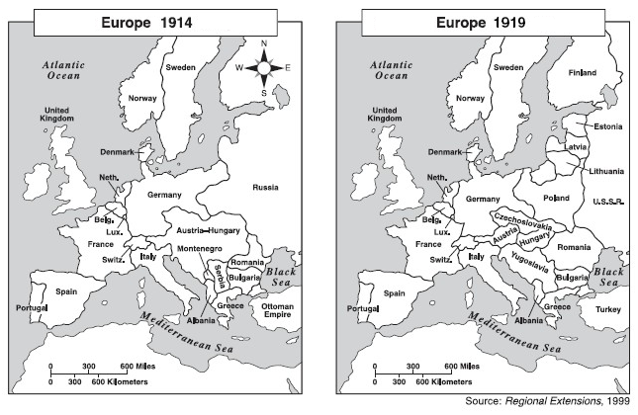
Activating Strategy
Notes:
Students work in pairs to compare the map of Europe in 1914 to the map of Europe in 1919.

Slide 2
Essential Question:
What factors led to the start of World War I and what were Georgia’s contributions?
Standard:
SS8H7d. Explain reasons for World War I and describe Georgia’s contributions.

Slide 3
Based on our activating strategy, we know there were significant changes in Europe following 1914. What happened?

Slide 4
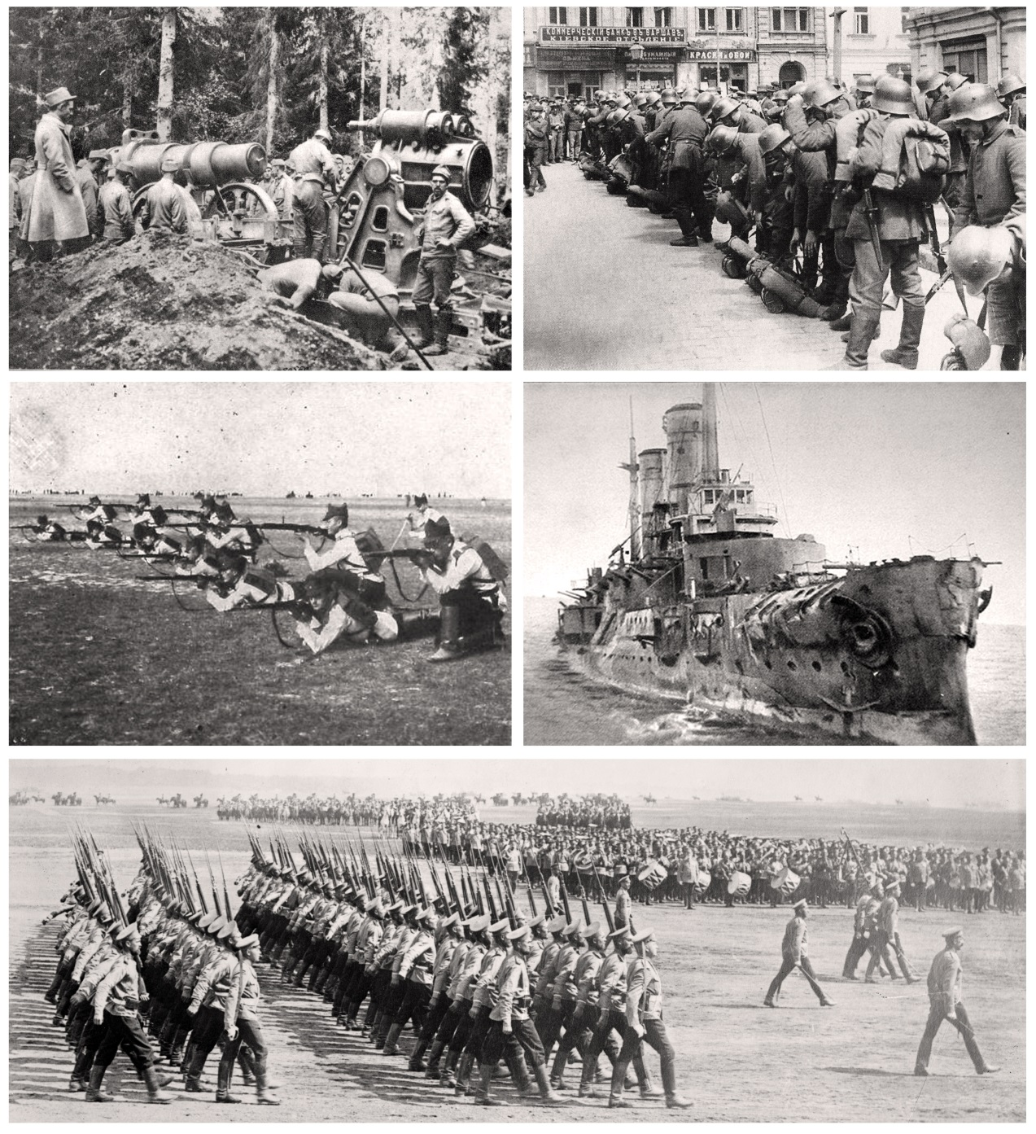
World War I

Slide 5
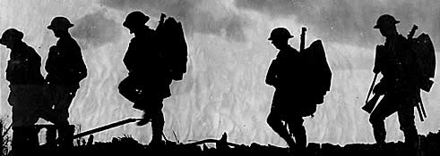
Causes of World War I
"The Great War was without precedent ... never had so many nations taken up arms at a single time. Never had the battlefield been so vast…never had the fighting been so gruesome..."
Notes:
5

Slide 6
Use the MAIN Graphic Organizer to take notes

Slide 7
Causes of World War I
Militarism – building up armed forces, getting
ready for war
Alliances – agreements or promises to
defend and help another country
Imperialism – trying to build up an empire
(powerful country that controls
several less powerful countries
Nationalism – having pride in your country,
willing to defend it
Notes:
After introducing the MAIN causes of WWI, have students go back and identify which political cartoon illustrates each concept.

Slide 8
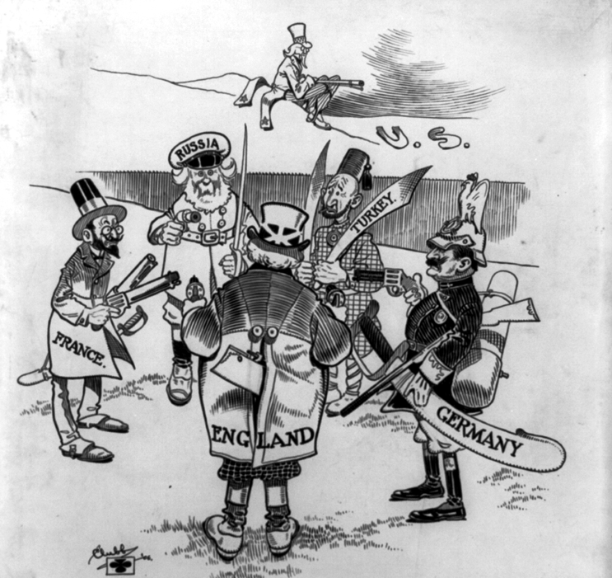
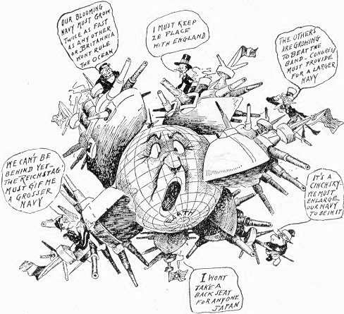
Militarism
Countries had built strong armies and navies to defend their own countries and their colonies. Tensions built as countries watched each other build up military power.

Slide 9
Militarism
Can you think of any recent examples of militarism?

Slide 10
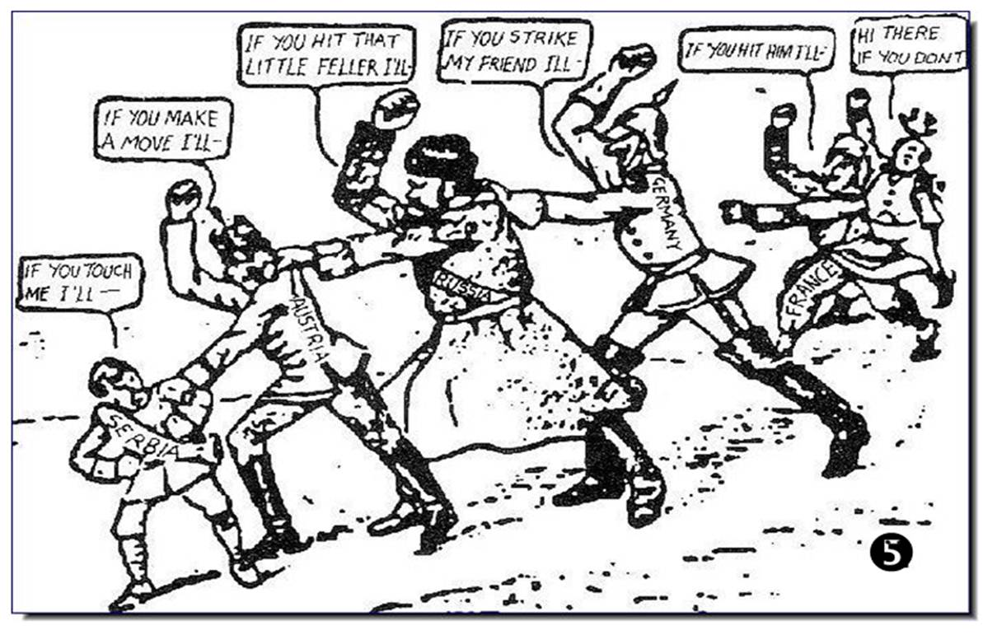
Alliances
European countries had joined alliances to better protect themselves. If one member was attacked, the others were obligated to help that country.
Notes:
10

Slide 11
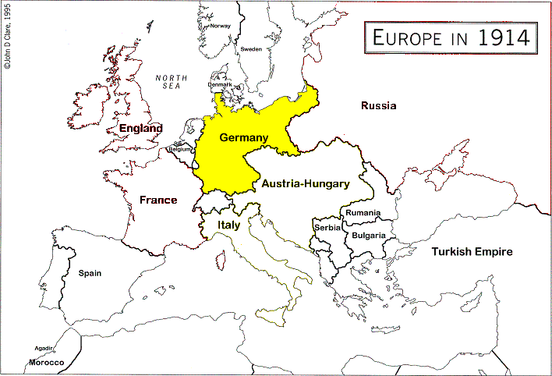
How could Germany’s location in Europe be a problem for them?

Slide 12
Germany’s problem was that it was in the middle of Europe. Being in the middle made it vulnerable if it came to war.
To solve its problem, Germany and other countries formed alliances.

Slide 13
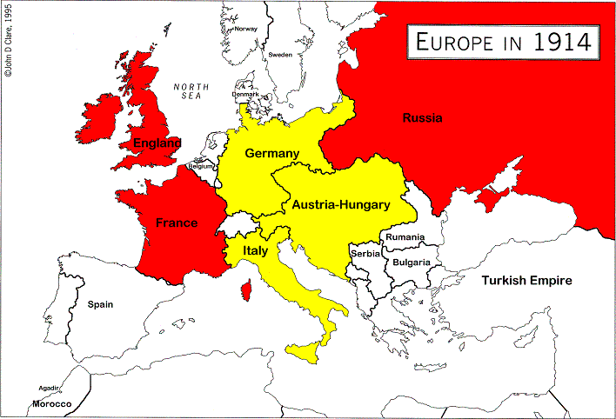
By 1914, Europe was divided into two massive alliances.

Slide 14
Distributed
Summarizing
With a seat partner, discuss a time in your life when an alliance (with a friend, family member, or someone else) has caused problems.

Slide 15
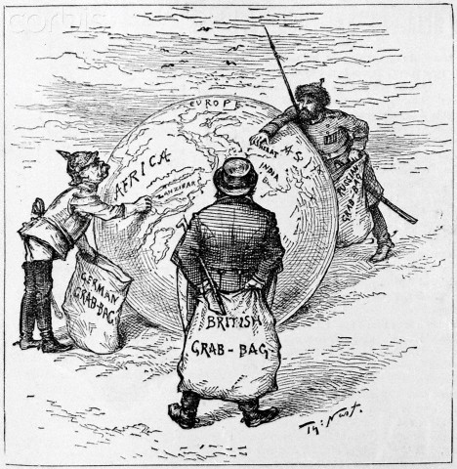
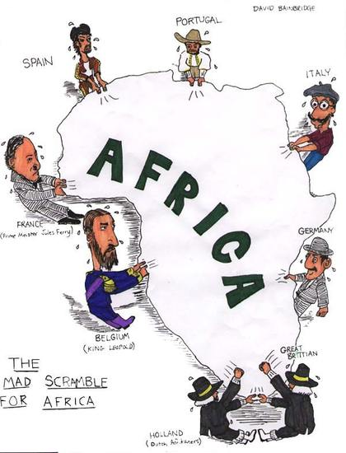
Imperialism
Rivalries developed as countries tried to grab colonies. Conflicts had occurred over control of colonies in Africa and Asia. European countries resented and distrusted each other.
Notes:
15

Slide 16
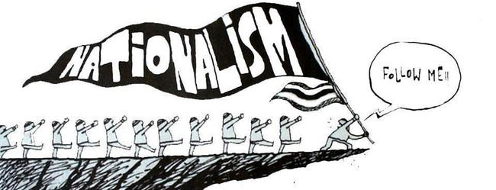
Nationalism
Pride in one’s country; nations sought their own interests over others. Many groups wanted to be free from the control of other nations.
Notes:
16

Slide 17
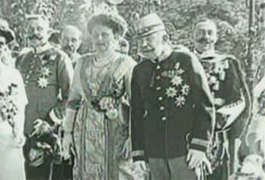
What sparked it all?
http://www.youtube.com/watch?v=njINCi9iIrA

Slide 18
The events that followed…
Austria-Hungary declared war on Serbia
Because of the assignation of Archduke Franz Ferdinand in June of 1914 by a Serbian, the emperor of Austria-Hungary declared war on Serbia.

Slide 19
The events that followed…
Austria-Hungary declared war on Serbia
Russia sent troops to defend Serbia
Russia sent troops to defend Serbia because Russia had a treaty with Serbia. Russia supported Serbia because they were both of a similar ethnic backgrounds.

Slide 20
The events that followed…
Austria-Hungary declared war on Serbia
Russia sent troops to defend Serbia
Germany declared war on Russia
Since Germany had a treaty with Austria-
Hungary, Germany declared war on Russia.

Slide 21
The events that followed…
Austria-Hungary declared war on Serbia
Russia sent troops to defend Serbia
Germany declared war on Russia
Germany declared war on France
France had a treaty with Russia so Germany declared war against France.

Slide 22
The events that followed…
Austria-Hungary declared war on Serbia
Russia sent troops to defend Serbia
And so the war begins!
Germany declared war on Russia
Germany declared war on France

Slide 23
The Central powers
Austria-Hungary
Germany
Turkey (Ottoman Empire)
The Allied Powers
Russia
France
United Kingdom
Italy
United States

Slide 24
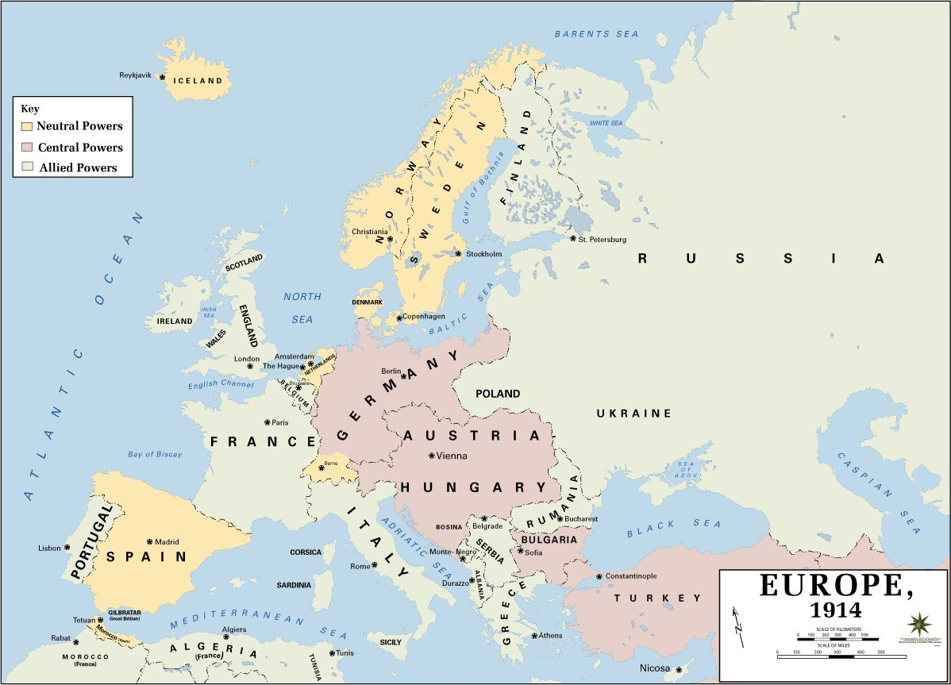

Slide 25
Distributed
Summarizing
Could World War I have been prevented? Why or why not?

Slide 26
Georgia’s Contributions
Close to 100,000 Georgians served in the armed forces during World War I
The increased demand for food and for ways to store it brought prosperity to Georgia farmers and boosted industry

Slide 27
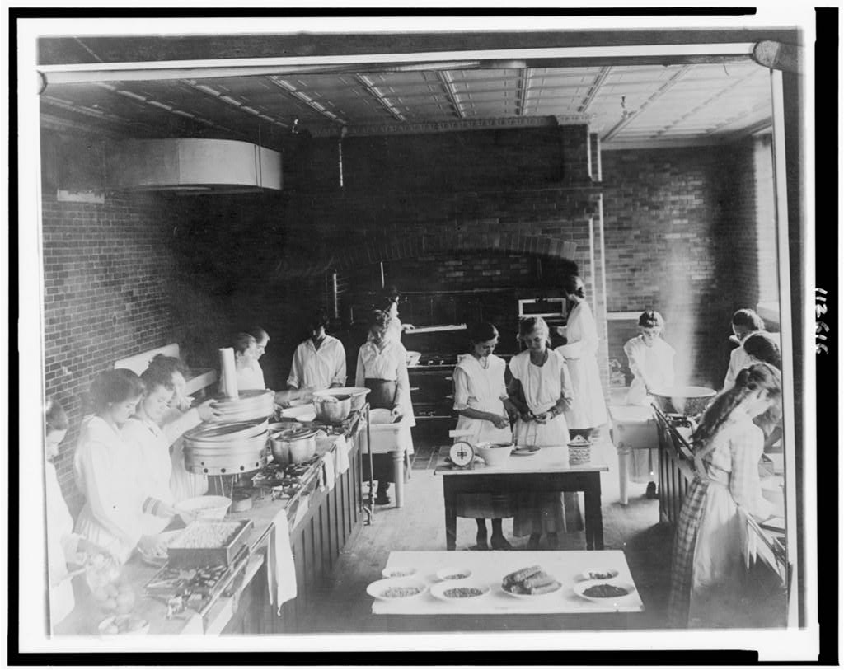
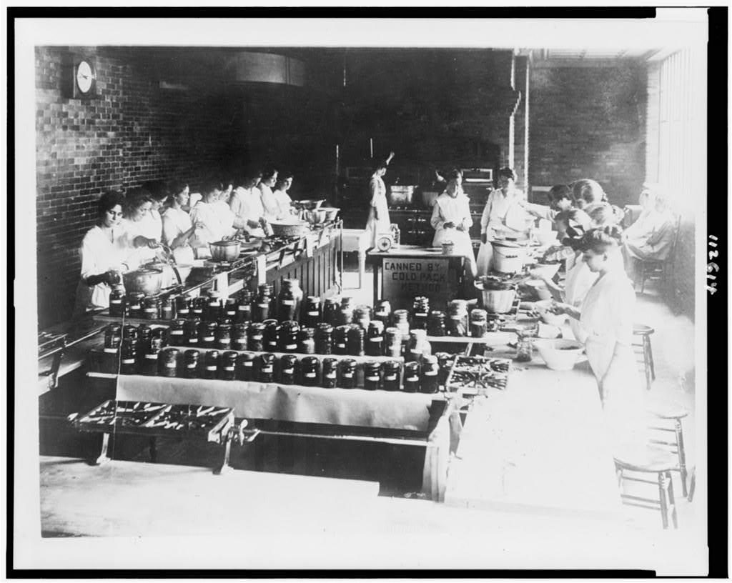
Georgia’s Contributions
Commercial canning plants were built to process sweet potatoes and peaches
Notes:
http://cdn.loc.gov/service/pnp/cph/3c10000/3c12000/3c12600/3c12616v.jpg
http://cdn.loc.gov/service/pnp/cph/3c10000/3c12000/3c12600/3c12614v.jpg Image is not of Georgians, but illustrates the canning plants

Slide 28
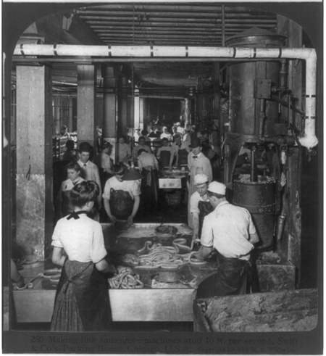
Georgia’s Contributions
Meat packing plants opened in Moultrie, Atlanta, Augusta, and Savannah

Slide 29
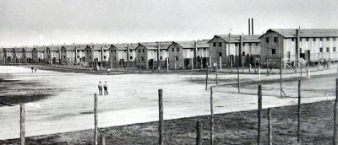
Georgia’s Contributions
Georgians housed prisoners of war for the
U.S. government.
In 1917, a camp at Fort Oglethorpe in north Georgia, was built to hold German merchant seamen

Slide 30
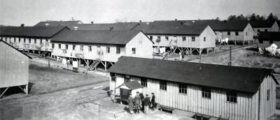
Georgia’s Contributions
In 1918, they were moved to Fort McPherson near Atlanta
General Hospital No. 6 at Fort McPherson treated about 10,000 wounded soldiers from 1917 to 1919.

Slide 31
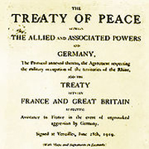
The War is Over!
The Treaty of Versailles
officially ended World War I.

Slide 32
Summarizing Strategy: 4 – 3 – 1
Identify or Describe 4 causes of World War I
Identify or Describe 3 contributions of Georgians during World War I
Identify or Describe 1 effect World War I had on Georgia

