Slide 1
Atlanta Mayors in the Modern Era:
Maynard Jackson
And
Andrew Young

Slide 2
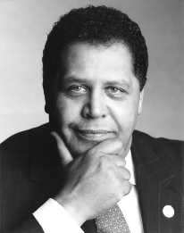
Maynard Jackson (1938-2003)

Slide 3
MAYNARD JACKSON (1938-2003)
Maynard Jackson was the first African American mayor of a major southern city.
A graduate of Morehouse College, he lost to Herman Talmadge in a bid for the U.S. Senate. However, he won a majority of the votes in Atlanta and became a force in Atlanta politics.
Jackson served as mayor of Atlanta from 1973-1981 and again from 1990-1994. His list of accomplishments is admirable.

Slide 4
ACCOMPLISHMENTS AS MAYOR
Provided more contract work to black-owned businesses
Expanded Hartsfield Airport
Sought to add more blacks to the police force
Encouraged Atlanta to become a financial center
Expanded international convention facilities and promoted Atlanta’s image as a major convention center

Slide 5
ACCOMPLISHMENTS AS MAYOR
Improved housing and social conditions through affirmative action programs
Improved the mass transit system making it one of the most modern in the United States
In the 1990’s worked closely with Andrew Young and Billy Payne to help bring the Olympics to the city.
Jackson retired from public life in 1994 due to health issues but continued to be active in business. He died in 2003 in Washington, D.C.

Slide 6
MAYOR MAYNARD JACKSON’S LEGACY
The airport was renamed as Atlanta Hartsfield-Jackson International Airport to honor his contributions in developing the airport to Atlanta’s benefit. The airport provides approximately 500,000 jobs in the metro area. It also provides national and international air service to passengers as well as cargo transport.

Slide 7
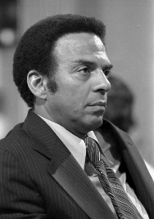
ANDREW YOUNG (1932-PRESENT)

Slide 8
ANDREW YOUNG (1932-PRESENT)
Andrew Young moved to Georgia to serve as a pastor.
He became active in the Civil Rights Movement, primarily focusing on voter registration drives.
In 1961, Young started working for the SCLC to help train civil rights volunteers in organizing and taking part in non-violent protest.
He soon became a close associate of Martin Luther King, Jr. and successfully organized demonstrations and voter registration campaigns throughout the South.
Young was with Martin Luther King, Jr. on the day he was assassinated.

Slide 9
ANDREW YOUNG (1932-PRESENT)
In 1972, Young was elected as Georgia’s first black Congressman since Reconstruction and, in 1977, President Jimmy Carter appointed him ambassador to the United Nations.
Andrew Young was then elected mayor of Atlanta in 1981 and, as mayor, he was instrumental in the city’s continued growth and national and international prestige.

Slide 10
ACCOMPLISHMENTS AS MAYOR
bringing $70 billion in new private investment to the city, 1,100 new businesses and one million jobs to the region,
expanding programs for including minority and female-owned businesses in all city contracts,
tripling college scholarships given to Atlanta public school graduates,

Slide 11
ACCOMPLISHMENTS AS MAYOR
overhauling and privatizing Zoo Atlanta, and
hosting the 1988 Democratic National Convention.
Even after leaving office in 1989, Young continued to work for Georgia’s economic development, served as co-chair of Georgia’s 1996 Olympic committee, and worked as a consultant for many international organizations which he continues to do today.

