Slide 1
The Economic Depression in Georgia
By: Ryder Santamaria

Slide 2
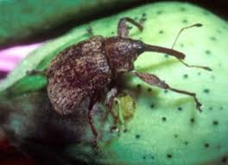
The Boll Weevil
The Boll Weevil was a small bug that burrowed itself inside of cotton bolls and plants it eggs inside of them. The boll weevils larvae eat their way out of the cotton boll, killing the plant.

Slide 3
The Boll Weevil's Effects
The boll weevil destroyed up to 60% of all cotton crop in Georgia, which destroyed a big part of the agricultural economy. The boll weevil also was a big contributor to the invention of pesticides and insecticides. It also caused a great farmer migration because many small farmers had trouble making a living.

Slide 4
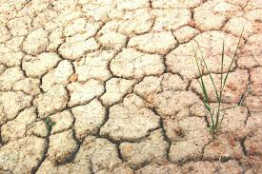
Drought
Georgia went through a severe drought starting in 1925, this drought made it almost impossible to grow any crops because the soil was very dry and deprived of all nutrients.

Slide 5
Effects
These two factors caused Georgia to go through a severe depression in 1915-1945. Many Georgian's had to find new jobs or lose their homes. This also caused a huge farmer migration because many farms were completely useless with the combination of a drought and the boll weevil. Banks also lost a lot of money because a majority of the money they had loaned to farms was lost in the destruction of the land, which ultimately led to the depression.

