Slide 1
CAUSES OF THE AMERICAN REVOLUTION AND THE IMPACT ON GEORGIA

Slide 2
The French and Indian War
Because of discontent in the colonies, the French and Indian War cost the British a lot of money. In order to help pay off the debt, they decided to tax the colonists.

Slide 3
Though the colony was not directly involved, Georgia’s borders expanded to the St. Mary’s River to the South, the Mississippi River to the West, and land around Augusta to the North.

Slide 4
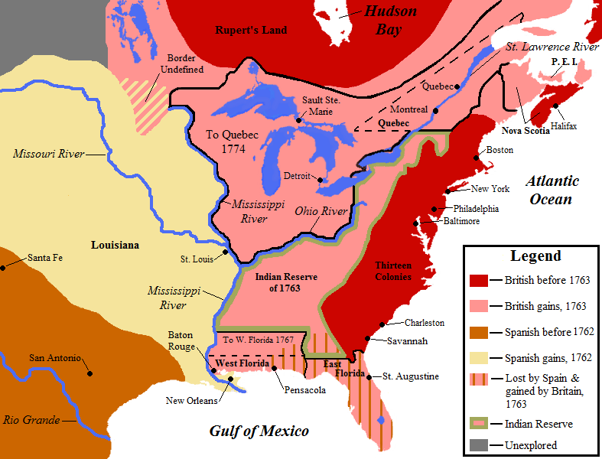
© 2014 Brain Wrinkles

Slide 5
NAVIGATION ACT OF 1763
Colonists could only use British vessels to ship their goods.
Georgia Connection: This act was not a problem for Georgia because all of its goods were only shipped to England anyway

Slide 6
STAMP ACT OF 1765
This tax, to raise money to pay for the war, taxed paper goods (newspapers, legal documents, licenses)
Reaction in the colonies was violent.
Georgia Connection:
No representative from GA went to Boston for the Stamp Act Congress.
A group of Georgians called the Liberty Boys (part of the Sons of Liberty) came together to oppose the Stamp Act.
Georgia was the only colony to sell the stamps but they didn’t sell many.

Slide 7
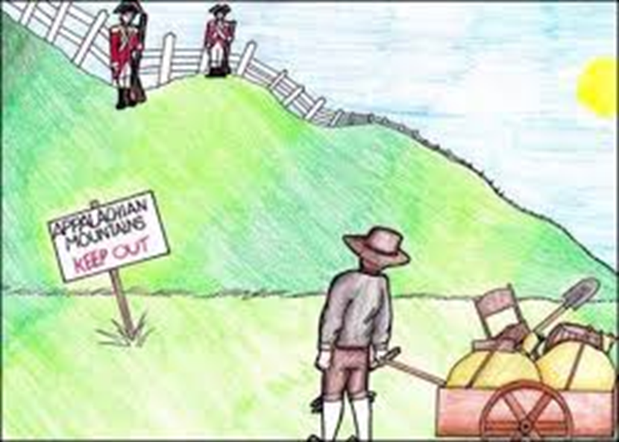
Proclamation of 1763 Forbade colonists from settling west of the Appalachians
Most colonists ignored the new law and stayed put or continued to migrate past the mountains.
The British army sent 7,500 men to keep peace on the frontier

Slide 8
Views – Proclamation of 1763
British/Loyalists- Defending the frontier is to expensive. Colonists would have to pay for troops.
Patriots- Tyranny, The land was already settled, and it was the only place farmers could get new cheap land
Georgia Connection: None; Georgia had gained both land and resources (water access from the Creek and Cherokee near Augusta)

Slide 9
INTOLERABLE ACTS
Parliament punished Massachusetts for the Boston Tea Party by passing these acts:
1) The Port of Boston was closed until payment for the tea was received.
2) There could be no town meetings unless authorized by the Governor.
3) Any British official accused of capital crimes had to be tried in England.
4) Quartering Act: Colonists had to house and feed British soldiers at their own expense

Slide 10
INTOLERABLE ACTS (continued)
Georgia Connection:
Because of these acts, 12 out of the 13 colonies sent representatives to the 1st Continental Congress in 1774.
Georgia did NOT send anyone.

Slide 11
QUARTERING ACT OF 1773
Part of the Intolerable Acts) Required colonists to feed and house British soldiers at their own expense.
Georgia Connection:
A Georgia woman became a hero as a result of this act.

Slide 12
THE END

Slide 13
Quotations are commonly printed as a means of inspiration and to invoke philosophical thoughts from the reader.

Slide 15
Maps
our office

Slide 16
Let’s review some concepts
Yellow
Is the color of gold, butter and ripe lemons. In the spectrum of visible light, yellow is found between green and orange.
Blue
Is the colour of the clear sky and the deep sea. It is located between violet and green on the optical spectrum.
Red
Is the color of blood, and because of this it has historically been associated with sacrifice, danger and courage.
Yellow
Is the color of gold, butter and ripe lemons. In the spectrum of visible light, yellow is found between green and orange.
Blue
Is the colour of the clear sky and the deep sea. It is located between violet and green on the optical spectrum.
Red
Is the color of blood, and because of this it has historically been associated with sacrifice, danger and courage.

Slide 17
iPhone project
Show and explain your web, app or software projects using these gadget templates.
Place your screenshot here

Slide 18
Tablet project
Show and explain your web, app or software projects using these gadget templates.
Place your screenshot here

Slide 19
Desktop project
Show and explain your web, app or software projects using these gadget templates.
Place your screenshot here

Slide 20
Thanks!
Any questions?
You can find me at @username & user@mail.me

Slide 21
Presentation design
This presentation uses the following typographies
Titles: Cinzel
Body copy: Libre Baskerville
You can download the fonts on these pages:
https://www.fontsquirrel.com/fonts/cinzel
https://www.fontsquirrel.com/fonts/libre-baskerville
You don’t need to keep this slide in your presentation. It’s only here to serve you as a design guide if you need to create new slides or download the fonts to edit the presentation in PowerPoint®

Slide 22
SlidesCarnival icons are editable shapes.
This means that you can:
Resize them without losing quality.
Change fill color and opacity.
Isn’t that nice? :)
Examples:

Slide 23
😉
Now you can use any emoji as an icon!
And of course it resizes without losing quality and you can change the color.
How? Follow Google instructions https://twitter.com/googledocs/status/730087240156643328
✋👆👉👍👤👦👧👨👩👪💃🏃💑❤😂😉😋😒😭👶😸🐟🍒🍔💣📌📖🔨🎃🎈🎨🏈🏰🌏🔌🔑 and many more...

Slide 24
Free templates for all your presentation needs
For PowerPoint and Google Slides
100% free for personal or commercial use
Ready to use, professional and customizable
Blow your audience away with attractive visuals

