Slide 1
The Civil War

Slide 2
Secession!
https://www.youtube.com/watch?v=pDgbXqxe7SQ

Slide 3
Essential Question: How did key battles and events influence the outcome of the civil war?
Standard: SS8H6b. State the importance of key events of the Civil War; include Antietam, the Emancipation Proclamation, Gettysburg, Chickamauga, the Union blockade of Georgia’s coast, Sherman’s Atlanta Campaign, Sherman’s March to the Sea, and Andersonville.

Slide 4
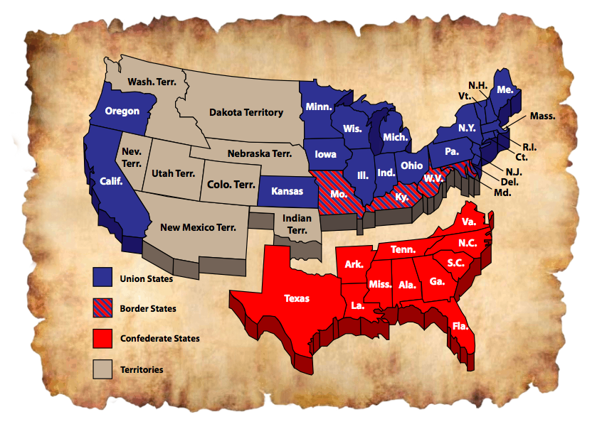
By 1861, most southern states had seceded from the Union and the Confederate States of America (CSA) was formed.

Slide 5
In this lesson you will learn about some of the important events that occurred during the Civil War and the direct effect the war had on Georgia.

Slide 6
The Battle of Antietam
http://www.history.com/topics/american-civil-war/battle-of-antietam

Slide 7
Antietam
http://www.civilwar.org/battlefields/antietam/maps/antietam-animated-map.html
September 17, 1862 – Site in Maryland where General Robert E. Lee and his Confederate soldiers were defeated by Union forces
Bloodiest one day battle of the Civil War / claimed 23,000 American lives
General Robert E. Lee attempted to attack the Union in the north in their own territory. His plan failed.
He was forced to withdraw and this was considered a Union win.
Lincoln used this victory as a springboard to release the Emancipation Proclamation

Slide 8
Think, Pair, Share Based on your notes and the video, identify a significant effect of the Battle of Antietam.
Although the Battle of Antietam can be considered a “draw” with no clear winner, Lee chose to withdraw. Abraham Lincoln saw this as the victory he needed to release the Emancipation Proclamation.

Slide 9
The Emancipation Proclamation
What does emancipation mean?

Slide 10
Emancipation: The act of freeing

Slide 11
Emancipation
The U.S. Constitution did not prohibit slavery. Individual states could outlaw slavery, but not the U.S. Government.

Slide 12
The Emancipation Proclamation
An executive order issued by President Lincoln (1862), declaring an end to slavery in those states that seceded from the Union. It said that all slaves in the rebellious states would be freed on Jan. 1, 1863.
At this point, ONLY slaves in the Confederate states would be freed.
This did not apply to slave states in the Union.
Abraham Lincoln knew that the Confederate states would not give up.
He also knew that once he abolished slavery that European countries would stay out of the conflict and would not support the South.

Slide 13
Emancipation
Paragraph two of the Emancipation Proclamation:
"That on the first day of January, in the year of our Lord one thousand eight hundred and sixty-three, all persons held as slaves within any State or designated part of a State, the people whereof shall then be in rebellion against the United States, shall be then, thenceforward, and forever free; and the Executive Government of the United States, including the military and naval authority thereof, will recognize and maintain the freedom of such persons, and will do no act or acts to repress such persons, or any of them, in any efforts they may make for their actual freedom.”

Slide 14
Emancipation
.
How did Lincoln resolve the conflict of the U.S. government not having the right to outlaw slavery?

Slide 15
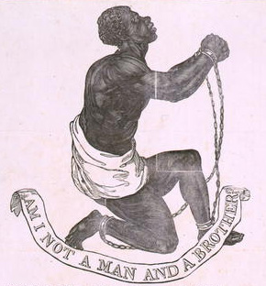
Emancipation
Slaves were considered to be property.
Property captured (called contraband) during war belongs to the army that captured it and its government.
Lincoln therefore stated in his Emancipation Proclamation that any property (slaves) captured by U.S. military forces would be freed.
Most Europeans did not like slavery. Therefore, now that the war was about freeing the slaves, they decided not to get involved with either the Union or the Confederacy.

Slide 16
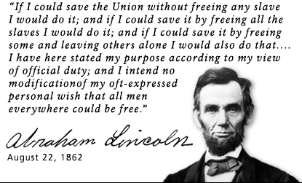
Lincoln’s primary goal was keeping the Union together. If the South had not seceded, he would not have issued the Proclamation.

Slide 17
United States Colored Troops
In the Emancipation Proclamation Lincoln addressed the enlistment of African Americans in the United States armed forces.
Image courtesy Library of Congress

Slide 18
Notes:
The War Department decided that African American soldiers would be placed in all African American units commanded by white officers.

Slide 19
United States Colored Troops
African Americans joined the United States military in large numbers. This led to a larger army, one of the deciding factors in the United States defeating the Confederacy.
On the next slide, read an excerpt from General Order 143, which created the “United States Colored Troops” (USCT).

Slide 20
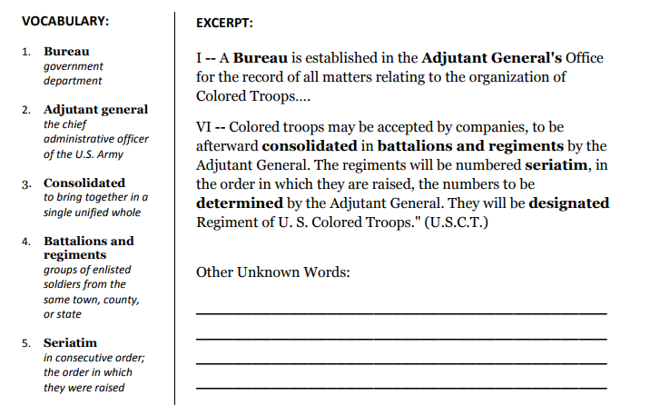

Slide 21
African Americans were now directly involved in their own emancipation.
Notes:
African Americans were now directly involved in their own emancipation.

Slide 22
The Emancipation Proclamation
http://www.history.com/topics/american-civil-war/emancipation-proclamation

Slide 23
Think, Pair, Share What might have happened if the Confederates (South) defeated the Union (North) in the Battle of Antietam?
Lincoln needed a Union victory to show that the Union was powerful enough to enforce the Emancipation Proclamation. Without the Union victory at Antietam, Lincoln would not have issued the Emancipation Proclamation

Slide 24
Key Points to Remember:
The “bloodiest” day in American history was the Battle of Antietam, Maryland.
The Union “victory” at Antietam allowed President Lincoln to issue the Emancipation Proclamation.
Great Britain and France remained neutral and did not enter the war on the side of the Confederacy.
The Emancipation Proclamation freed slaves in the Confederate States (Eventually all states would free their slaves)
With African Americans joining the armed forces, the United States had a greater advantage over the Confederate States because of its number of soldiers and sailors.

Slide 25
Battle of Gettysburg
http://www.history.com/topics/american-civil-war/battle-of-gettysburg

Slide 26
Gettysburg
Pennsylvania site of the deadliest battle of the Civil War (July 1-3, 1863)
Turning point of The Civil War
Over 50,000 soldiers killed
Another attempt by Lee to invade the North
After heavy losses and three days, Lee retreated back to Virginia
The South never invaded the North again.

Slide 27
Gettysburg
The South was demoralized by this loss.
After Gettysburg, the North put constant pressure on the South and eventually invaded the rebellious states.
After the battle, President Lincoln gave “The Gettysburg Address” speech which offered a rationale for the war and a purpose for why so many men fought and died. This speech is considered one of the most important speeches in American history.

Slide 28
Gettysburg was the deadliest battle of the Civil War and it demoralized (discouraged) the South.
After the battle, Lincoln traveled to Gettysburg for the dedication of a military cemetery. There he gave what is considered one of the most important speeches in American History, The Gettysburg Address.
https://www.youtube.com/watch?v=9_EWq6KnPbM

Slide 29
Update Table of Contents

Slide 30
Battle of Chickamauga
Battle of Chickamauga Animated Map [show the first segment and the last two segments to summarize the events]

Slide 31
Chickamauga
Georgia was virtually untouched until the Battle of Chickamauga
It lasted three days (Sept 18-20, 1863) and was the second bloodiest battle of the entire war (34,000 soldiers killed) What was the bloodiest?
Chickamauga was the largest battle ever fought in Georgia (just 10 miles south of the Tennessee border)
Confederate general: General Braxton Bragg
Union General: General William S. Rosencrans

Slide 32
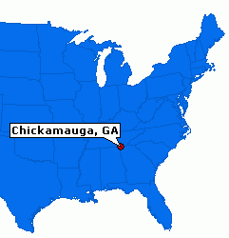
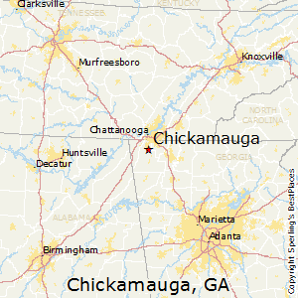

Slide 33
Battle of Chickamauga
Chickamauga was part of the Union objective to capture Chattanooga, an important rail center, and then move on to Atlanta, also a significant rail hub.
Chickamauga was the largest Union defeat in the Western Theater.
HOWEVER, Confederate General Bragg failed to follow Union forces into Chattanooga and, by the time they turned their attention to Chattanooga, it was too late.
They were soundly defeated by troops under the command of Union General Ulysses S. Grant. Once Chattanooga was firmly under Union control, it was used as a launching point for Sherman’s Atlanta Campaign.

Slide 34
Chickamauga- A Confederate Victory
The Union goal was to capture Chattanooga, TN, and important rail center, and then use that as a stepping stone to capture a more important rail road hub, Atlanta.
Significance: First, it was the largest Union defeat in the West. Second, due to the South’s victory, the Union’s focus was to recapture Chattanooga.
The attack on Chattanooga was a southern defeat that led to the promotion of Ulysses S. Grant as the General of the U.S. Army. Once Chattanooga was securely in Union hands, it was used as a launching point for Sherman’s Atlanta Campaign.

Slide 35
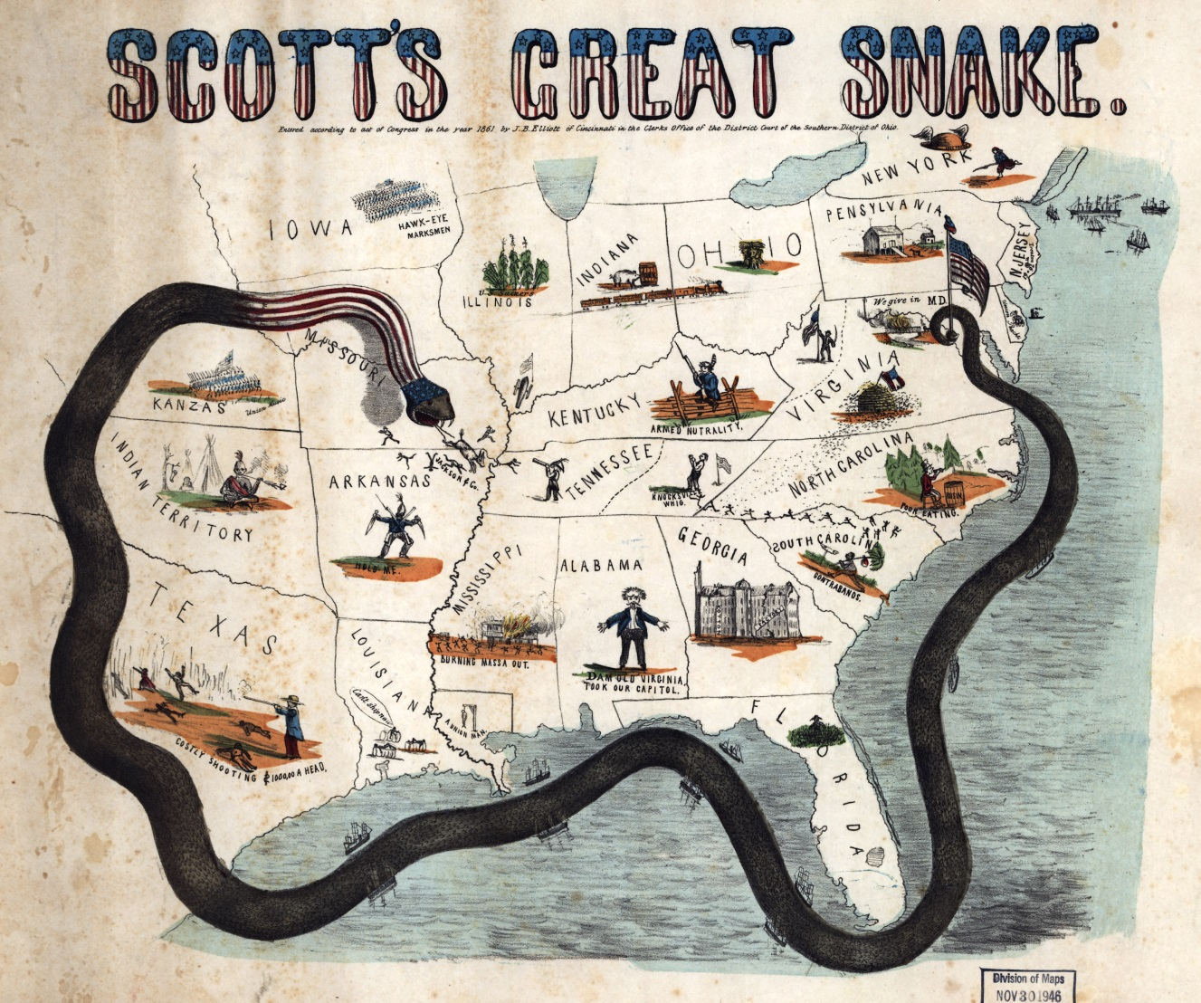
Union Blockade of Georgia’s Coast
The Union Blockade is often referred to as the “Anaconda Plan”. What does that mean and why?

Slide 36
Union Blockade of the Coast
One of the United States’ most important strategies during the Civil War
The North’s objective was to use its superior navy to prevent the South from shipping cotton to England and France in return for weapons and other supplies
Often called the “Anaconda Plan” due to its intention of “Squeezing” the CSA to death”

Slide 37
At first, the Union blockade was not successful and almost 9 out of 10 “blockade runners,” private citizens who took the risk of evading the Union blockade for the chance at huge profits, were able to make it to Europe and back.
Things changed when the North destroyed the brick Fort Pulaski with cannons. The North restricted attempts to sneak past the Union blockade, and built several gun boats, including 3 “ironclads.”
GA was unable to deal with the powerful Union Navy. The US also made several attacks on GA including occupying St. Simons Island and attacking the port town of Darien.

Slide 38
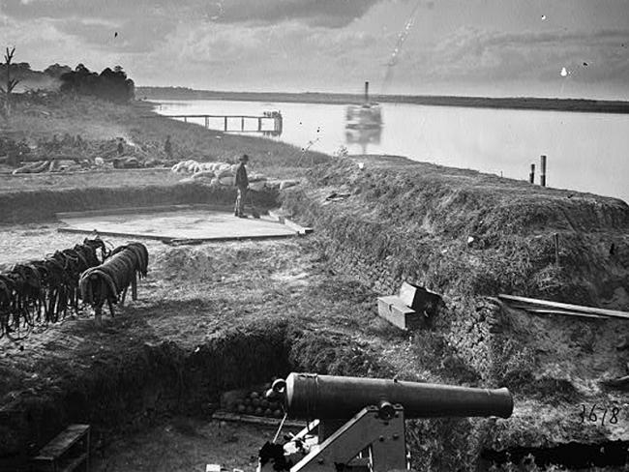
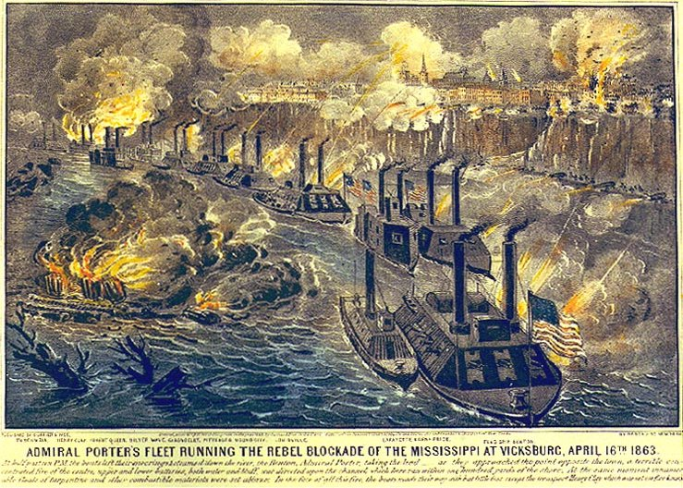
Union Blockade of Georgia’s Coast
Blockade Runners in the American Civil War [5:28]

Slide 39
TRUE or FALSE
1. The Union blockade attempted to cripple the South’s economy.
2. Blockade runners carried large supply loads to the Confederacy.
3. The Union blockade was part of the Anaconda Plan.
4. The North did not start their blockade of the South until the end of
the war.
5. Some members of the British Royal Navy helped the Confederacy.
6. The South hoped to trade cotton for weapons.
7. The Union blockade only lasted two years of the Civil War.
8. Ships were stationed along the Atlantic and Gulf Coasts.

Slide 40
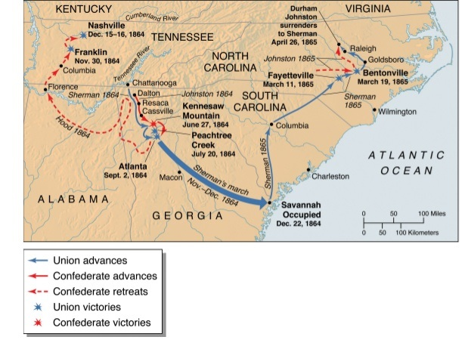
Sherman’s Atlanta Campaign
Why was the capture of Atlanta critical?

Slide 41
Sherman’s Atlanta Campaign
Sherman had two separate military campaigns in Georgia, the first was to capture Atlanta
Atlanta was a major railroad hub, so it was a strategic move to control the city
The capture of Atlanta was a major blow to the South
It took Sherman almost 4 ½ months. There was not one major battle but rather several small battles that allowed Sherman to get close enough to bombard it with cannon fire

Slide 42
Sherman’s Atlanta Campaign
Confederate General Hood was forced to withdraw from Atlanta on September 2, 1864
The capture of Atlanta was critical not only due to Atlanta’s industrial role, but also because it gave the North a victory to celebrate and the will power to continue fighting. It also assured Lincoln’s presidential re-election

Slide 43
The capture of Atlanta was critical not only due to Atlanta’s industrial role for the South, but also because it gave the North a victory to celebrate and assured Lincoln’s re-election.

Slide 44
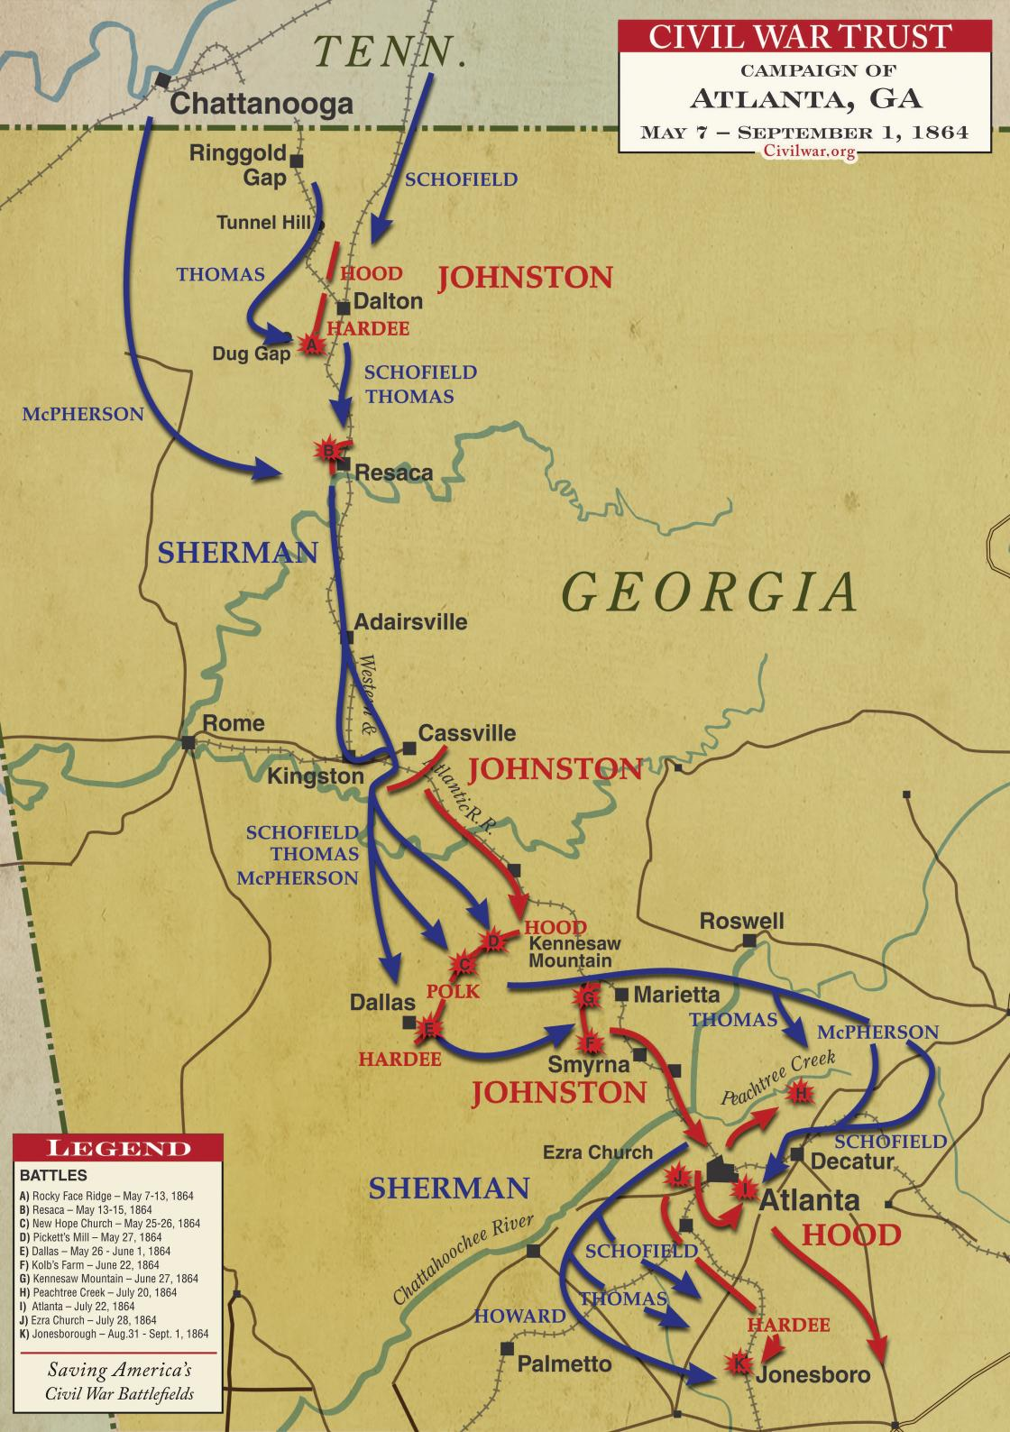

Slide 45
Sherman’s Atlanta Campaign
General Sherman Captures Atlanta [2:08]

Slide 46
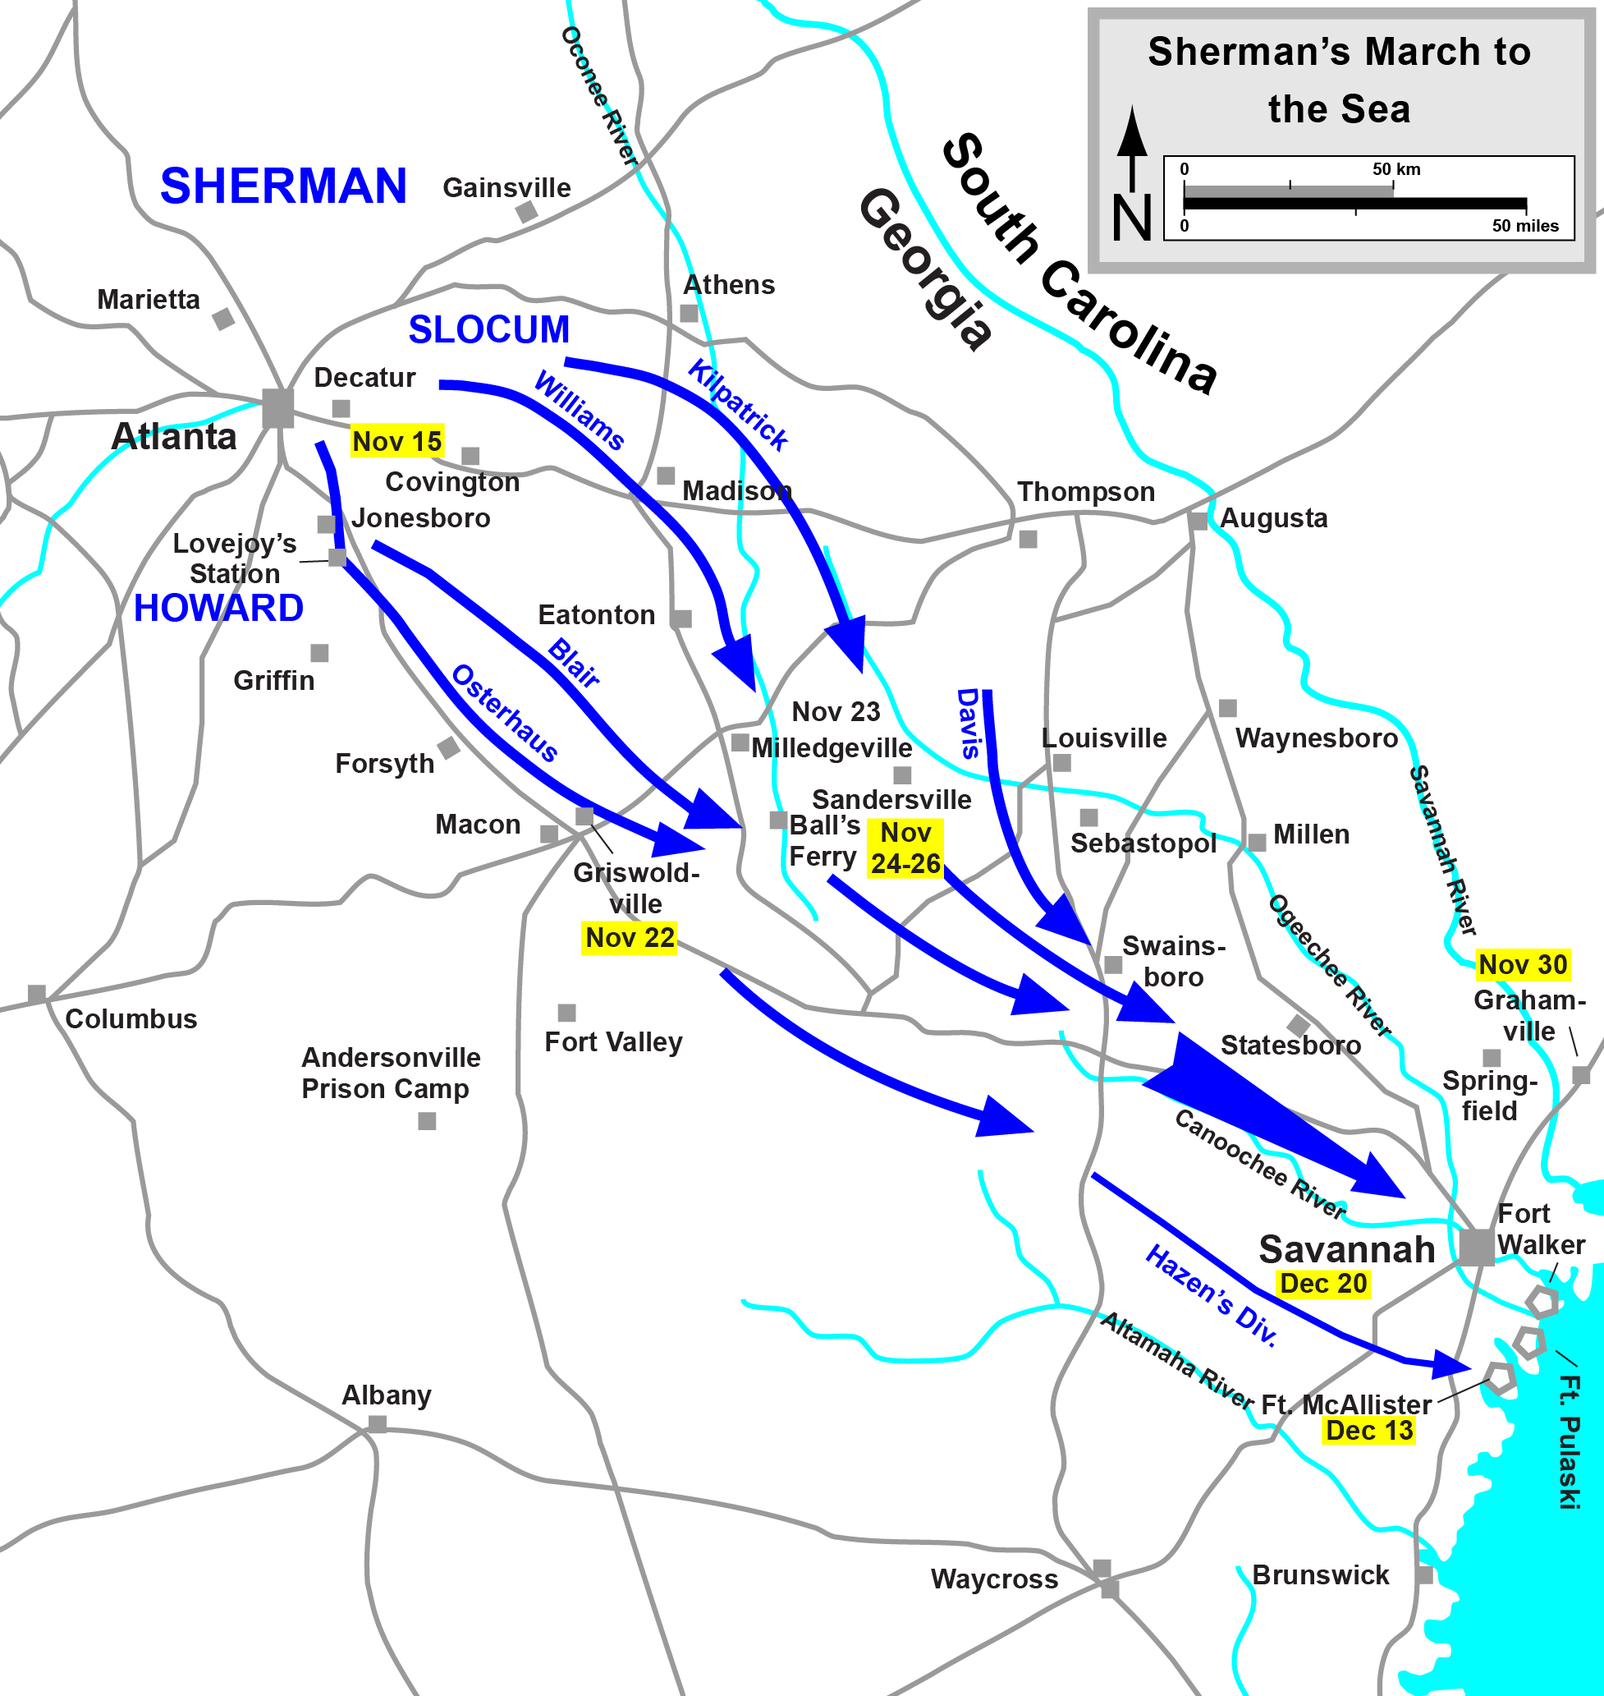
Sherman’s March to the Sea

Slide 47
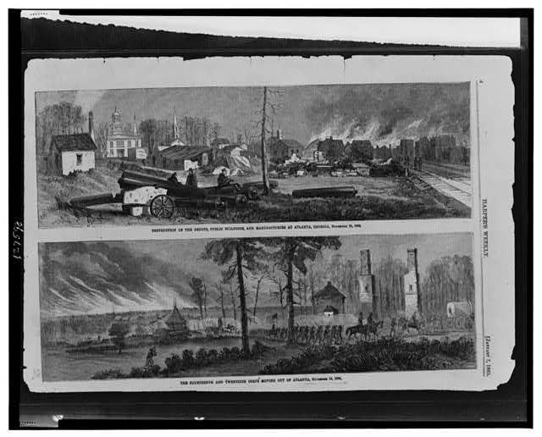

Slide 48
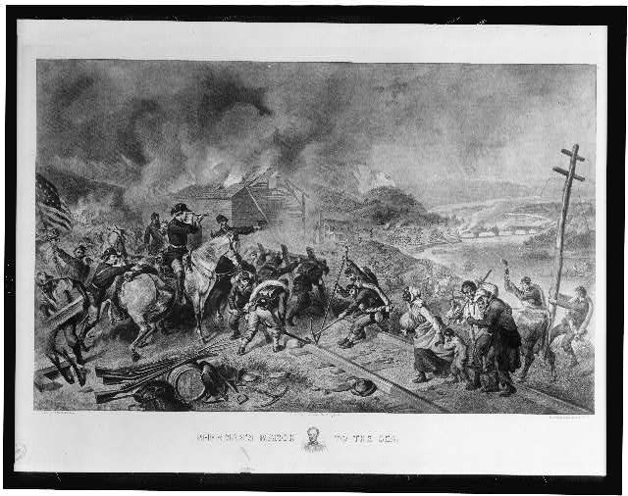

Slide 49
Sherman’s March to the Sea
The movement of General William T. Sherman’s Union forces from Atlanta, Georgia, to the port of Savannah, resulting in the capture of the port.
The march destroyed much of the Confederate army’s infrastructure, support, and trade routes
Sherman wanted to end the war quickly and punish the South for starting the war
The march began on November 15, 1864 and ended on December 21, 1864.
The path he took was 300 miles long and 60 miles wide.

Slide 50
Sherman’s March to the Sea
Many soldiers lived off civilian food and supplies and took valuables.
Sherman burned buildings and factories.
In some cases, he destroyed entire towns (Griswoldville, GA).
Savannah surrendered without a fight (did not want to be destroyed), and Sherman said it was Lincoln’s Christmas present (thousands of dollars in cotton was being stored in Savannah because of the blockade and the North took it).

Slide 51
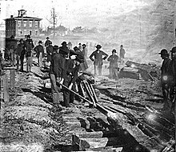
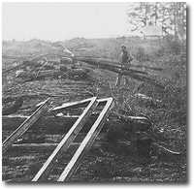
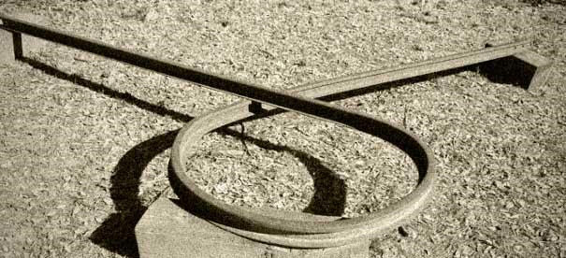
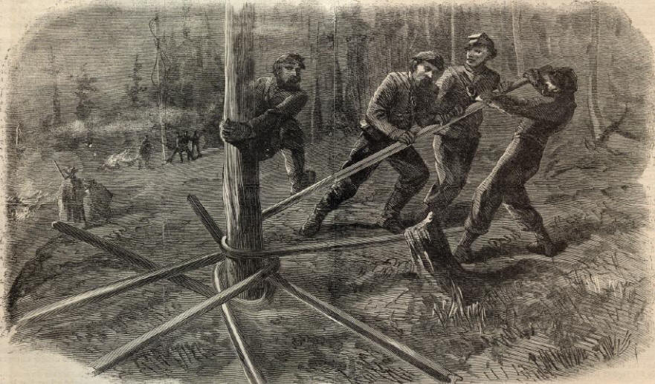
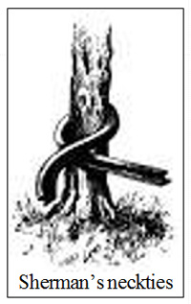
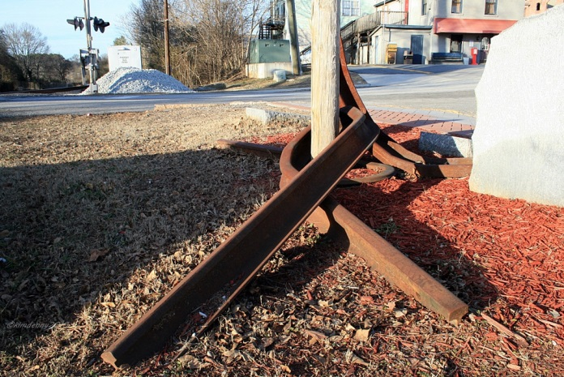
Sherman Neckties/Bowties

Slide 52
Sherman’s March to the Sea [see curriculum map for primary source documents]
Blood and Glory: The Civil War in Color: Sherman’s March to Savannah [2:08]
Marching Through Georgia Song
Sherman’s March to the Sea Georgia Stories Video (printed activity)

Slide 53
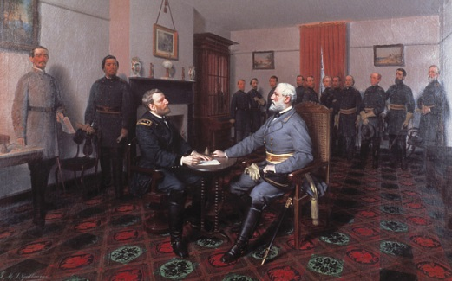
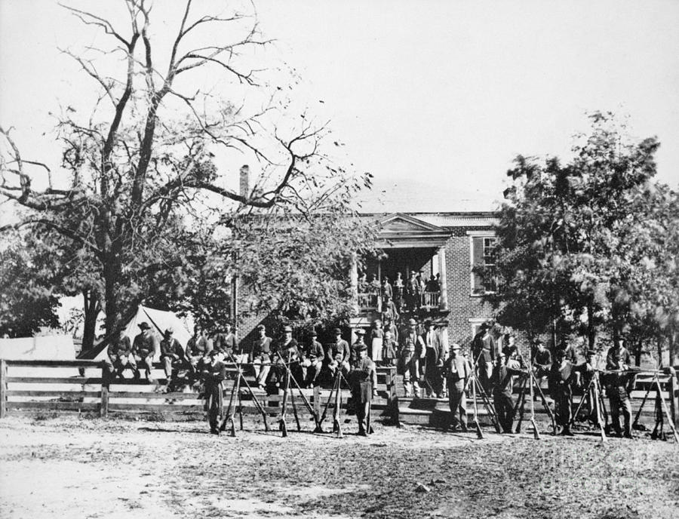
The End of the War
In February 1865, General Sherman's troops left Savannah and headed for South Carolina.
On April 9, Lee's army arrived at the small Virginia county of Appomattox Court House. There, the Confederates were surrounded by a much larger Union force.
Lee and Grant met at around 1:30 PM at the McLean House and Lee formally surrendered.

Slide 54
When it became clear to the Confederates that they were surrounded, Lee observed that “there is nothing left me to do but to go and see Gen. Grant, and I would rather die a thousand deaths.”
Brig. Gen. Edward Porter Alexander, suggested that Lee disperse the army and tell the men to regroup or return to their states to continue fighting.
Lee rejected the idea, explaining that “if I took your advice, the men would be without rations and under no control of officers. They would be compelled to rob and steal in order to live. They would become mere bands of marauders…. We would bring on a state of affairs it would take the country years to recover from.”

Slide 55
The End of the War
Lee was given favorable terms of surrender: allowing the men to return to their homes and letting the officers, cavalrymen, and artillerymen keep their swords and horses if the men agreed to lay down their arms and abide by federal law. Grant even supplied food to the Rebels, who were desperately low on rations.
Grant's leniency – together with Lee's reluctance to risk a guerrilla war – can be partially credited for the relative peacefulness of the Reconstruction.
Although a formal peace treaty was never signed by the combatants, the submission of the Confederate armies ended the war and began the long and difficult road toward reunification.

Slide 56
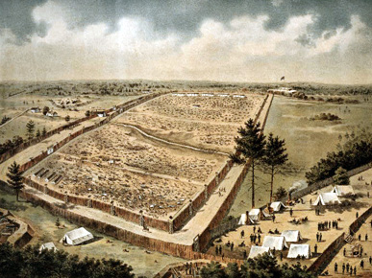
Andersonville

Slide 57
Andersonville
Andersonville Prison is the most notorious prisoner of war camp from the Civil War era.
Located in Macon County / built in 1864
It was built for only 10,000 prisoners, but reached over 30,000 in population during the peak of its occupancy.
The main water source, a small creek, was contaminated and caused disease in the prison

Slide 58
Andersonville
Due to the success of the blockade, the prison was not able to be supplied sufficiently.
Over 13,000 men died there. This was more than in any other Civil War prison.
The commander of the camp, Captain Henry Wirz, was executed by the North for war crimes.
Captain Wirz was the only Confederate official tried and executed for war crimes.

Slide 59
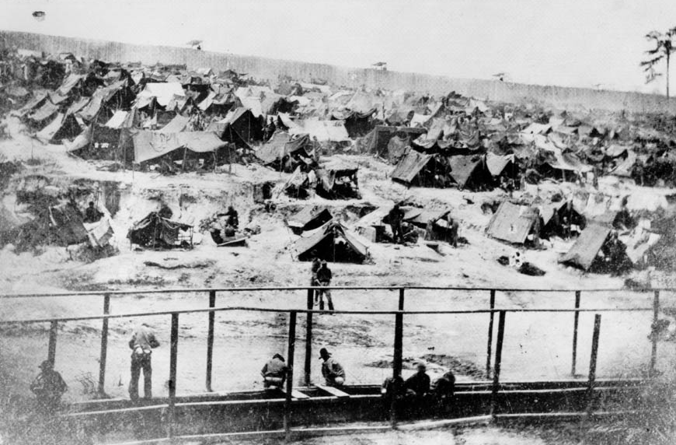

Slide 60
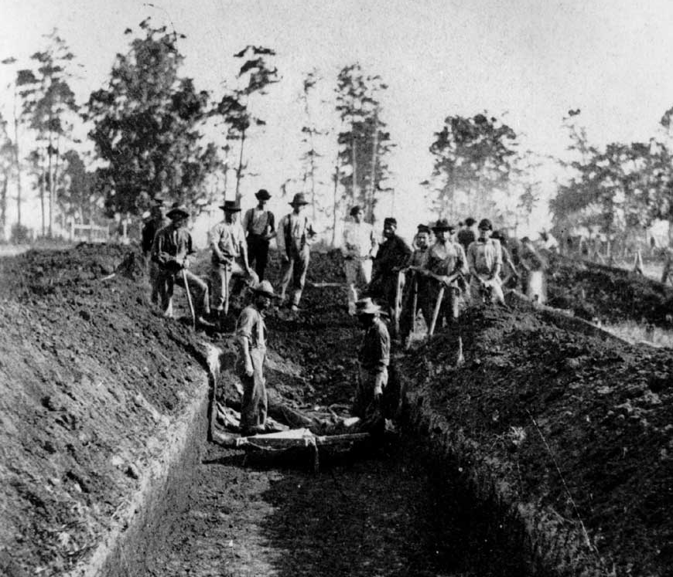

Slide 61
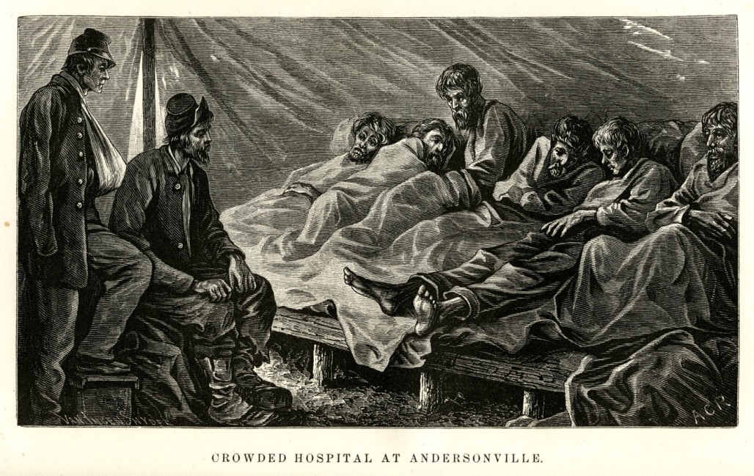
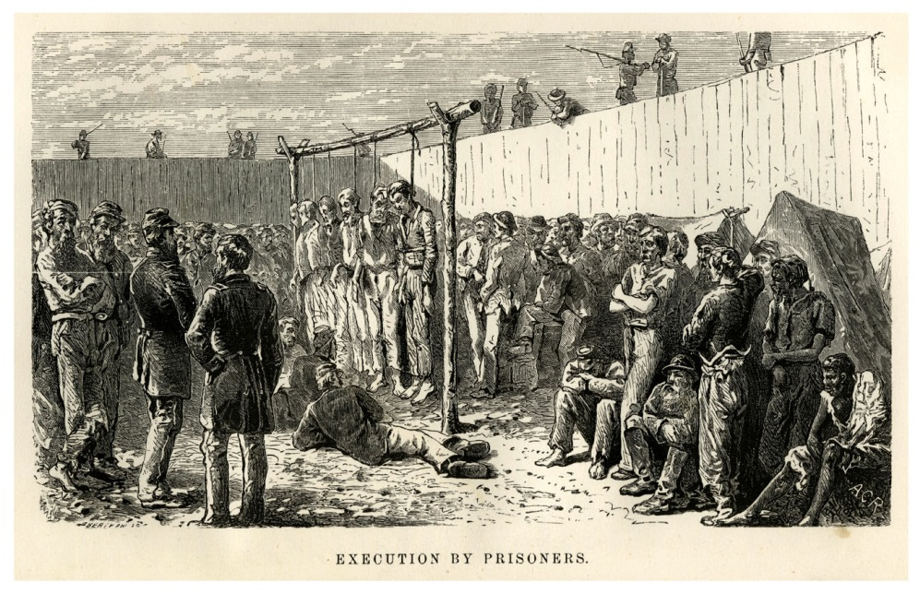
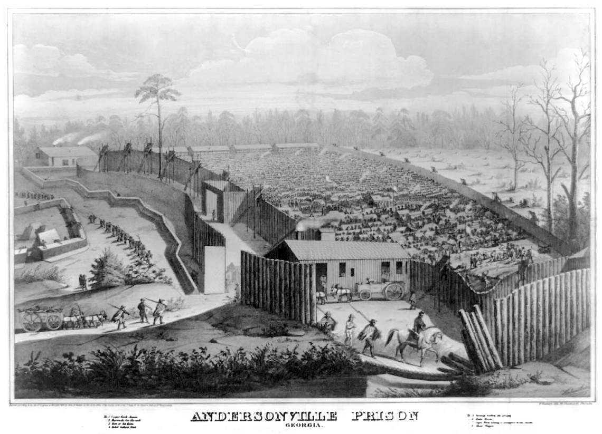

Slide 62
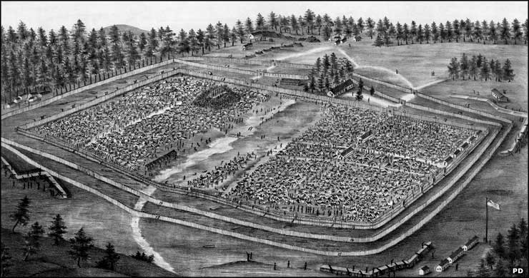

Slide 63
Andersonville
https://www.youtube.com/watch?v=zg0lpjQi9cI

Slide 64
Events During the Civil War Summarizer

