Slide 1
French and Indian war
SS8H3a. Explain the causes of the American Revolution as they impacted Georgia; include the French and Indian War, Proclamation of 1763. and the Stamp Act.

Slide 2
WHO were the key figures in the French and Indian War and what were their contributions?
France and Great Britain
Gen. George Washington tried to claim the Ohio River Valley (ORV) but France, with Native Americans’ help, defeated him.
Native Americans fought on both sides.
William Pitt took on debt to ultimately help the British turn the tide and win.
Debt indirectly led to the Revolution.

Slide 3
When did the war take place and when did it end?
Fighting began in 1754 and lasted until 1763.
Called the 7 Years War even though it lasted 9 years. War not formally declared until 1756.
Treaty of Paris in 1763 (February) officially ended the war.

Slide 4
Where did the war occur and on what territory did the rivalry focus?
Both sides claimed land west of the Allegheny Mountains and Ohio River Valley (ORV).
In 1756, the war between France and Great Britain expanded into Europe.
Georgians afraid war would expand to them, and that Native Americans (Choctaw, Creek, Cherokee) would side with France.
Spain, on south border DID side with France.

Slide 5
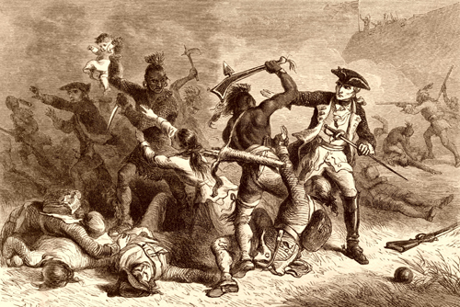
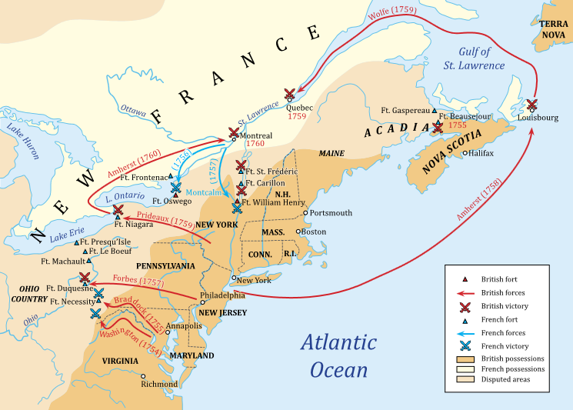

Slide 6
Why did the French and Indian War occur and what were the conflicts leading up to it?
LAND: Growing population of Virginia and other British colonies necessitated the need for land in the Ohio River Valley west of the Allegheny Mountains.
GREED: Wanted to acquire the most land in the New World and control its treasures. France had wealth from fur trade in the northern territories.
FEAR: Another country (France) would gain more power.

Slide 7
How did the war progress and what were the advantages and disadvantages of each side?
British: most powerful navy
France: stronger army.
Both: alliances with Indian tribes.
France: more experienced leadership.
France was winning initially but the tide turned when William Pitt saw that colonies could be used to grow the British Empire and borrowed heavily to finance the war. Britain won.

Slide 8
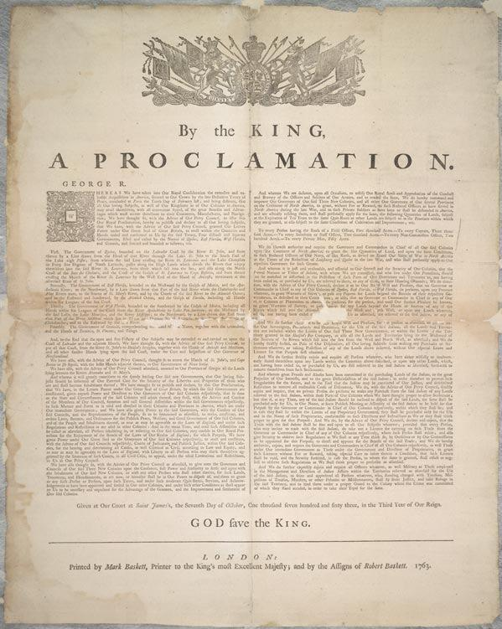
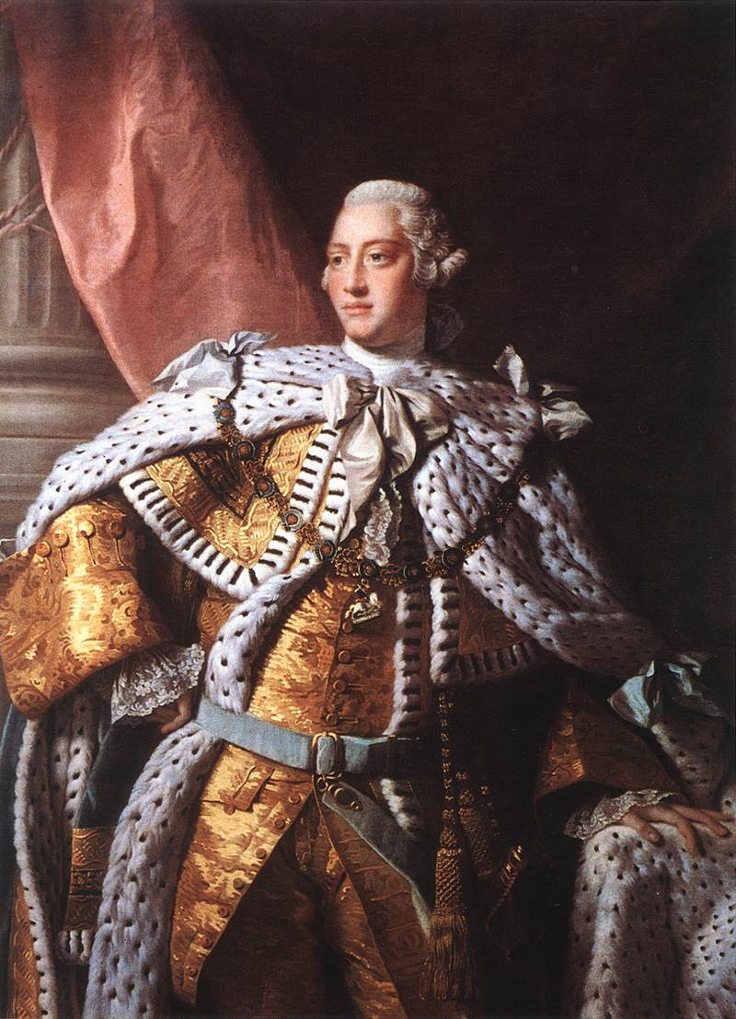
King George III issued the Proclamation of 1763.
© 2014 Brain Wrinkles

Slide 9
What was the significance of this war and what were the results of the Proclamation of 1763?
Georgia’s fear of expansion resulted in the building of forts and strengthening of defense.
Treaty of Paris gave Britain control of Canada and Florida.
Though GA not directly involved, Georgia’s borders expanded to the St. Mary’s River to the South, the Mississippi River to the West, and land around Augusta to the North.
Proclamation of 1763 (Nov.) forbade settlement west of the Appalachians to avoid conflict with Native Americans.
BRITAIN WAS LEFT WITH A HUGE WAR DEBT THAT INDIRECTLY HELPED LEAD TO THE AMERICAN REVOLUTION.

Slide 10
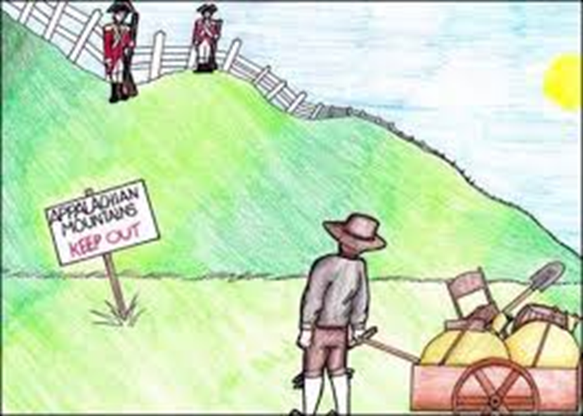
Proclamation of 1763 Forbade colonists from settling west of the Appalachians
Most colonists ignored the new law and stayed put or continued to migrate past the mountains.
The British army sent 7,500 men to keep peace on the frontier

Slide 11
Proclamation of 1763 Caricatures
Directions: Create a caricature for four different Georgia colonists affected by the Proclamation of 1763. Write a statement that explains this person’s perspective and feelings about the King’s order. Include facial expressions, clothing, symbols, etc., on each person.
A businessman who wants to expand trade routes west of the Mississippi River: | A trading company owner interested in moving his company to the southern Georgia coast:
A frontiersman who has recently moved his family west of the Appalachian Mountains: | A wealthy landowner living on the Florida-Georgia border:
© 2014 Brain Wrinkles

Slide 12
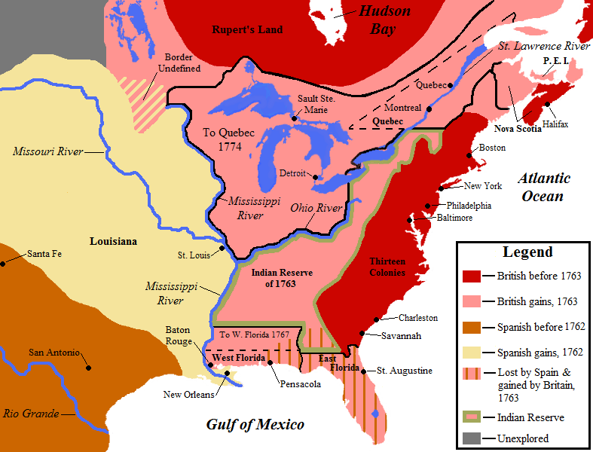
© 2014 Brain Wrinkles

Slide 13
REMEMBER:
The Treaty of Paris (February 1763) officially ended the French and Indian war.
BUT
The Proclamation of 1763 (November) forbade colonists from settling west of the Appalachians (to avoid any additional debt from possible conflict with Native Americans)

