Slide 1

Setting the Foundation
Building Georgia’s government from the ground up
Georgia’s Constitution, Separation of Powers, Checks and Balances, Citizens’ Rights and Responsibilities

Slide 2
SS8CG1
The student will describe the role of citizens under Georgia’s constitution.
  a. Explain the basic structure of the Georgia state constitution.
  b. Explain the concepts of separation of powers and checks and balances.
  c. Describe the rights and responsibilities of citizens.
  d. Explain voting qualifications and elections in Georgia.

Slide 3
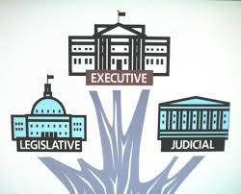
Georgia’s Government
It is the governing document that outlines the foundation of Georgia’s government: the structure of the legislative, executive, and judicial branches, governmental offices, and citizens’ rights and responsibilities in the state of Georgia.
What is the Georgia state constitution?

Slide 4
Georgia’s government
How many constitutions has Georgia had?
Georgia has had 10 constitutions.
The current constitution was ratified in 1983.
It is modeled after the U.S. Constitution.

Slide 5
Georgia’s Government
U.S. Constitution | Both | GA Constitution
-Preamble (Introduction) -Articles (7) -Does not reference education -Legislature called Congress -Supreme Court judges appointed -Bill of Rights in amendment section | -Bicameral legislature= a two-house body(GA General Assembly) made up of the House of Representatives and the Senate -Power divided among 3 branches (executive, legislative, judicial) -Have amendments -Have system of checks and balances -Have separation of powers | -Preamble (Introduction) -Articles (11) -References education -Legislature called General Assembly -Supreme Court judges elected -Bill of Rights in 1st article

Slide 6

Georgia’s Government
Article I: Bill of Rights
Article II: Voting & Elections
Article III: Legislative Branch
Article IV: Constitutional Boards & Commissions
Article V: Executive Branch
Article VI: Judicial Branch
What is the basic structure of the Georgia state constitution?

Slide 7
Georgia’s Government
Article VII: Taxation & Finance
Article VIII: Education
Article IX: Counties & Municipal Corporations
Article X: Amendments to the Constitution
Article XI: Miscellaneous Provisions
What is the basic structure of the Georgia state constitution?

Slide 8
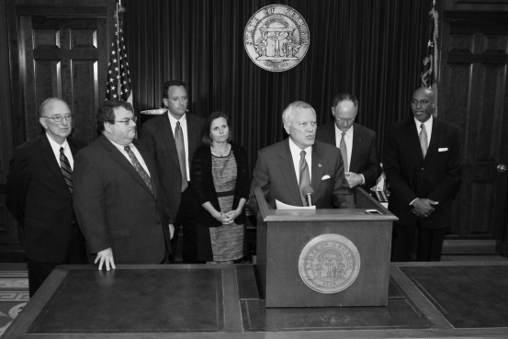
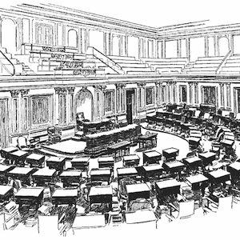
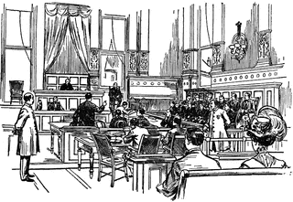
Georgia’s Government
The three branches of government are the:
  Executive Branch: Enforces laws
  Legislative Branch: Makes laws
  Judicial Branch: Interprets laws
What are the three branches of government?

Slide 9

Structure of Georgia Government
Governor’s Mansion
State Supreme Court
State Capitol
General Assembly
Governor
Lieutenant Governor

Slide 10
Structure of Georgia Government
Executive Branch | Legislative Branch | Judicial Branch
Enforces the laws. | Makes the laws. | Interprets the laws.
Governor: Brian Kemp (Republican) 83rd Governor Lieutenant Governor: Geoff Duncan (Republican) Also includes the head officials of these departments: Department of Agriculture, Attorney General, GA Insurance and Safety Fire Commissioner, Public Service Commission, Secretary of State, and State School Superintendent. | General Assembly House of Representatives: 180 members representing the citizens of Georgia. Senate: 56 members representing the citizens of Georgia. | Courts at the state, county and city levels. Supreme Court Juvenile Courts Court of Appeals Superior Courts Probate Courts Magistrate Courts

Slide 11
Georgia’s Government
The writers of the U.S. Constitution wanted to separate the powers of the branches of government so no one branch would have a majority of the power.
They included a system of “checks and balances” to keep the branches of government accountable to one another.
How do the separate branches of government ensure equal power among the branches?

Slide 12
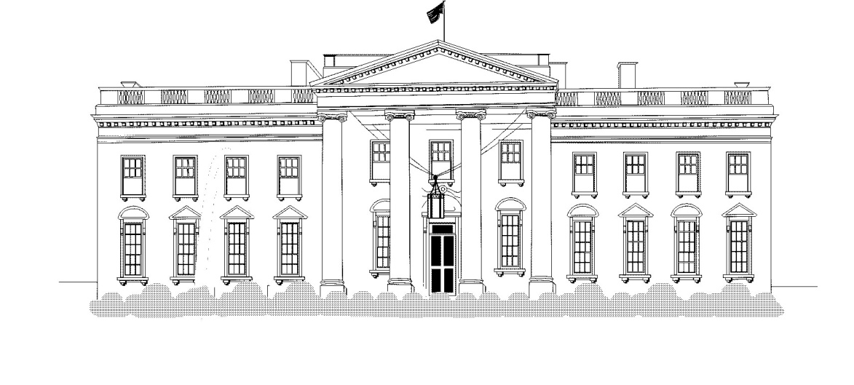

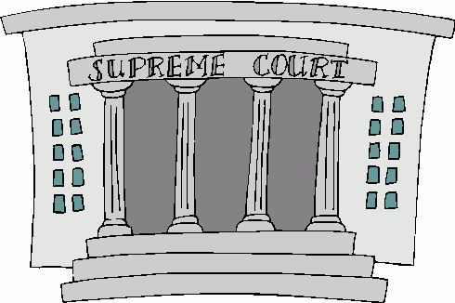
Checks and Balances
EXECUTIVE BRANCH
Veto legislation; Call special session
Reviews Executive Orders
Override veto; Confirm appointments; Impeach officials
Appoints some court officials
Determines whether laws are constitutional
Can propose constitutional changes; Impeach officials
LEGISLATIVE BRANCH
JUDICIAL BRANCH

Slide 13

Georgia Citizen
Rights and Responsibilities
Article I of the Georgia Constitution outlines the Rights of the citizens of Georgia.
The first constitution of Georgia supported the basic rights of the citizens.
The current rights are modeled after the U.S. Constitution’s Bill of Rights.
What are the rights and responsibilities of Georgia citizens?

Slide 14
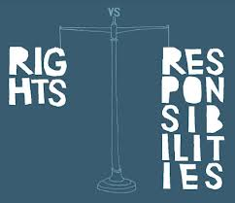
Georgia Citizen
Rights and Responsibilities
Similar rights and freedoms to the U.S. Constitution
  Right to freedom of religion
  Right to keep and bear arms
  Right to freedom of speech
  Right to assemble
  Etc.
Different rights and freedoms from the U.S. Constitution
  Right to life, liberty and property
  Freedom of conscience
  Banishment and whipping as punishment for a crime
  Fishing and hunting
What are the rights of Georgia citizens?
Notes:
Right to life, liberty, and property: No person shall be deprived of these unless by due process of law
Freedom of conscience: Each person shall be allowed to worship God as he/she chooses
Banishment & Whippings: neither banishment beyond the limits of the state or whipping shall be used as punishment for a crime
Fishing and Hunting: Basically is regulated for the people and their good (Department of Natural Resources)

Slide 15
Georgia Citizen
Rights and Responsibilities
Actions that harm others
Actions that break laws
Actions that infringe on others’ rights
What actions could take these rights away?

Slide 16
Georgia Citizen
Rights and Responsibilities
Examples of citizen responsibilities to the government:
  Jury Duty
  Paying taxes
  Serving in military when required.
  Volunteering
  Voting
What are the responsibilities of Georgia citizens?

Slide 17


Election & Voter Requirements
You must be 18 years of age or older.
Be a citizen of the U.S.
Citizen of Georgia and live in the county where you wish to vote.
Be registered with the Secretary of State’s office 30 days before election.
Have a VALID form of identification – such as a voter ID card, driver’s license or state issued ID
What are the requirements to vote in Georgia?

Slide 18
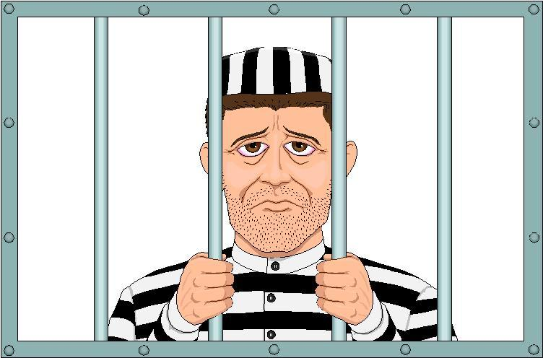
Election & Voter Requirements
A person may not vote if they are serving a felony sentence.
  Once the sentence requirements are complete, the person may vote again.
A person may not vote if they have been found by a judge to be mentally incompetent.
Why can’t some people vote?

Slide 19
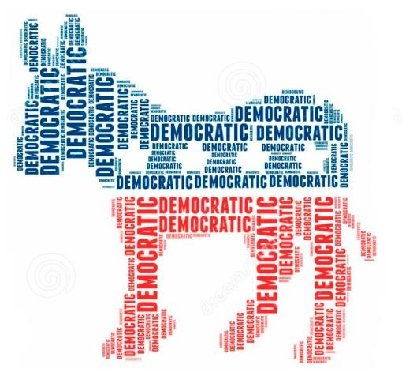

Political Parties
What are political parties?
Groups of people who join together because of shared ideas and interests
  Help voters know what a candidate stands for
Two major political parties in US:
  Democrats
  Republicans

Slide 20
Political Parties
What are political parties?
Minor political parties also exist:
  Libertarian
  Green Party
  Reform Party
Independents are not part of a particular political party

Slide 21
Primary Elections
Elections which select candidates to represent a political party at the General Election (Governor, Lt. Governor, Secretary of State)
When Georgia was a one-party state, these were the only elections that truly counted.
Even now, if only one party is represented at the Primary level, the Primary determines the election.
What are primary elections?

Slide 22
Primary Elections
In some states, voters must register as a Democrat or a Republican to be able to vote in primary elections
In Georgia, any voter may vote in any party’s primary election at the state level
What are primary elections?

Slide 23
General Elections
An election where the winners from both parties’ primaries, along with members of third parties and independents, compete for political offices.
The elections are also held in even number years and take place on the second Tuesday of November.
What are general elections?
Quoted directly from Grade Eight Teacher notes – page 93

Slide 24
Special elections, Run-offs, & referendums
What are special elections?
An election to vote for a vacancy or special issue.
If neither candidate gets 50% of the vote, a run-off is held to determine the winner. (at the primary or general elections)
Voters are allowed to vote on law.
What are run-offs?
What is a referendum?

Slide 25
Election | Description
Primary | Elections which select candidates to represent a political party at the General Election (Governor, Lt. Governor, Secretary of State)
General | An election where the winners from both parties’ primaries, along with members of third parties and independents, compete for political offices. The elections are also held in even number years and take place on the second Tuesday of November.
Special | An election to vote for a vacancy or special issue. (Ex: Special election was held in April of 2017 due to GA-6 U.S. House of Representatives Rep. Tom Price’s resignation from post in order to work for the U.S. Secretary of Health and Human Services. This special election ended up in a runoff election between Karen Handel and Jon Ossoff)
Run-Off | If neither candidate gets 50% of the vote, a run-off is held to determine the winner. (at the primary or general elections)

Slide 26

Wisdom, Justice, and Moderation
March 28, 1935
Gov. Eugene Talmadge signed a joint resolution of the General Assembly adopting a pledge of allegiance to the Georgia state flag, which at the time consisted of three bars - red, white, and red - with a vertical blue band on which was centered the state seal. The new pledge stated: “I pledge allegiance to the Georgia flag and to the principles for which it stands; Wisdom, Justice, and Moderation.”

Slide 27
Works cited
"Elections." Georgia Secretary of State. N.p., n.d. Web. 13 Oct. 2014.
Esslinger, Erica. "Ericaesslinger." Mrs Essies Georgia Studies Class. N.p., 12 Oct. 2012. Web. 13 Oct. 2014.
"Grade Eight Teacher Notes." (n.d.): N. Pag. Georgiastandards.org. Georgia Department of Education, 16 Oct. 2012. Web. 13 Oct. 2014.

