Slide 1
Georgia’s Geography

Slide 2
SS8G1 Describe Georgia’s geography and climate.
a. Locate Georgia in relation to region, nation, continent, and hemispheres

Slide 3
Vocabulary
Cardinal Directions
Intermediate directions

Slide 4
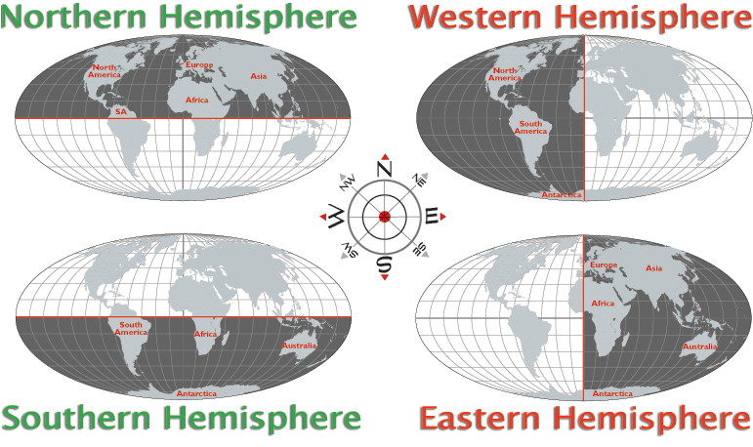
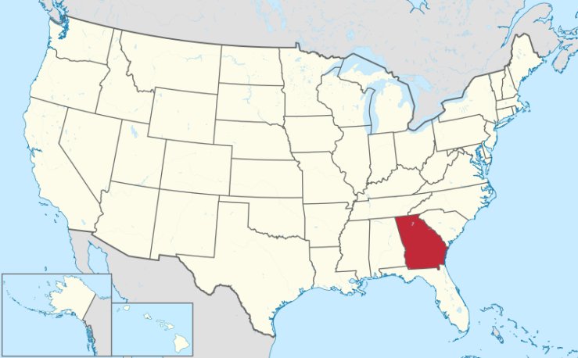
The state of Georgia is located in the southeastern area of the nation of the United States of America. It is located on the continent of North America, and it is in the Northern (latitude) and Western (longitude) Hemispheres.
Equator
Prime Meridian

Slide 5
States Bordering Georgia
North Carolina South Carolina Tennessee Alabama Florida
Never Sing To A Fly

Slide 6
SS8G1 Describe Georgia’s geography and climate.
b. Distinguish among the five geographic regions of Georgia in terms of location, climate, agriculture, and economic contributions.
Five REGIONS in Georgia:
Appalachian Plateau
Valley and Ridge
Blue Ridge
Piedmont
Coastal Plains

Slide 7
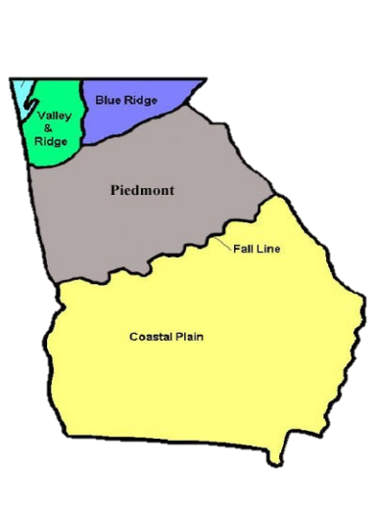
The Appalachian Plateau
Smallest region!
LOCATION: northwest GA; known as the TAG corner (the region connects with Ten. and Ala.).
PHYSICAL CHARACTERISTICS: This region features flat/sloping land above surrounding valleys.
CLIMATE: The climate of this region has cooler temperatures due to higher elevation (1800-2000 feet above sea level) and northern latitude. Summer temperatures can reach to the 80’s and occasionally the 90’s while during the winter months, temperatures span from the 20’s to the 40’s. During winter months, some snow and ice cover the region.

Slide 8
The Appalachian Plateau
AGRICULTURE: limited due to poor soil. However, some corn and soybeans are produced in this region.
ECONOMIC CONTRIBUTIONS: tourism (especially hiking) and forestry. The production of coal and limestone are productive as well. This region is the only known source of coal in the state.
FEATURES: Cloudland Canyon and Lookout Mountain. No significant rivers are located in the Appalachian Plateau region. Many caves.

Slide 9
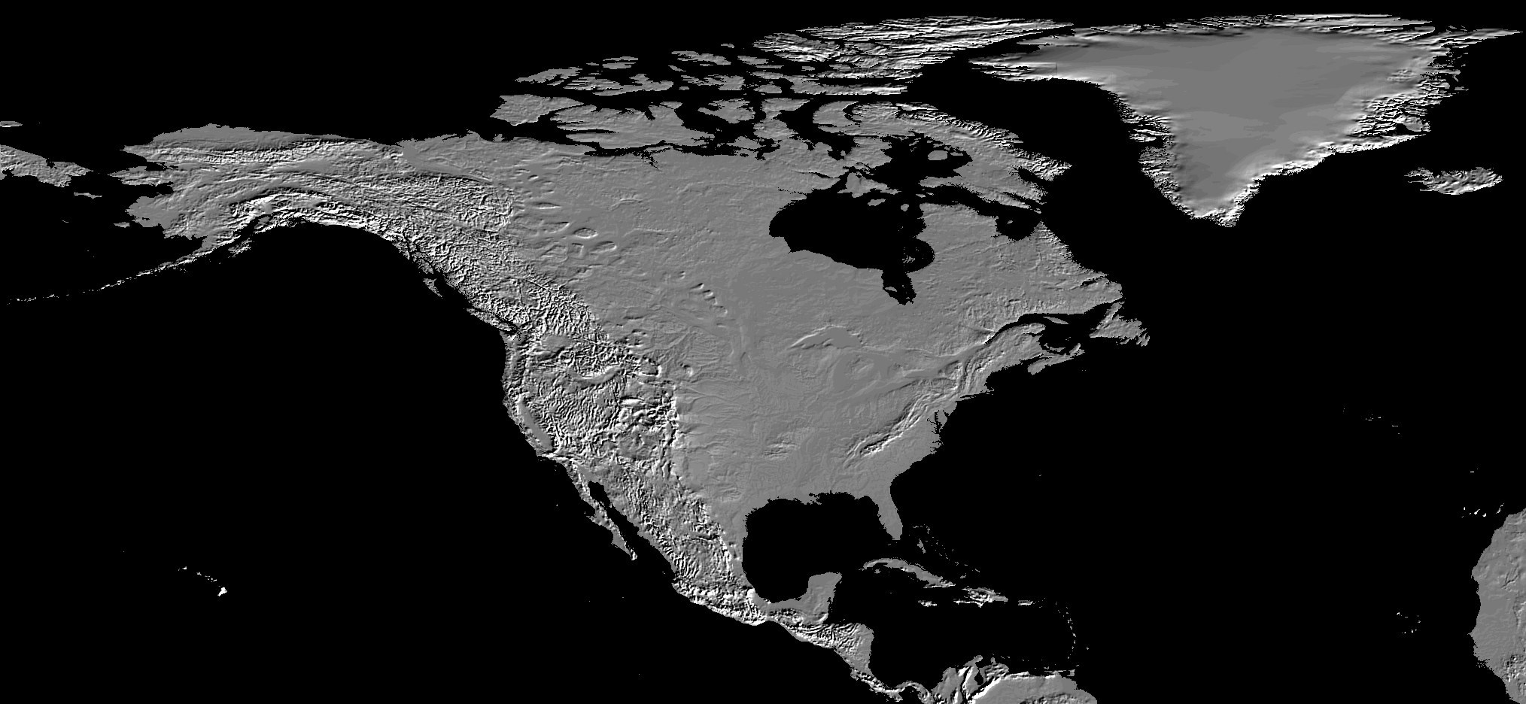
North America

Slide 11
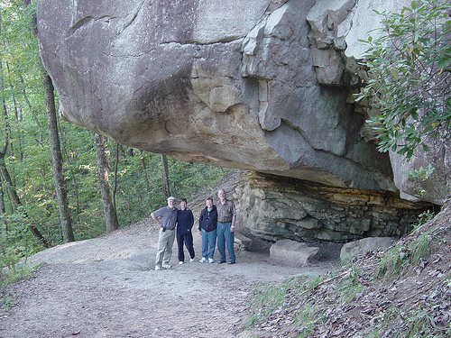

Slide 12
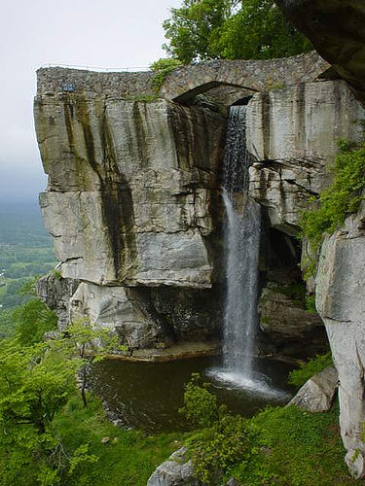

Slide 13
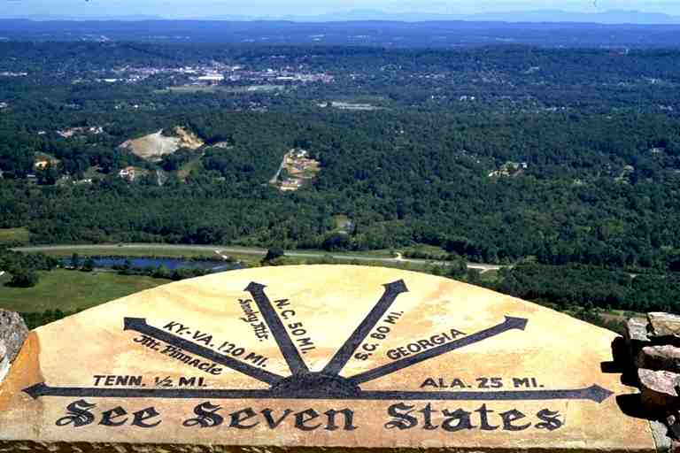

Slide 14
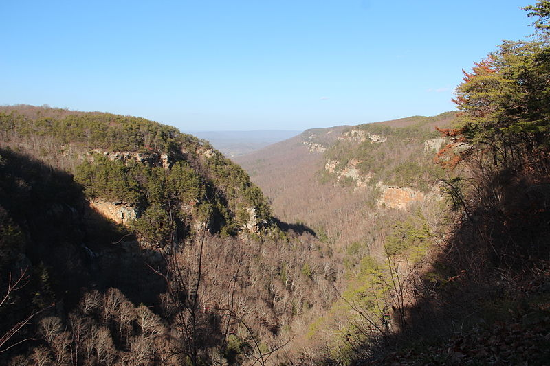
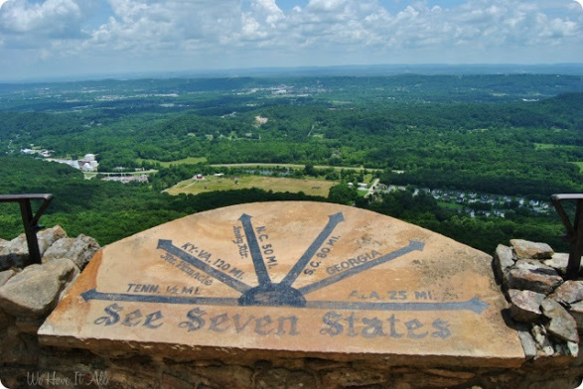
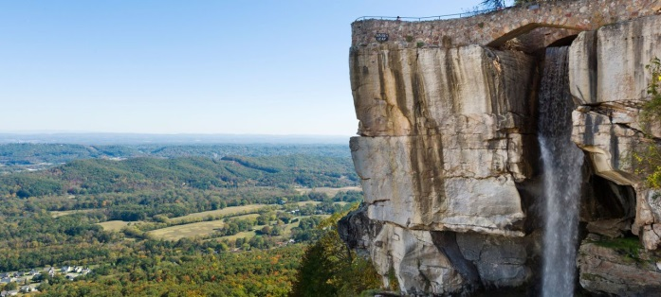
Remember
Smallest region!
Smallest region
TAG Corner (the “A” can stand for Alabama or you can remember “Appalachian”)
Colder temps due to northern location and higher elevation
Poor soil, some corn and soybeans grown
Tourism, forestry, coal (only source of coal in GA), limestone
Cloudland Canyon and Lookout Mountain. Caves.

Slide 15
Smallest region!
I told my friend not to go hiking with a serial killer – or at least not on the same walking trail as me. In the end he took the psychopath.

Slide 16
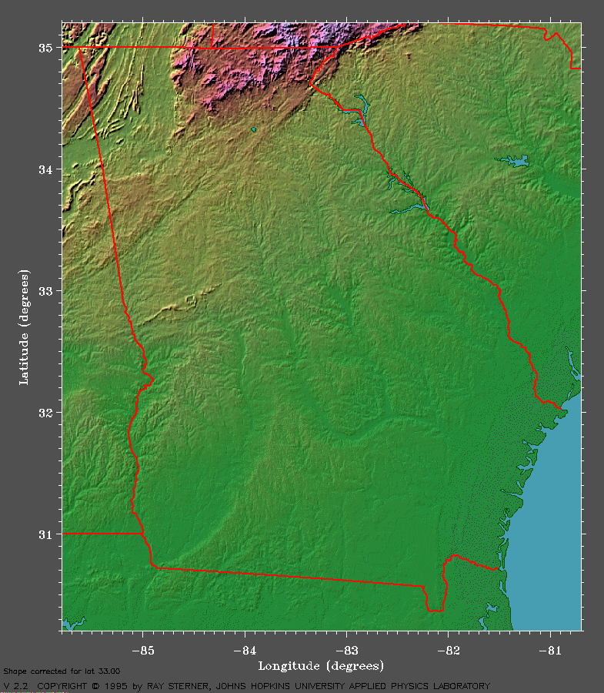
Georgia
Ridge and Valley

Slide 17
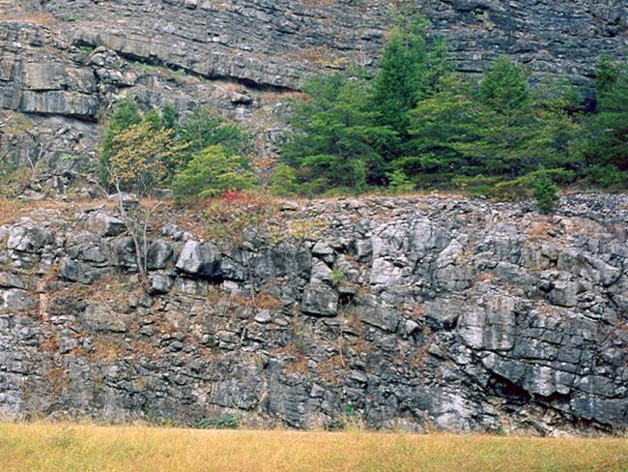
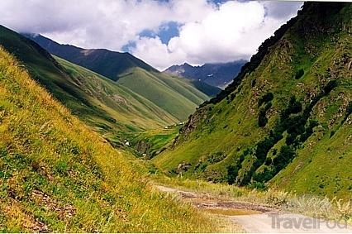
Valley and Ridge Region
B/w App. Plat. And B. Ridge!
LOCATION: northern GA, this region lies between the Appalachian Plateau region and the Blue Ridge region.
PHYSICAL CHARACTERISTICS: Long, parallel ridges (layers of rock) separated by wide, fertile valleys.
CLIMATE: The climate of this region has cooler temperatures due to its higher elevation and northern latitude. Some snow and ice in winter. Summers can get warm.

Slide 18
Valley and Ridge Region
AGRICULTURE: Approximately 4% of the valleys are farmed and used as pastures. Crops include corn, soybeans, wheat and cotton. Hardwood and pine timber is harvested as well.
ECONOMIC CONTRIBUTIONS: Textiles and carpets are produced in this region. Some mining.
FEATURES: Dalton, Georgia is the “carpet capital of the world.” Numerous caves.

Slide 19
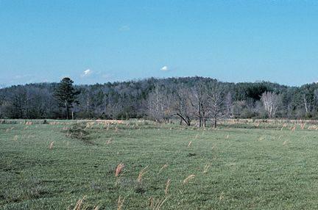
Notes:
19

Slide 20
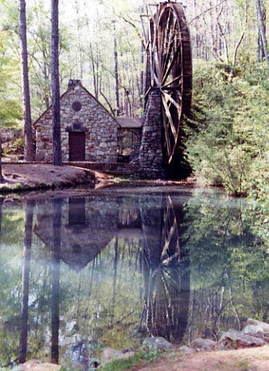
Berry College Water Mill
Notes:
20

Slide 21
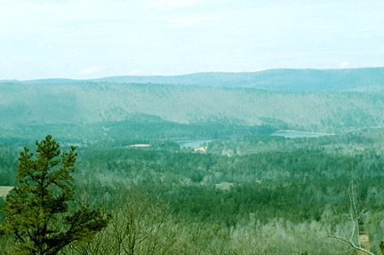
Johns Mountain Northeast Floyd County
Notes:
21

Slide 22
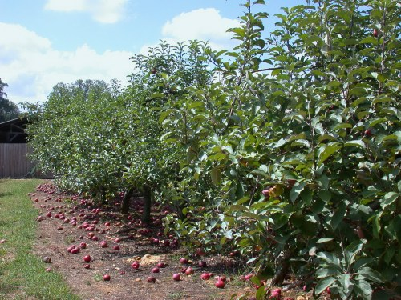

Slide 23
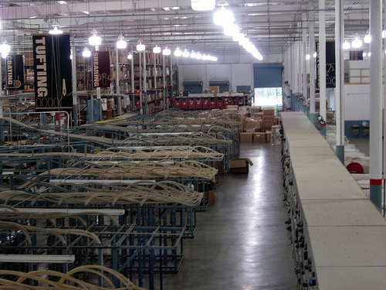

Slide 24
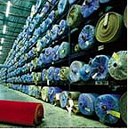

Slide 25
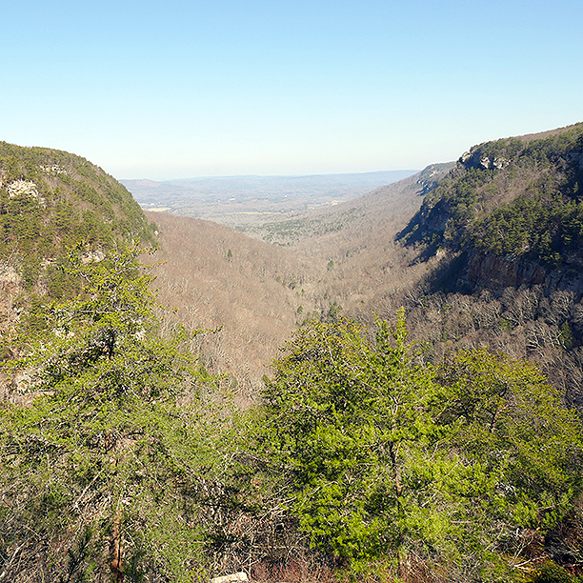
Remember
B/w App. Plat. And B. Ridge!
Northern region b/w App. Plat. And B. Ridge
Long, parallel ridges separated by wide, fertile valleys
Climate cooler due to northern location and higher elevation
Some valleys used as farms/pastures. Corn, soybeans, wheat, cotton. Hardwood and pine.
Textiles and carpets produced, some mining
Dalton, GA is “carpet capital of the world”

Slide 27
Blue Ridge Region
NE corner- Blue Ridge Mts!
LOCATION: Northeastern corner of GA
PHYSICAL CHARACTERISTICS: The Blue Ridge Mountains are the highest in the Appalachian Highlands. The name of this region comes from the blue haze that seems to envelop the mountains.
CLIMATE: Due to high elevation, the Blue Ridge region features cooler weather. It is the region with the highest precipitation rate at over 80 inches of rain per year. As a result, the major rivers, including the Chattahoochee and Savannah Rivers, originate in the Blue Ridge region.

Slide 28
Blue Ridge Region
AGRICULTURE: Small farms, located in the region’s valleys, produce apples, corn, and vegetables. Pastures are home to large animals.
ECONOMIC CONTRIBUTIONS: Historically, mining (Gold mining) opportunities have been profitable and encouraged tourism. Timber is profitable for the region.
FEATURES: Brasstown Bald, Georgia’s highest peak, and the beginning of the Appalachian Trail (Springer Mt.). Dahlonega, the home to the United States’ first gold rush, offers mining opportunities to willing tourists.

Slide 29
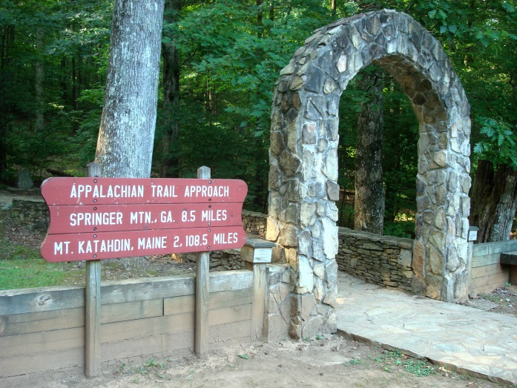
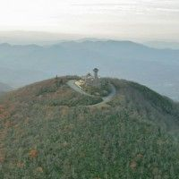
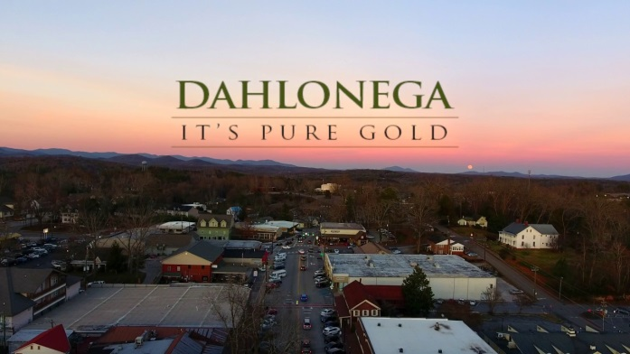
Remember
NE corner- Blue Ridge Mts!
NE corner of GA
Blue Ridge Mts. (part of Appalachian Mts.)
Cooler weather. Most precipitation in GA results in origination of major rivers like Chattahoochee and Savannah
Valley pastures and farming- apples, corn, vegetables
Mining, timber, tourism
Brasstown Bald (GA’s highest peak), beginning of Appalachian Trail, Dahlonega (first gold rush in U.S.)

Slide 30
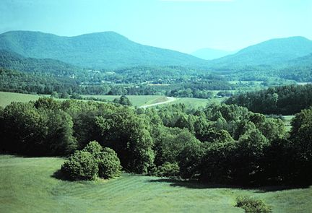
Notes:
30

Slide 31
Brasstown Bald

Slide 32
Brasstown Bald

Slide 34
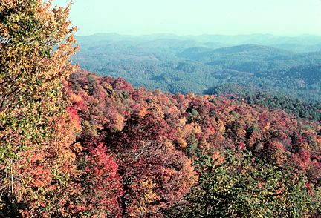
Blue Ridge Mountains in Fall
Notes:
34

Slide 35
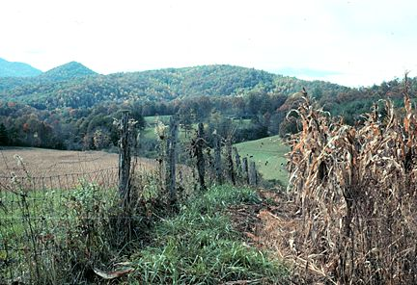
Blue Ridge Mountain Farm
Notes:
35

Slide 36
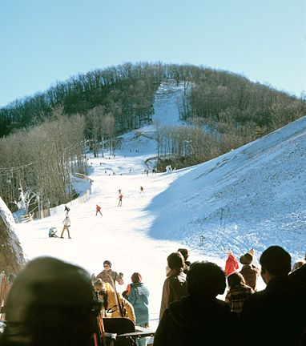
Sky Valley Ski Resort (Rabun County
Notes:
36

Slide 37
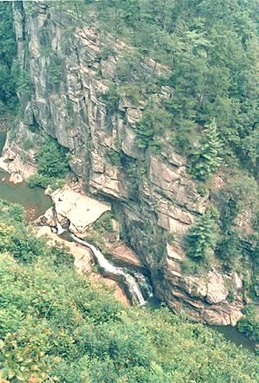
Tallulah Gorge
Notes:
37

Slide 38
Tallulah Gorge

Slide 39
Piedmont Region
Most populated!
LOCATION: Central part of GA. The Fall Line separates Piedmont from the lower Coastal Plain region
PHYSICAL CHARACTERISTICS: Gently rolling hills. The term Piedmont means “foot of the hills”. Featured in this region are major rivers flowing south toward the Coastal Plain. These rivers tend to be shallow and can feature waterfalls or rapids. Rivers and waterfalls are used to generate energy. Red clay, formed when water mixes with the iron rust, is a characteristic
Climate: Steamy and hot in the summers and sometimes snow in the winters.

Slide 40
Piedmont Region
AGRICULTURE: Significant agricultural production. Crops produced include cotton, soybeans, and wheat. Poultry/eggs, hogs, and cattle/beef are produced.
ECONOMIC CONTRIBUTIONS: Timber is harvested. Industrialization produces a diverse type of products, including carpet milling, aircraft and automobile manufacturing, and poultry processing. Farming is still economically important in this region, but animal products such as poultry, eggs, and beef are dominant.
FEATURES: Second largest region. Location of important urban cities like Atlanta, Columbus, Macon and Augusta among others. Tornadoes can exact destruction in this region.

Slide 41
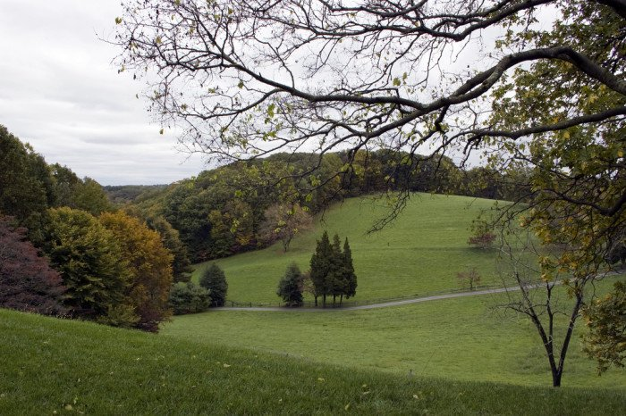
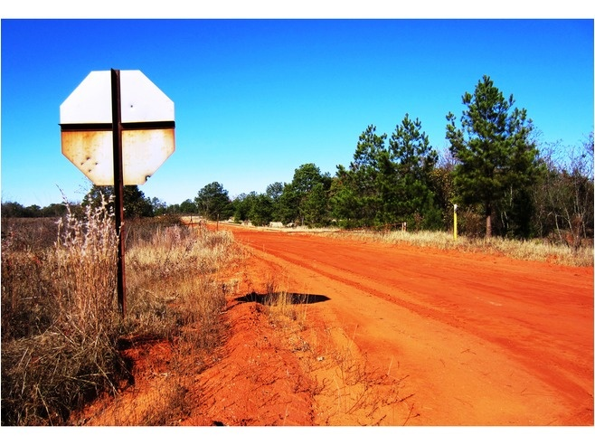
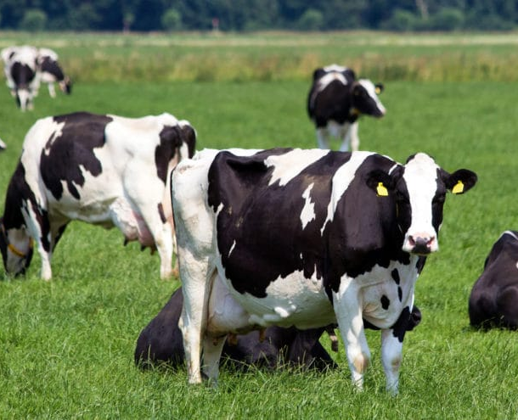
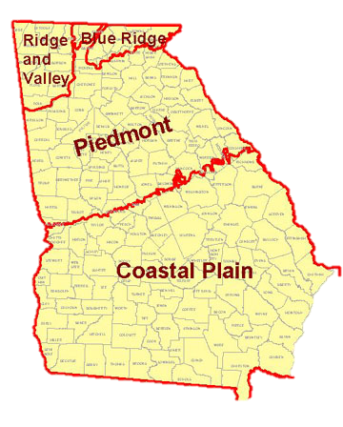
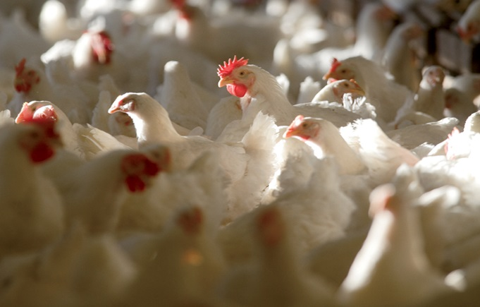
Piedmont Region
FALL LINE

Slide 42
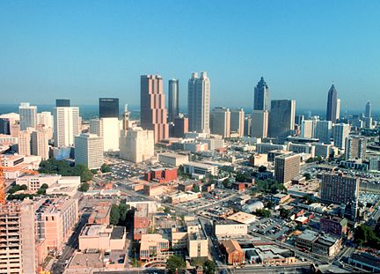
Atlanta

Slide 43
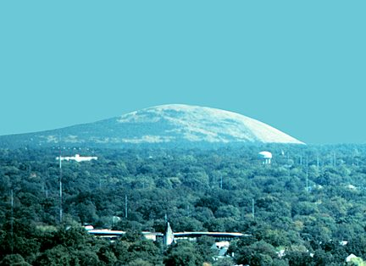
Stone Mountain

Slide 44
Remember
Most populated!
Largest population
Located in middle of the state- Fall Line divides Piedmont from lower Coastal Plain
Gently rolling hills, major rivers flowing south, red clay
Hot summers, cooler winters with occasional snow
Significant agricultural production- cotton, soybeans, wheat; Dominant animal product industry: Poultry/eggs, hogs, and cattle/beef
Timber, industrialization creates products like carpet milling, aircraft/automobile manufacturing, poultry processing. Agricultural and animal products
Second largest region, urban cities like Atlanta, Columbus, Macon and Augusta; tornadoes can cause destruction
Power generated by rivers and waterfalls

Slide 45
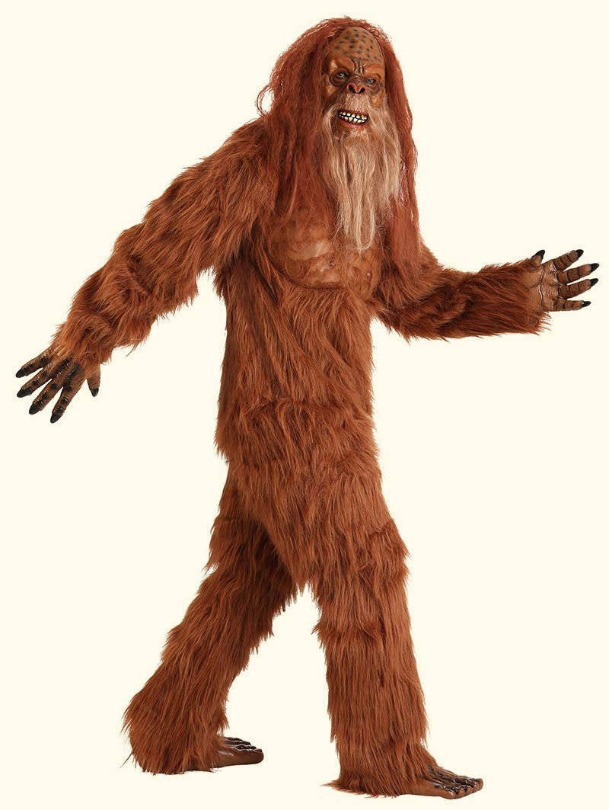
Remember
Most populated!
What do you call a Sasquatch who loves working with Georgia’s red clay?
A hairy potter.

Slide 46
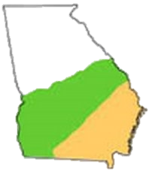
Coastal Plain(s) Region
Inner Coastal Plains- Agriculture
Outer Coastal Plains- swampy,, ocean coast
Inner Coastal Plains-
Western area, touches Alabama, agriculture
Outer Coastal Plains- Eastern area, touches Atlantic Ocean

Slide 47
Coastal Plain(s) Region
LOCATION: The largest and southernmost region.
PHYSICAL CHARACTERISTICS: This region, 60% of the state, can be divided into two regions: the Inner Coastal Plain and the Outer Coastal Plain. The Inner Coastal Plain (in the western part of the region) is the agricultural heartland of the state. The Outer Coastal Plain includes the coast of GA and the Okefenokee Swamp. Major rivers flow through this region to the GA coast or the Gulf of Mexico.
CLIMATE: This region of Georgia is characterized by hot, steamy summers and mild winters. Snowfall and ice are less likely to occur in this region

Slide 48
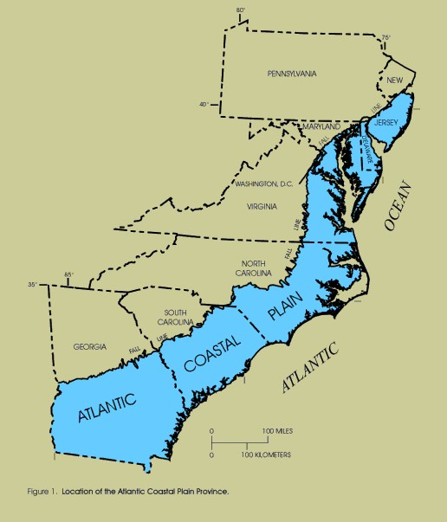
In prehistoric times, the Coastal Plain was covered by ocean. The waves wore down hills and land formations, causing a relatively flat and low-lying landscape.
The ocean reached the Fall Line, which is what separates the Piedmont region (higher elevation) from the worn-down Coastal Plain region
Due to the low-lying and flat land, rivers in the Coastal Plain are wider and slower after going over the Fall Line.
When the ocean retreated, great buildups of soft and sandy sediment were left. The closer to the Atlantic Ocean, the sandier and swampier the soil is. The further from the Atlantic Ocean, the better soil is for agriculture.
“Okenfenokee”- Native American word meaning “trembling Earth” (soft/unstable soil)

Slide 49
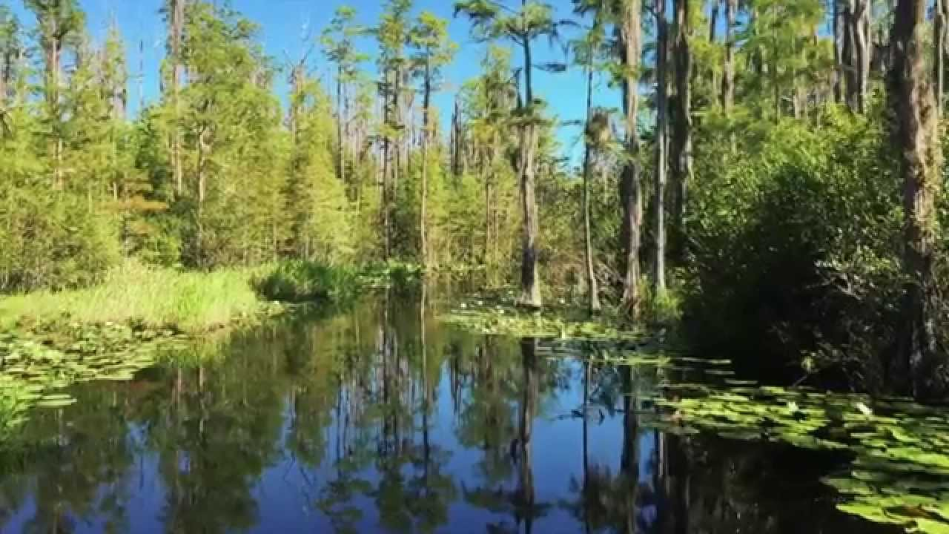
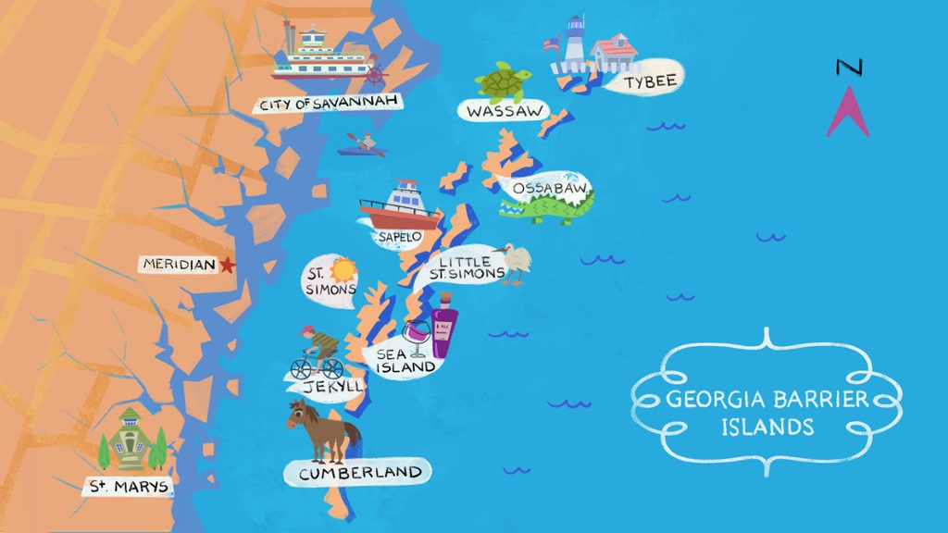
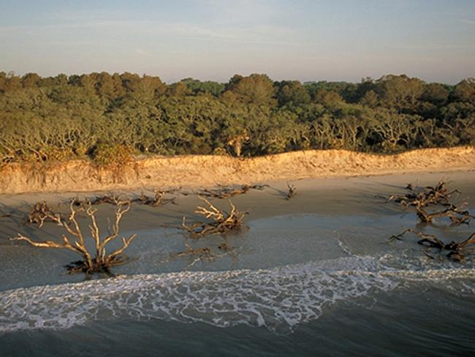
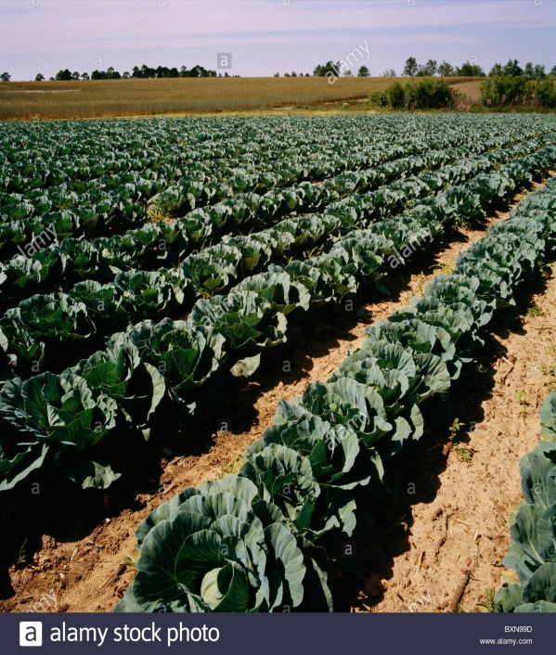
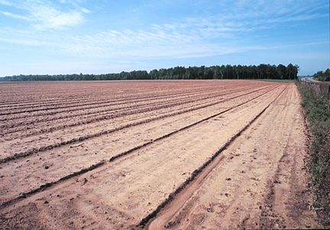

Slide 50
Coastal Plain(s) Region
AGRICULTURE: The Inner Coastal Plain features fertile soil that produces peanuts, peaches, soybeans, cotton, Vidalia onions, and pecans. The Outer Coastal Plain is less fertile due to the sandy soil. However, pine trees are harvested. Some crops are grown away from the coast.
ECONOMIC CONTRIBUTIONS: The pulp and paper industry is prominent. Commercial fishing and seafood processing occurs in coastal regions. Tourism and recreation in the Outer Plains are important to coastal towns. The impact of agriculture on the state’s economy is critical. The deep-water ports of Savannah and Brunswick and the inland ports of Bainbridge and Columbus connect GA products with global markets.
FEATURES: The barrier islands protect mainland Georgia from hurricanes. Okefenokee Swamp; “Okefenokee” is a Native American word meaning “trembling Earth” (soft/unstable soil)

Slide 51
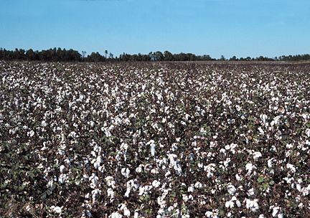
Cotton Farming
Notes:
51

Slide 52
Peach Orchard
Notes:
52

Slide 53
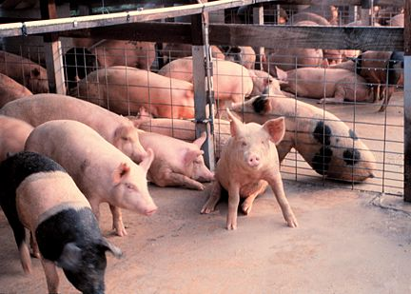
Hog Farming
Notes:
53

Slide 54
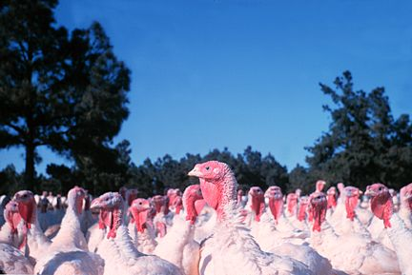
Turkey Farming
Notes:
54

Slide 55
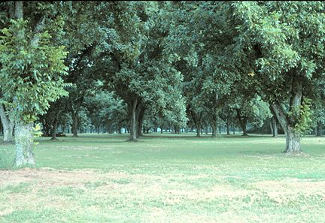
Pecan Orchard
Notes:
55

Slide 56
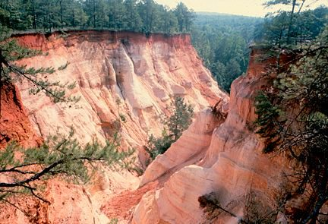
Providence Canyon
Notes:
56

Slide 57
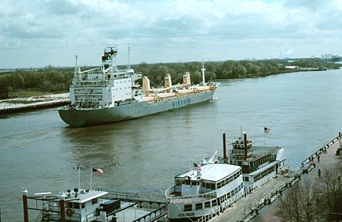
Savannah Port
Notes:
57

Slide 58
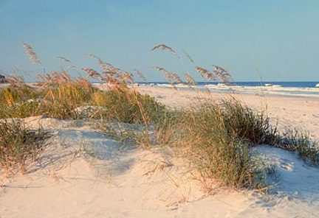
Georgia’s Beaches
Notes:
58

Slide 59
Okefenokee Swamp
Notes:
59

Slide 60
Remember
Largest and southernmost region divided into two regions- swampy and sandy Outer Plain contains coast and Okefenokee Swamp; soil-rich Inner Plain is agricultural heart of GA
Hot summers, mild winters. Little snow
Inner- peanuts, peaches, soybeans, cotton, Vidalia Onions, Pecans
Outer- Pine trees
Outer-$ comes from pulp/paper industry, fishing and seafood, tourism on coast. Deep water ports in Savannah, Brunswick and inland ports in Bainbridge and Columbus are important for trade.
Inner Plain has the largest agricultural industry in GA.
Barrier islands protect mainland GA from hurricanes; “Okefenokee” Swamp

Slide 61
I was stranded in the swamp for days with no food
I had no choice but to hunt down large white birds and eat them. Through the whole ordeal, I found myself filled with egret.

Slide 62
Were you paying attention?
1. Region that receives the most precipitation?
2. Region containing Dalton, the “carpet capital of the world”?
3. Name of the highest peak in Georgia?
4. In what region is the highest peak in GA located?
5. What region is responsible for the most agricultural production?
6. What region is responsible for producing the most animal products?
7. Two important physical features in Coastal Plain?
8. Region that contains the TAG corner?
9. Region characterized by rolling hills and numerous major cities?
10. What is the name of the feature that separates the Piedmont region from the Coastal Plain?

Slide 63
Were you paying attention?
1. Region that receives the most precipitation? Blue Ridge
2. Region containing Dalton, the “carpet capital of the world”? R&V
3. Name of the highest peak in Georgia? Brasstown Bald
4. In what region is the highest peak in GA located? Blue Ridge
5. What region is responsible for impacting the economy with agricultural production? (Inner) Coastal Plain
6. What region is responsible for producing the most animal products? Piedmont
7. Two important physical features in Coastal Plain? Okefenokee Swamp and Barrier Islands
8. Region that contains the TAG corner? Appalachian Plateau
9. Region characterized by rolling hills and major cities? Piedmont
10. What is the name of the feature that separates the Piedmont region from the Coastal Plain? Fall Line

