Slide 1
Native American Removal

Slide 2
Creek Nation
Creek Nation: a confederation of several southeastern tribes
Creek Nation was the most populous tribe and held the most land
Many white Georgians intermarried with the Creek and became tribe members
Georgians initially hoped that the Creek would become members of the plantation economy(planters and ranchers). While some did, many chose to continue their traditional life style.
Their interactions with runaway slaves also led many Creek to oppose the institution of slavery.

Slide 3
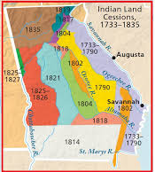
Creek and Settler Relationships
The Creek sided with the English during the Revolution; this caused a negative relationship with many Georgians.
A decrease in deer population made many white Georgians covet Creek land. These settlers pushed state and federal leaders for Creek removal.
There were several major Creek land cessions after the Revolution including the Treaty of New York in 1790, which stipulated that the Creeks cede most of land east of the Ocmulgee River to the United States.

Slide 4
Creek Civil War
Creek civil war broke out in 1813; called the Red Stick War
Divided into two factions:
Red sticks
wanted war to fight white settlers who were encroaching on their land
led by Alexander McGillivray
White sticks –
wanted peace
led by William McIntosh
Red Sticks
White Sticks
Those Who Wanted War
Those Who Wanted Peace

Slide 5
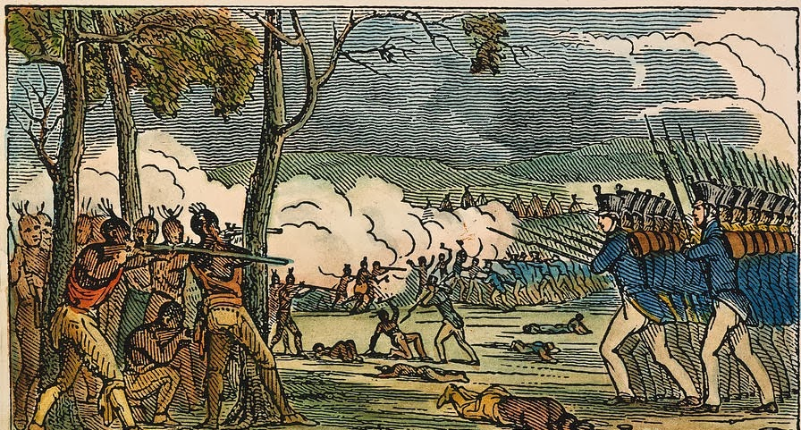
Local British and Spanish traders supplied the Red Sticks with arms and supplies because of their shared interest in preventing the expansion of the US into their territory.
U.S. troops and militia entered the conflict- in particular, General Andrew Jackson, who was in charge of leading the attacks against Creeks

Slide 6
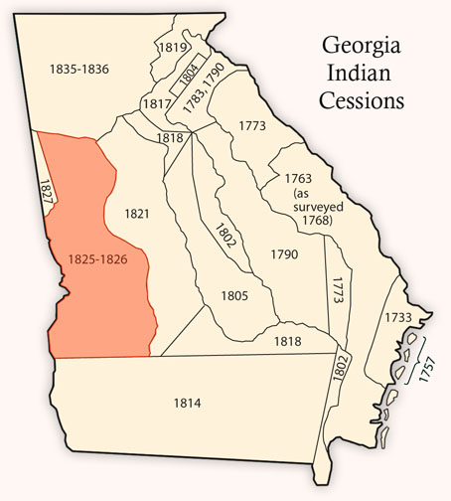
Treaty of Indian Springs
The civil war resulted in a Creek defeat by (future President) General Andrew Jackson at the Battle of Horseshoe Bend, in present day Alabama.
Following this war, the Creek lost 22 million acres of land.
In 1825, under the Treaty of Indian Springs, a Creek Chief named William McIntosh signed away the remainder of Creek land in Georgia after taking a bribe from an Indian agent.

Slide 7
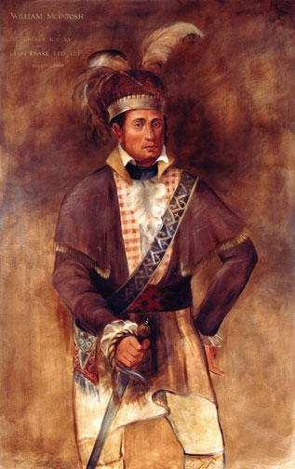
William McIntosh (1778-1825)
Creek Chief with Scottish father and Creek mother
Blood relations to prominent Georgian families solidified McIntosh’s political connections and loyalty to the U.S.
McIntosh infuriated his Creek tribesmen by consistently siding with the U. S., even during the Red Stick War.
After the war, the Creek Nation suffered through a terrible famine and McIntosh used this opportunity to regain his status in Creek society by obtaining the influential position of allocating food and supplies to those Creeks in need.

Slide 8
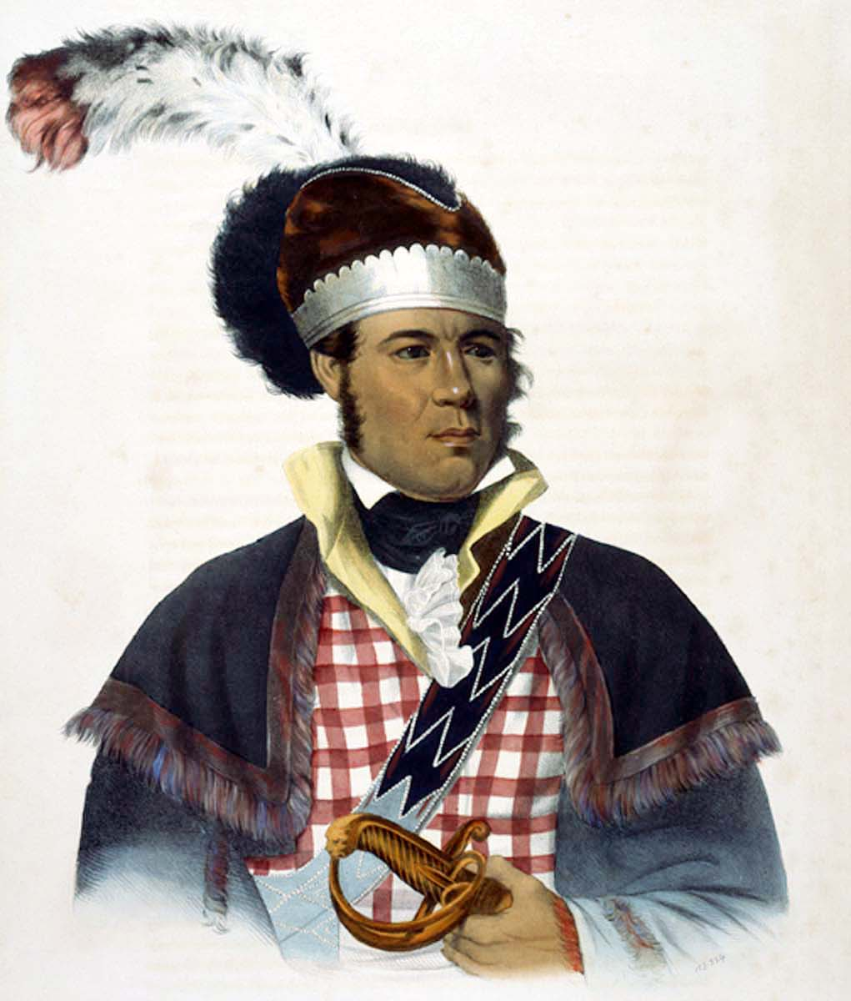
William McIntosh (1778-1825)
McIntosh was in favor of changing the traditional Creek lifestyle by encouraging the move to agricultural production and slaveholding.
McIntosh led this lifestyle himself, being the owner of two plantations.
Most Creeks did not support his abandonment of their traditional ways.

Slide 9
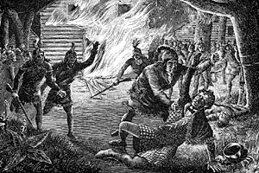
McIntosh and the Treaty of Indian Springs
McIntosh, along with 6 other Creek chiefs, agreed to sell the remainder of Creek land in Georgia without the tribe’s consent, in the Treaty of Indian Springs (1825)
McIntosh received extra cash for his personal lands in the treaty.
Upon hearing about what they considered to be a bribe, the Creek Nation ruled to execute McIntosh for his actions.
200 Creek warriors shot and stabbed McIntosh repeatedly at his home (1825)
This treaty officially removed the Creek from Georgia’s borders.

Slide 10
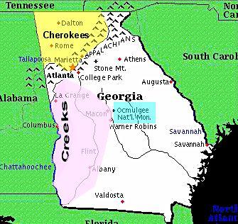
Cherokee Native Americans
The Cherokee lived in North Georgia mountains
After colonization, Cherokee traded exclusively with England; this loyalty caused conflict between the Cherokee and Creek (who traded with both the French and the English)
During the Revolution, the Cherokee continued to support the British and fought the Americans even after the war officially ended.
The hostilities continued until 1793.

Slide 11
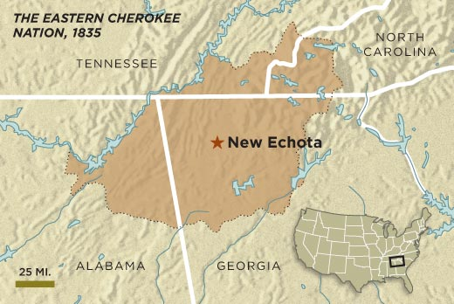
A “Civilized” Nation
Once peace was established, the Cherokee made treaties with the U.S. government- for example, allowing the Federal Road to run through their land
They believed imitating U.S. society (“civilized” like white settlers) was their best hope for keeping their land.
In the 1820s, the Cherokee developed a modern capital city called New Echota, a written language, a written constitution, and a newspaper. They invited Moravian missionaries to set up schools and adopted an agricultural system that included the use of slavery

Slide 12
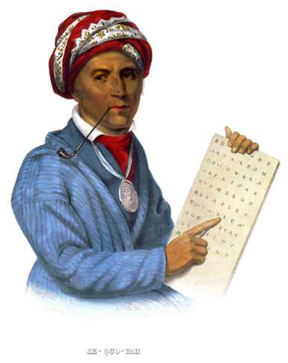
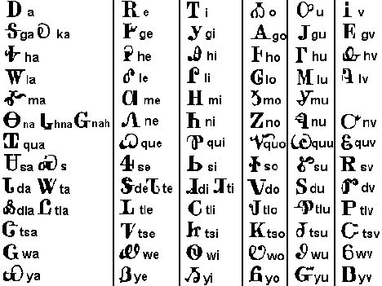
Sequoyah
Sequoyah (ca.1770-ca.1840)– developed the Cherokee SYLLABARY.
A system of eighty-four to eighty-six characters that represented syllables in spoken Cherokee (hence it is a syllabary, not an alphabet.)
First native written language.
Used it to create a library
The syllabary was used to print some articles in the Cherokee Phoenix newspaper, published in New Echota

Slide 13
Dahlonega Gold Rush
This did not stop white settlers in Georgia from demanding Cherokee removal to west of the Mississippi River- especially when gold was discovered in Dahlonega in 1828
By late 1829 north Georgia, (Cherokee Nation) was flooded by thousands of prospectors lusting for gold.
The sudden influx of miners into the Cherokee Nation was known even at the time as the Great Intrusion. Cherokee Phoenix:"Our neighbors who regard no law and pay no respects to the laws of humanity are now reaping a plentiful harvest. . . . We are an abused people."
Between 1805 and 1832 the state of Georgia held lotteries to distribute land seized from the Cherokees

Slide 14
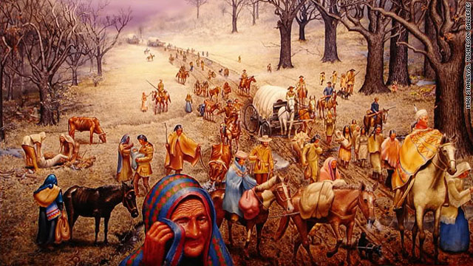
Cherokee Removal http://www.todayingeorgiahistory.org/content/treaty-new-echota
In 1832, the Cherokee won the Supreme Court case Worcester v. Georgia. This decision maintained that the Cherokee were an independent nation and were not subject to Georgia law.
However, in 1835, a small group of Cherokees signed the Treaty of New Echota without permission from the Cherokee gov’t.
President Andrew Jackson signed the treaty and Congress approved it. In 1838, most of the Cherokee were forcefully removed from the state and suffered on the Trail of Tears to Oklahoma.

Slide 15
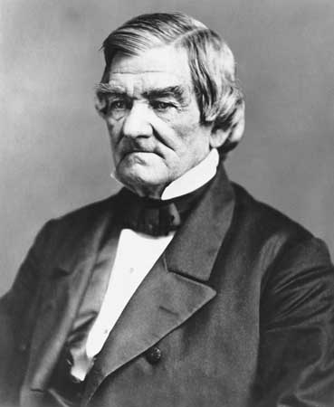
John Ross (1790-1866)
Born of mixed heritage; Ross spoke English and practiced many European customs
Ross became a successful businessman; he used his wealth and connections to win gov’t positions in the Cherokee Nation
Became principal chief of the Cherokee Nation in 1827, just as gold was discovered and Georgians began lobbying for Indian removal
However, Ross had faith in the U.S. Government, primarily the U.S. Supreme Court, and believed that the government would protect the most “civilized” tribe in the Southeast.

Slide 16
John Ross (1790-1866)
Ross continued to fight removal until 1838, when he negotiated a deal with the U.S. government to pay for moving expenses.
Ross was not protected from tragedy on the Trail of Tears. Ross’ wife died of exposure on the long journey to Oklahoma.
In OK, Ross continued to serve as principal chief of the Cherokee.
During the Civil War, Ross initially sided with the Confederacy, but soon supported the Union. This caused a split between the Cherokee in Oklahoma; Ross remained chief of the Cherokee who supported the Union
After the war, Ross became chief of the reunited tribe and remained in this position until his death in 1866.

