Slide 1
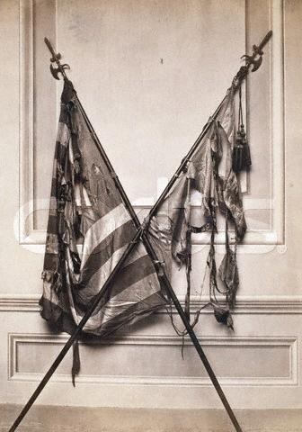
Introduction to the Civil War 1861-1865
The regimental colors of the 19th Massachusetts Infantry Regiment were damaged in battle during the American Civil War.

Slide 2
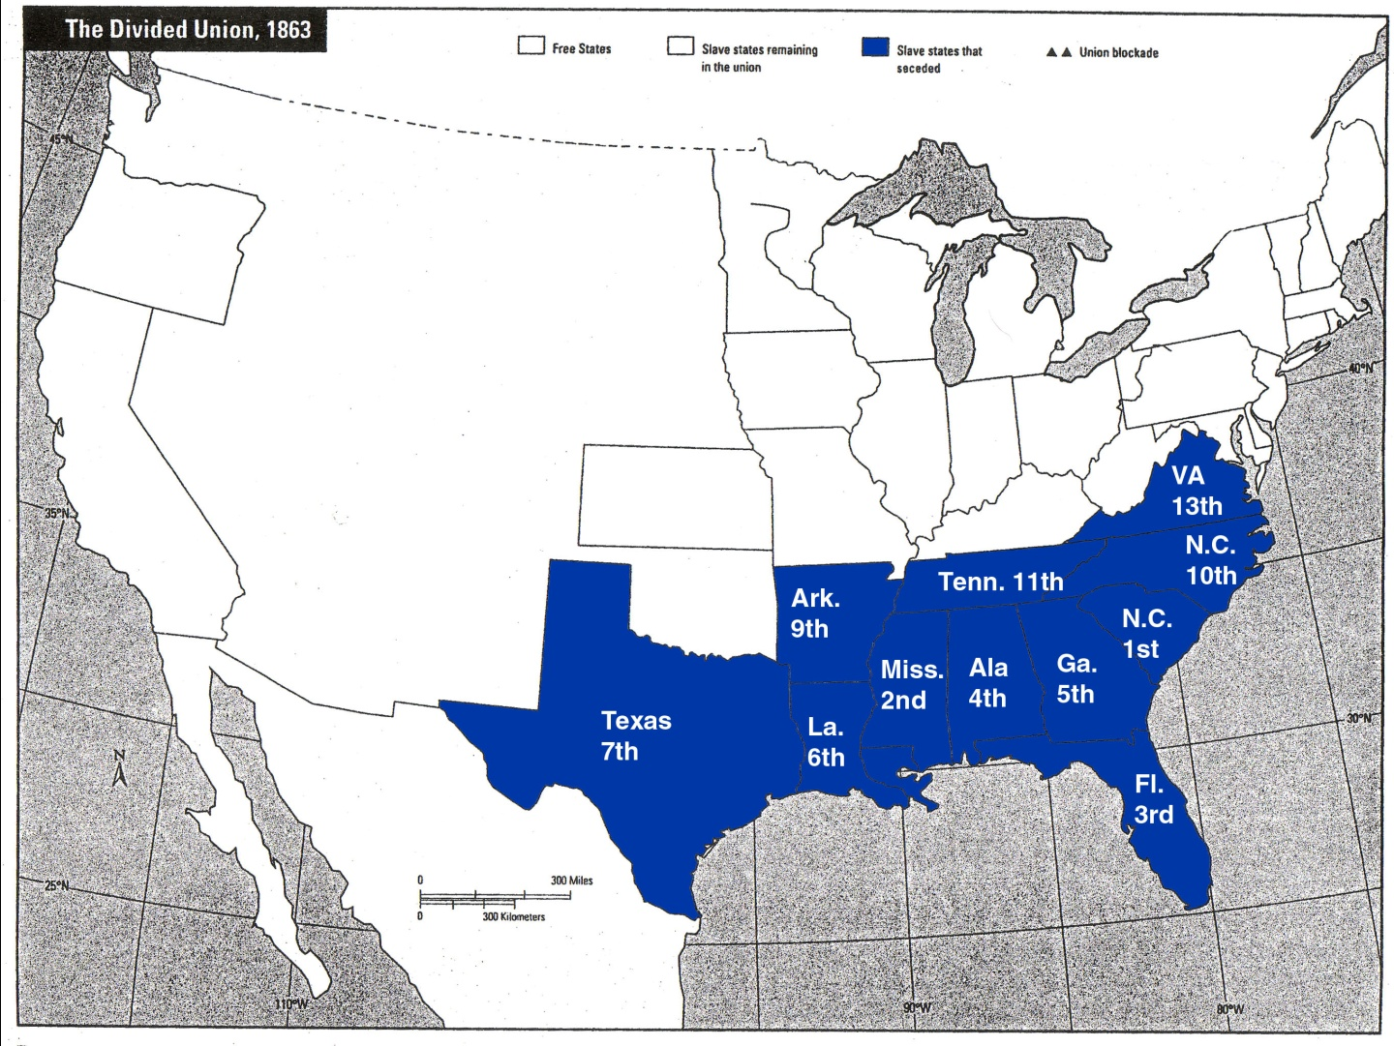
The Civil War
Who was involved?
#1 The Confederate States of America

Slide 3
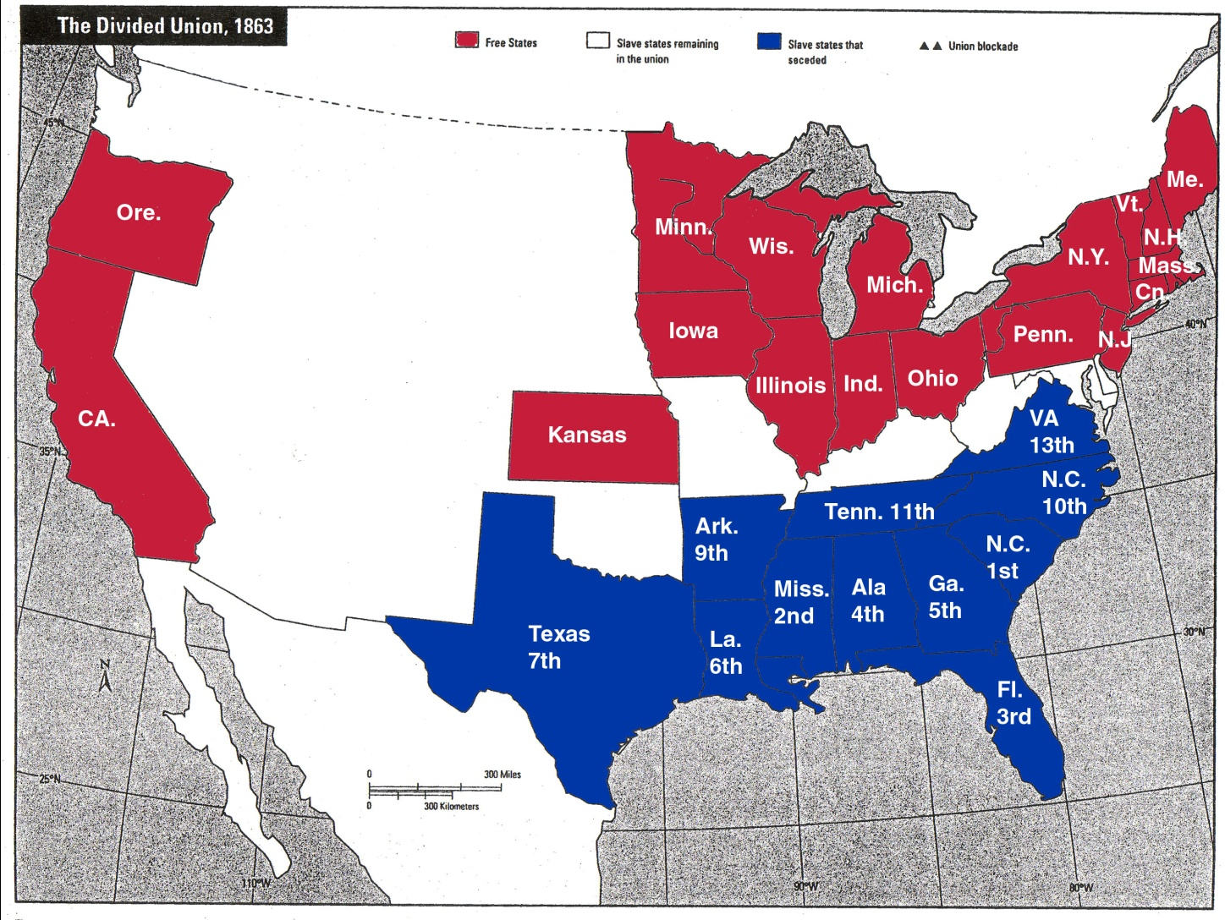
The Civil War
Who was involved?
#2 The Union (Free States & Territories)

Slide 4
The Civil War
Who was involved?
#3 The Border States

Slide 5
The Civil War
“I hope to have God on my side but I have to have Kentucky” -- Abraham Lincoln
Why were the Border States so important?
Important geographically
Why were the Border States so unusual?
Slave states that stayed with the Union

Slide 6
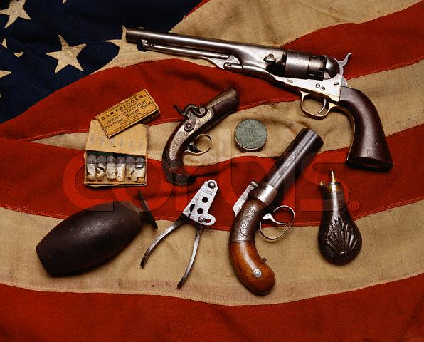
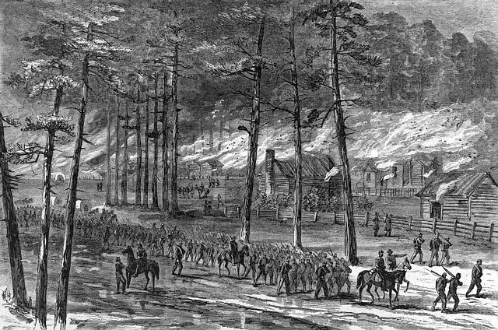
The Civil War
How did they fight?
Total War – organization of all the resources (people and products) of a country towards the war effort
The resources of enemy civilians are fair targets in total war (ex. Farms, food, etc)

Slide 7
Question:
Are governments ever justified in targeting civilians (non-soldiers) in wartime?

Slide 8
Advantages and Disadvantages:
North
Population: 22 million
4 million men of combat age
South
Population: 9 million
1.2 million men of fighting age
3.5 million slaves
North has the advantage in population

Slide 9
Advantages and Disadvantages:
North
Economy: 100,000 Factories
70,000 miles of Railroad
$190,000 in bank deposits
South
Economy: 20,000 factories
9,000 miles of Railroad
$50,000 in bank deposits
North has the advantage in industrial power

Slide 10
Advantages and Disadvantages:
North
Armed Forces: mostly drafted soldiers with overly cautious officers
More soldiers
African Americans - 10% of Union forces
Strong navy
South
Armed Forces: better trained soldiers & better leadership
No real navy
North has the advantage in # of soldiers, but South in the quality of soldiers & generals

Slide 11
Advantages and Disadvantages:
North
Government - Strong well-established government
South
Government - Weak government, most power given to states
North has a stronger government, better able to direct resources (people & products) towards the war

Slide 12
Advantages and Disadvantages:
North
Motivation: Preserve the union
Later - free the slaves
South
Motivation: Preserve way of life
Who has the advantage in motivation? You decide.

Slide 13
Goals:
North
Anaconda Plan
1. Blockade the South
2. Divide - Split the Confederacy by gaining control of the Mississippi River
3. Conquer - remaining parts
South
1. Defend existing territory
2. Gain recognition of Confederacy as independent nation
Whose goals would be easier to reach?

Slide 14
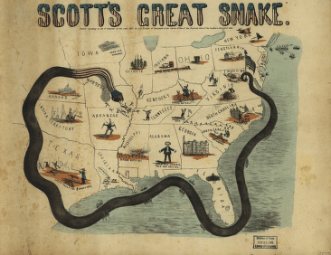
Anaconda Plan

