Slide 1
SS8H12b
Jimmy
Carter

Slide 2
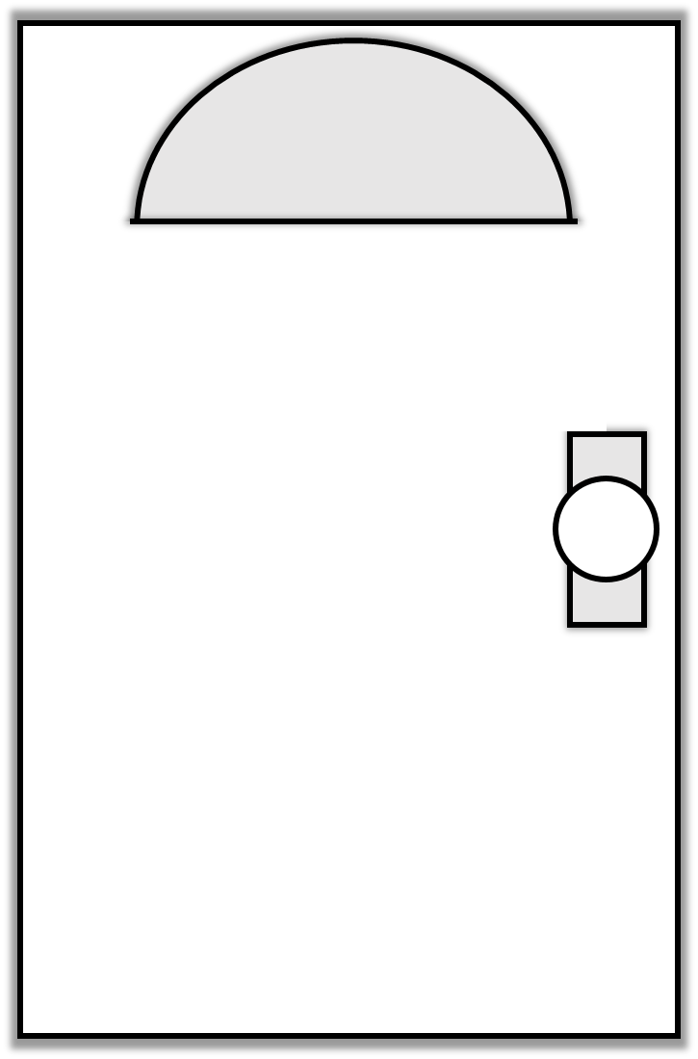
Doors to Understanding: Jimmy Carter
What I
Know
What I
Want to Know
What I
Learned

Slide 3
Early Life
James Earl Carter, Jr. was born on October 1, 1924 in Plains, Georgia.
Carter had a military career in the Navy, but returned home to Plains after his father passed away.
Jimmy, his wife Rosalynn, and their four kids managed the family peanut farm.

Slide 4
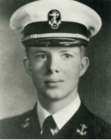
James Earl Carter, Jr.

Slide 5
Senator
Carter began his political career in 1962 when he won the state senate position for the 14th District of Georgia.
He served two terms in the State Senate and promoted the need for reorganizing Georgia’s system while in office.

Slide 6
Governor
In 1970, Jimmy Carter won the governor’s race and quickly began to create a “new Georgia”.
In his inaugural address, he informed Georgians that it was time for segregation to end.
Carter favored integration and often butted heads with his lieutenant governor, Lester Maddox, over promoting civil rights.

Slide 7
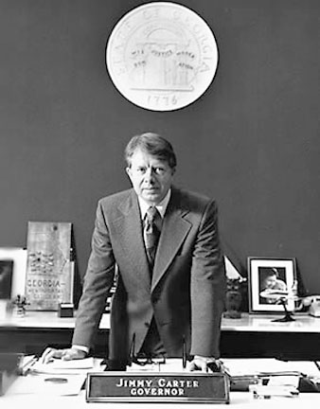
In his inaugural speech, Carter stated, “No poor, rural, weak, or black person should ever have to bear the additional burden of being deprived of the opportunity of an education, a job, or simple justice.”

Slide 8
Governor
Carter used his four years in office to restructure the entire state government and completely change the format of the state budget.
He also pushed for reforms of Georgia’s education, mental health, and criminal justice systems.
Carter also favored business and industrial growth in Georgia.

Slide 9
President
In the 1976 election, Carter defeated incumbent Republican President Gerald Ford to become the 39th president of the United States.
President Carter served from 1977 to 1981 and created several new programs and departments that are still a fundamental part of the federal government today.

Slide 10
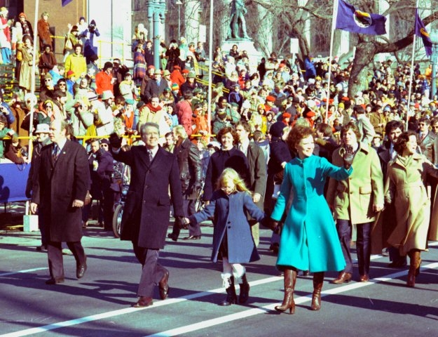
On inauguration day, President Carter and his family walk down Pennsylvania Avenue.

Slide 11
Camp David Accords
For centuries, Arabs and Jews have fought over land in the Middle East.
President Carter invited Egypt’s president and Israel’s prime minister to Camp David (the president’s personal retreat) to try to work out a peace agreement.
On September 17, 1978, the leaders negotiated a peace treaty and signed the Camp David Accords.
Many saw this as a diplomatic miracle and Carter was given credit for his role in negotiating the agreement.

Slide 12
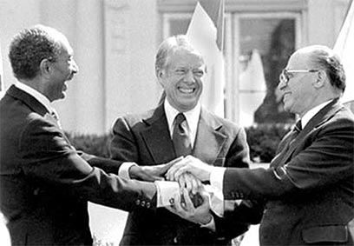
On 17th September 1978, Sadat and Begin signed a document entitled "The Framework for Peace in the Middle East”, also known as the Camp David Accords.

Slide 13
Soviets
After Carter exercised his foreign policy in the Middle East, he established the SALT II nuclear limitation treaty with the Soviet Union which limited the number of nuclear weapons held by the US and the USSR.
Not long after agreeing to the terms, the Soviets ignored the agreement and invaded Afghanistan.
President Carter responded with a grain embargo and a boycott of the 1980 Olympic Games in Moscow; however, many Americans questioned whether he was capable of being tough enough with the Soviets.

Slide 14
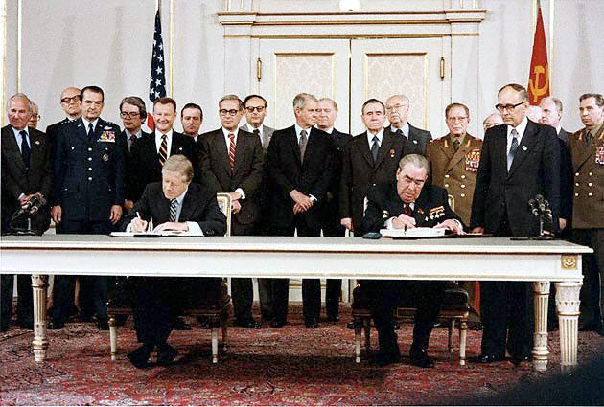
Carter & Brezhnev sign SALT II - 1979

Slide 15
Iran Hostage Crisis
Even more damaging for Carter’s presidency was the Iran Hostage Crisis.
In 1979, Iranian students captured the US embassy in Tehran and took those inside hostage.
The students were angry at Carter for allowing Iran’s former leader to enter the US for medical treatment.
They demanded the Shah be returned to Iran in exchange for the hostages.

Slide 16
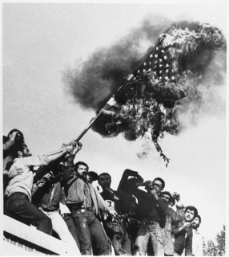
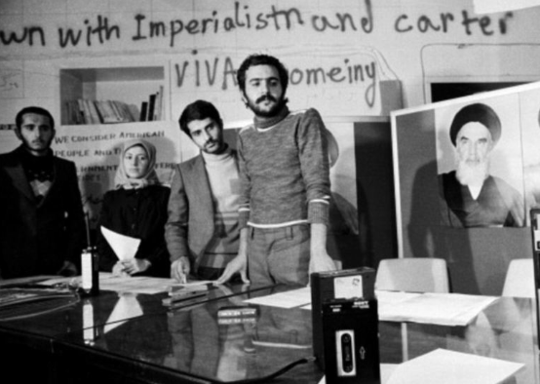
Iranian students storm
US embassy

Slide 17
Iran Hostage Crisis
Carter refused the exchange and the crisis continued.
Five months later, Carter authorized a rescue attempt that failed when a military helicopter crashed into a transport plane, killing several US soldiers.
Americans were angry and blamed President Carter for not taking better control of the event.
When Carter lost the 1980 election, the Iranians agreed to let the hostages go.

Slide 18
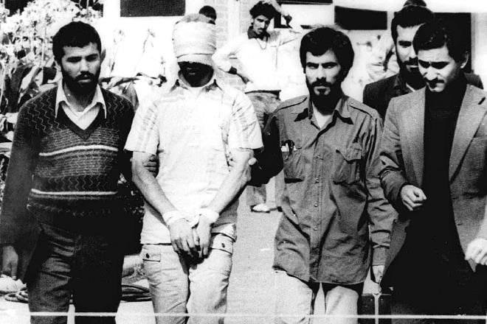
The 52 hostages were released within hours of Carter leaving office.

Slide 19
Post-Presidency
While his approval ratings may not have been high as president, Carter has become one of the most admired ex-presidents in history.
Carter has worked to promote democracy and human rights around the world, and has often been called on to represent the US in diplomatic efforts.
He built the Carter Center in Atlanta in 1982, and it works to fight diseases and starvation throughout the world.
The Center has also monitored over 80 elections in 34 countries to ensure fair and balanced results and provided additional assistance to the democratic process.

Slide 20
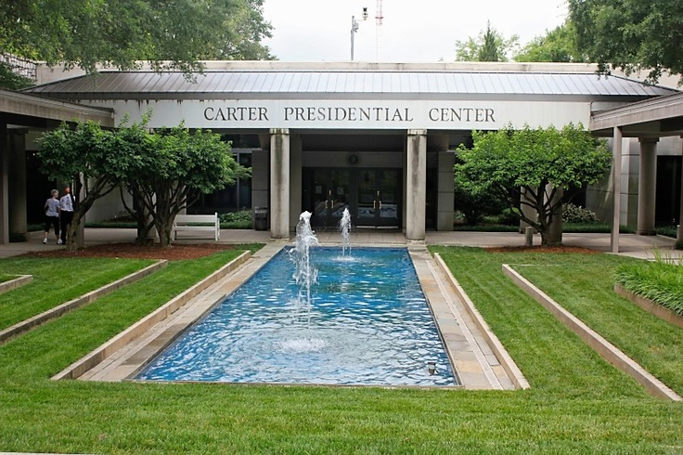

Slide 21
Nobel Prize
For his dedication to humanitarian efforts and ending international conflict, Carter was awarded the Nobel Peace Prize in 2002.
The award is given to the person whose work has most benefited mankind.

Slide 22
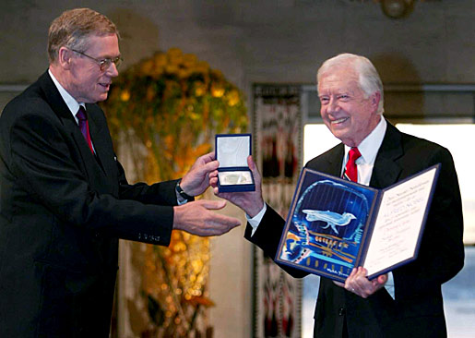
Jimmy Carter receives Nobel Peace Prize.

Slide 23
TIME
Man of the Year
Year
Write a description that includes who the person is and why he was selected as the Man of the Year.
Draw an illustration of Jimmy Carter (or of something that he’s known for).
Write a short caption that includes the person’s name & what he’s known for.
© 2015 Brain Wrinkles

Slide 24
TIME
Man of the Year
© 2015 Brain Wrinkles

