Slide 1
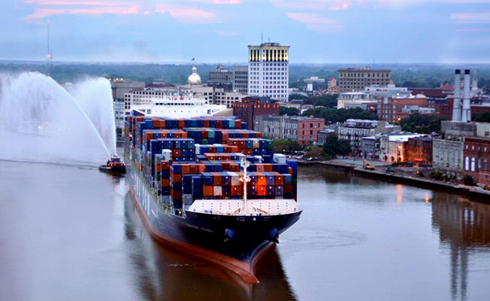
Georgia’s Driving Economic Forces Today

Slide 2
SS8H12d. Analyze Georgia’s role in the national and global economy of the 21st Century, with regard to tourism, Savannah port expansion, and the film industry.
I. Tourism in Georgia has become one of the state’s largest industries. Because of the great geographic diversity in the state, over 100 million visitors traveled to Georgia’s mountains, beaches and major cities with unique attractions. With Atlanta as the top destination and Savannah and the Georgia coast following close behind, these cities and regions provide job opportunities for community members.

Slide 3
SS8H12d. Analyze Georgia’s role in the national and global economy of the 21st Century, with regard to tourism, Savannah port expansion, and the film industry.
Tourism has become the fifth largest employer in the state with revenues in the neighborhood of $59 billion providing 439,000 jobs.
In 2016, the tourism industry generated $3 billion in direct and indirect taxes.
The tourism industry employed 10.2% of Georgia’s workforce in 2016.
One third of the tourists visiting Georgia were Georgians who enjoyed overnight stays at regional attractions.

Slide 4
SS8H12d. Analyze Georgia’s role in the national and global economy of the 21st Century, with regard to tourism, Savannah port expansion, and the film industry.
II. The Savannah Harbor Expansion Project (SHEP) is finally under construction after a 15-year study to determine the impact on the economy of Georgia and the nation. Savannah’s port is the fourth-busiest container port in the U. S. and is the fastest growing port.

Slide 5
SS8H12d. Analyze Georgia’s role in the national and global economy of the 21st Century, with regard to tourism, Savannah port expansion, and the film industry.
II. Savannah Harbor Expansion Project
Will be able to serve larger vessels with heavier loads now that the Panama Canal expansion is complete;
The ability to bring in ships with 3 times the current capacity;
More American businesses will ship products from this critical port in their supply chains;
Allows greater scheduling flexibility;
Will support jobs throughout the nation;
Have an economic impact of generating $67 billion in revenue.

Slide 6
SS8H12d. Analyze Georgia’s role in the national and global economy of the 21st Century, with regard to tourism, Savannah port expansion, and the film industry.
Savannah Harbor Expansion Project
More than 350,000 jobs will be impacted and about $18.5 billion in personal income will impact the region.
The impact of SHEP will help manufacturers on the national and global horizon

Slide 7
SS8H12d. Analyze Georgia’s role in the national and global economy of the 21st Century, with regard to tourism, Savannah port expansion, and the film industry.
III. Georgia’s film Industry
Georgia is rapidly becoming a major player in the film industry. The reasons for this are:
Encouraging financial incentives such as tax breaks,
The diversity of locations for filming, and
Growing production resources and professional support,
Georgia’s moderate climate allows for year-round production, and
The airport in Atlanta provides for quick transportation for members of the industry.

Slide 8
SS8H12d. Analyze Georgia’s role in the national and global economy of the 21st Century, with regard to tourism, Savannah port expansion, and the film industry.
III. Georgia’s film Industry
Since its creation in 1973 by then-governor Jimmy Carter, the Georgia Film Commission has grown to rank third behind California and New York.
The Georgia Film Academy and colleges and universities, including the Savannah College of Arts and Design (SCAD), will help fill the projected 3,500 - 5,500 job opportunities by 2021.
Tyler Perry, producer and actor, is currently converting the former Fort McPherson location into one of the largest film studios in the United States. With 800 film and television projects since 1972, Georgia’s film industry is likely to continue to grow.

