Slide 1
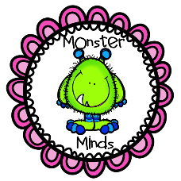
Post WWII Georgia
SS8H10 a-c
© Monster Minds 2017

Slide 2
William B Hartsfield
William Hartsfield (1890-1971) is primarily known for two things.
The first was his active support in bringing air transportation to the state.
The second was his coinage of the phrase often used to describe Atlanta’s racial tolerance: “the city too busy to hate.”
Nevertheless, Hartsfield, who never graduated from high school or college, was significant for other reasons.
Primarily he was Atlanta’s longest serving mayor (’37-’41; ’42-’61), and his support of the civil rights movement kept Atlanta from the racial violence that engulfed many other southern cities.

Slide 3
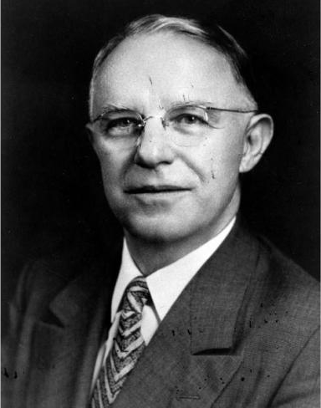
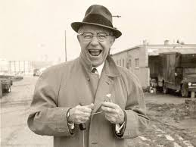
© Monster Minds 2017

Slide 4
William B Hartsfield
Born in Atlanta, Hartsfield attended the city’s public school.
Though he never finished high school, as a young man Hartsfield found work in a law firm and spent his nights studying for the bar exam.
After being admitted into the bar, he opened his own law firm in 1921.
In 1922, he began his political career when he was elected to the Atlanta city council.
As a member of the council, Hartsfield commenced his lifelong support of aviation and was instrumental in opening Atlanta’s first airport in 1925.

Slide 5
William B Hartsfield
In 1937, Hartsfield became mayor of Atlanta. In his first term, he did many things to help the city during the depression.
This includes convincing Robert Woodruff, the president of the Coca-Cola Company, to finance the city’s 1936 December payroll.
Though Hartsfield lost the 1940 election, he was re-elected in 1942 when Atlanta mayor Robert Le Craw left to fight in WWII.
Hartsfield remained in the mayor’s office for almost 20 years.

Slide 6
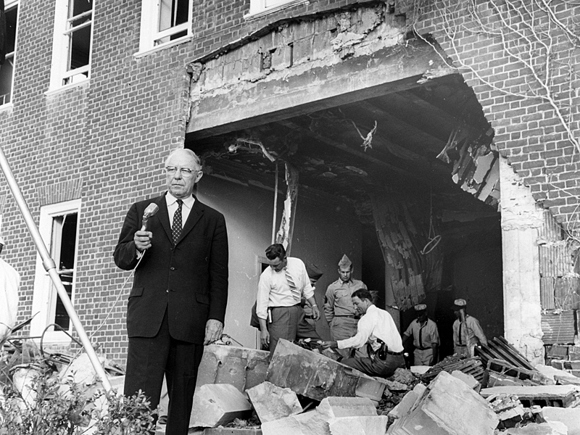
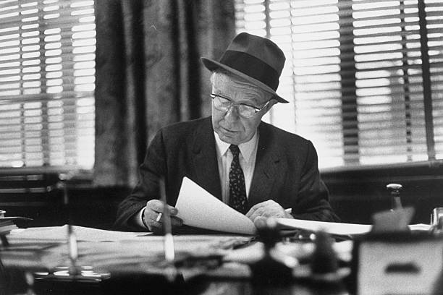
Hartsfield after an Atlanta attack
© Monster Minds 2017

Slide 7
William B Hartsfield
During his second tenure as mayor, Hartsfield was instrumental in the calm integration of Atlanta’s public schools, as well as tripling Atlanta’s size.
This was done by annexing several square miles, overseeing the building of many public parks, and expanding Atlanta’s expressway system.
It was during his administration that Atlanta’s political and business leaders called Atlanta “The City Too Busy to Hate.”
Hartsfield retired from public office in 1961.
After his death in 1971, Atlanta named its airport Hartsfield International in his honor.

Slide 8
Ivan Allen, Jr.
Ivan Allen, Jr., Atlanta’s mayor from 1962-1970, continued Hartsfield’s aggressive development policies.
However, he was also more adamant in the fight for civil rights as well.
For example, on Allen’s first day as mayor, he had all of the white and “colored” signs removed from city hall and desegregated the building’s cafeteria.

Slide 9
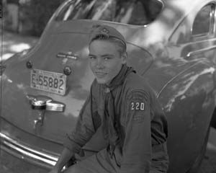
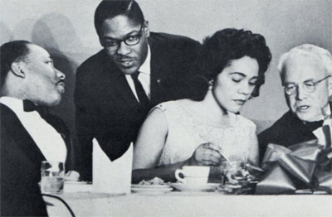
© Monster Minds 2017

Slide 10
Ivan Allen, Jr.
Allen was the son of business leader Ivan Allen, Sr.
Born in Atlanta, Allen graduated from Georgia Tech and worked in his father’s office products company.
From 1942-1945 he served in WWII, and after the war, became president of his father’s company in 1946.
As a leading figure in Atlanta for many years after the war, Allen decided to run for mayor in 1961.
A proponent for civil rights, Allen worked with Martin Luther King, Jr. and Atlanta’s business leaders to secure the city’s smooth transition into desegregation.

Slide 11
Allen pictured speaking with Coretta Scott King and Martin Luther King, Jr. at Atlanta’s first integrated social event
Allen participated in Boy Scouts in his youth
© Monster Minds 2017

Slide 12
Ivan Allen, Jr.
Allen also continued to bring growth to the city.
He was instrumental in the building of Interstate 285, was an early advocate of the MARTA (Metropolitan Atlanta Rapid Transit Authority) commuter rail line, and was responsible for 55 new building projects during his tenure as mayor.
Perhaps Allen may be best known for his support of bringing major league sports teams to the city.
He convinced Atlanta’s political, economic, and social leaders to financially support the construction of major league stadiums.

Slide 13
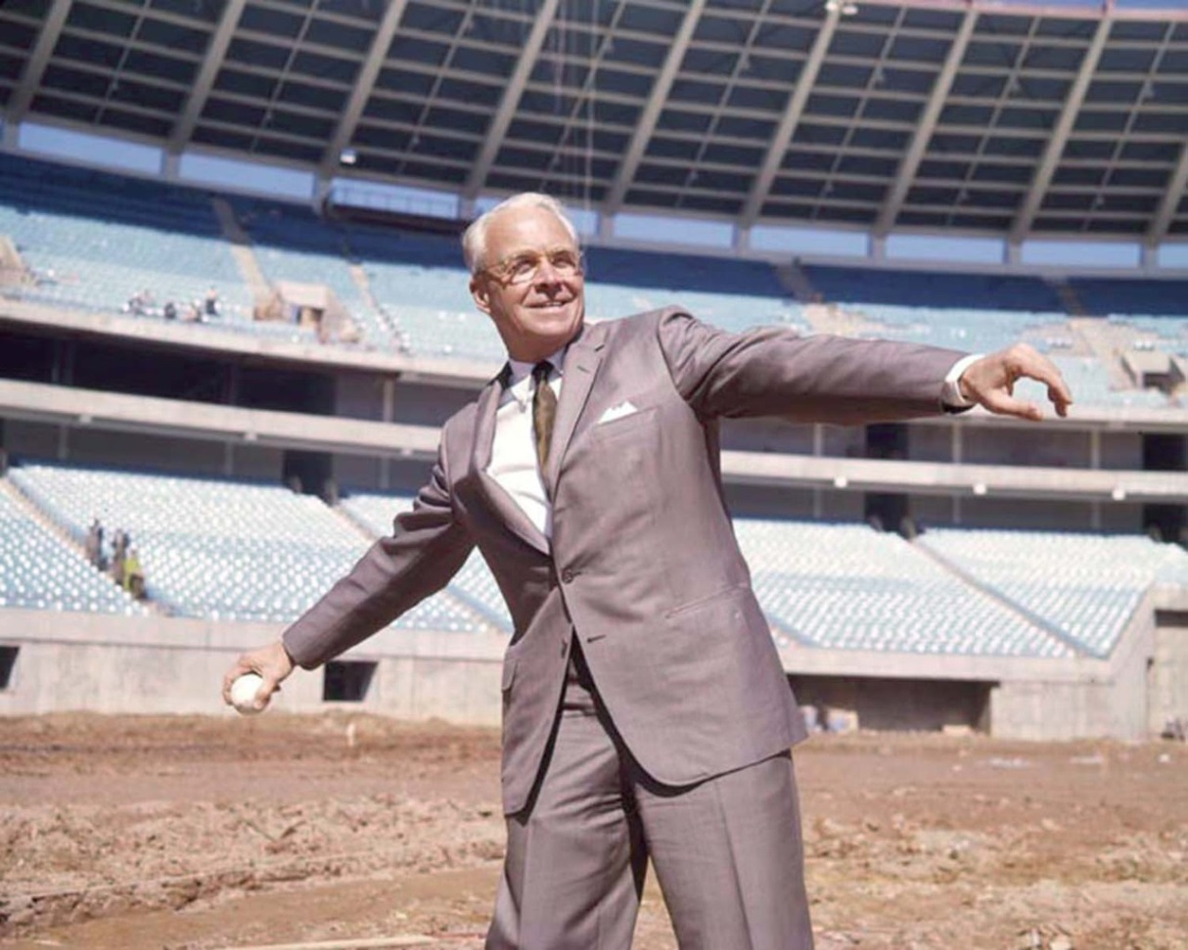
© Monster Minds 2017

Slide 14
Ivan Allen, Jr.
This gave Atlanta an aura of being a “Major League City” and their facilities ultimately helped to bring the 1996 Olympic games to the city.
Allen brokered the deal to bring the Braves to Atlanta in 1966.
He also persuaded the NFL to start a new franchise in the city, which became known as the Atlanta Falcons.
The basketball team, the Hawks, would follow in 1968.
While these sports teams have been mainstays since their arrival, Atlanta has been the home of may other professional sports teams, including men’s hockey, arena league football, and women’s soccer and basketball.

Slide 15
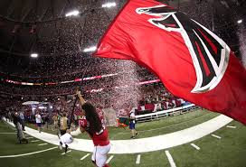
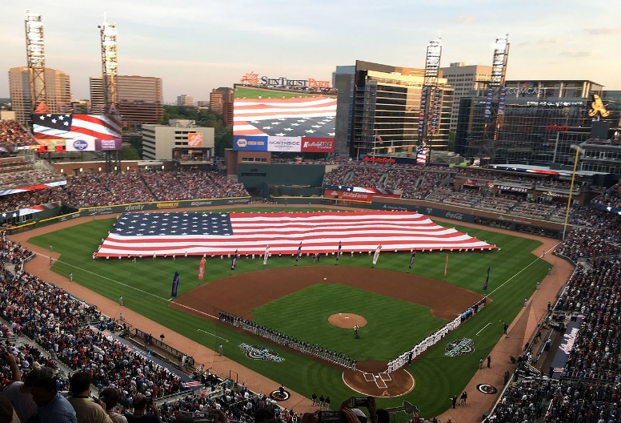
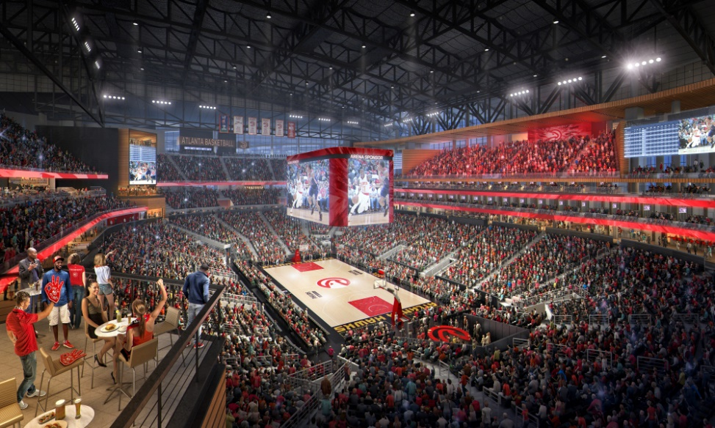
The Braves’ new stadium (below) is at Suntrust Park.
The Atlanta Falcons (above) celebrating after a win
A full crowd at an Atlanta Hawk’s game (below)
© Monster Minds 2017

