Slide 1
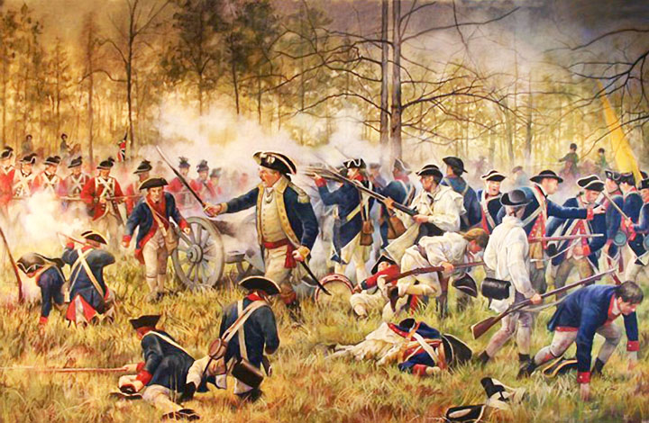
Revolutionary War Battles in Georgia
Unit 3

Slide 2
Activating the Lesson
http://www.gpb.org/files/big-question
After viewing the video, which side would you be on. Give examples from what was said in the video.

Slide 3
Mixed Feelings in Georgia
The desire for independence was not as strong in Georgia as in other colonies.
Why?
Georgia had prospered under British rule.
Georgia needed protection from Native Americans.
Many of the laws and taxes imposed on the colonies had little effect on Georgia.

Slide 4
Mixed Feelings in Georgia
There were some Georgians that were dissatisfied with British policies.
Georgia did not send a representative to the meeting opposing the Stamp Act.
The publisher of the Georgia Gazette, Georgia’s only newspaper, stopped publication for a year in protest to the tax.

Slide 5
Independence
In 1774, the First Continental Congress met in Philadelphia.
Georgia was the only colony to not send a delegate.
The delegates decided to cut off trade with England until taxes and trade regulations were repealed.
Before a second Continental Congress could meet, fighting broke out – Lexington and Concord, Massachusetts.

Slide 6
Independence
In 1775, the Second Continental Congress met; Georgia was represented this time.
A committee headed by Thomas Jefferson wrote the Declaration of Independence.
It was adopted on July 4, 1776.
Georgia signers of the Declaration were:
Button Gwinnett
Lyman Hall
George Walton

Slide 7
Matching Key People & Events
Battle of Lexington and Concord
Button Gwinnett
2nd Continental Congress
Thomas Jefferson
Redcoats
Declaration of Independence
Author of the Declaration of Independence
British soldiers
Georgia’s delegate to the 2nd Continental Congress
Statement of American Independence from England
First armed conflict of the Revolutionary War
Meeting where colonists listed reasons for independence from England

Slide 8
True/False Make False statements True
All Georgians were in favor of American independence from Britain.
Georgia was not represented at the 1st Continental Congress.
The first armed conflict of the American Revolution took place in Massachusetts.
Georgia was not represented at the 2nd Continental Congress.
Both the 1st and 2nd Continental Congresses took place before the Revolutionary War began.
Thomas Jefferson was the primary author of the Declaration of Independence.
Georgians Button Gwinnett, Lyman Hall, and George Walton signed the Declaration of Independence.

Slide 9
War comes to Georgia
Loyalties in Georgia were split.
Loyalists or Tories were people loyal to England.
Patriots were those supporting independence.
In 1778, British regiments began moving inland from the Georgia coast.
The first major battle in the South took place in Savannah.
Savannah fell to the British on December 29, 1778.
Augusta fell a month later.

Slide 10
Point of View Loyalist or Patriot?
“England has supported the colony since the beginning. Some of these colonists are not grateful for that, but I certainly am!”
“I believe in this battle for independence and am willing to fight for it.”
“I hope the British troops overwhelm the local, untrained militia.”
“I was born in England and remain loyal to her.”
“It’s time to take a stand. We will no longer pay those taxes imposed on the colonies!”
“Losing Savannah and Augusta to the British is a bad blow, but we must continue to fight!”

Slide 11
Battle of Kettle Creek
Although not as important as other American victories, this battle was important to Georgia patriots.
To raise morale
To give them much needed supplies
To set the stage for several victories.

Slide 12
Battle of Kettle Creek
It took place on February 14, 1779.
Elijah Clarke and Thomas Dooly led the Georgia militia on an attack of an encampment of 600 British Loyalists.
Although outnumbered, the Patriots routed the Loyalist troops with a surprise attack.
Heroic actions of Elijah Clarke and Austin Dabney during this battle made them Georgia heroes.

Slide 13
Siege of Savannah
In October 1779, a joint force of French and Patriot troops attacked Savannah in hopes of regaining it.
The French fleet was commanded by Count Charles Henri D’Estaing.
The battle lasted only 90 minutes but led to the deaths of 800 allied troops to Britain’s 18.
Count Casimir Pulaski, a famous Polish soldier who came to fight for freedom, died in a cavalry charge.

Slide 14
Siege of Savannah
The attack failed.
Savannah remained under British control until 1782.
This battle was the second bloodiest battle of the Revolutionary War.
http://www.gpb.org/georgiastories/stories/savannah_under_attack

Slide 15
Treaty of Paris of 1783
The treaty that ended the Revolutionary War.
It granted the United States independence from England.

Slide 16
Yes or No Explain why or why not.
Were Loyalists allied with the British?
Was the Battle of Kettle Creek an American defeat?
Was the siege of Savannah the bloodiest battle in the Revolution?
Were the French allied with the British during the siege of Savannah?
Did the Treaty of Paris of 1783 give America independence from England?

Slide 17
Heroic Georgians
Elijah Clarke
Early in the war, he fought the Creeks and Cherokee who had sided with the British.
He led a small group of men disrupting the British and Loyalists with surprise attacks behind enemy lines.
The surprise attacks were called guerilla tactics.
He helped recapture Augusta in 1781.
Not only did he battle the Loyalists but also wounds, small pox, and the mumps.

Slide 18
Heroic Georgians
Austin Dabney
He was a slave who fought under Elijah Clarke.
He took the place of his master, substituting for him in the war.
He thought to be the only African-American to fight in the Battle of Kettle Creek.

Slide 19
Heroic Georgians
Austin Dabney
After the war, Dabney lived with one of his fellow soldiers, Giles Harris who took care of Dabney after he was wounded.
In 1786, Georgia’s General Assembly gave Dabney his freedom.
This prevented Dabney’s former master from taking advantage of Dabney’s fame.
The state also granted him 50 acres of land for his service during the Revolution.

Slide 20
Heroic Georgians
https://www.pbs.org/video/georgia-stories-nancy-hart-story/

Slide 21
Heroic Georgians
Nancy Hart: six foot tall, red-head
She is most well-known for capturing and killing several Loyalist soldiers who food and quarters.
As they were eating and drinking, Nancy Hart was hiding their weapons.
When they realized that their weapons were gone, they charged her.
She killed one, wounding another, and holding the others at gunpoint until her husband got home.

Slide 22
Heroic Georgians
Nancy Hart:
The rumor…
The soldiers were hanged and buried on her property.
In 1912, railroad workers came across a grave on the Hart property with six skeletons.
She served as a Patriot spy during the war.
It is also rumored that she fought in the Battle of Kettle Creek.

Slide 23
Heroic Georgians
Compare the video to what we learned in class. In great detail, describe Nancy Hart and why she was important to Georgia during the Revolutionary War.

Slide 24
How well do you know our Georgia Heroes?
In what 1779 battle did Elijah Clarke fight?
What kind of tactics did Elijah Clarke use so effectively against the British? Explain how they worked.
What city did Clarke help recapture in 1781?
Name two diseases that Clarke battled during the Revolutionary War.

Slide 25
How well do you know our Georgia Heroes?
Why was Austin Dabney serving as a soldier?
Why did the General Assembly give Dabney his freedom?
In what battle did Dabney suffer his wounds?

Slide 26
How well do you know our Georgia Heroes?
Why did British soldiers charge at Nancy Hart?
What was found in a grave near Nancy Hart’s property in 1912?
Who was Hart County named after? Why is that significant?
What physical characteristic may have helped Nancy Hart pose as a man?

Slide 27
Georgia’s Political Leaders
Button Gwinnett
He was a delegate to the Second Continental Congress.
He signed the Declaration of Independence.
He was the chairman of the committee that wrote the Georgia Constitution of 1777.
He became governor in 1777.
Gwinnett feuded with his bitter enemy Lachlan McIntosh.
Gwinnett challenged McIntosh to a duel and died from his injuries three days later.

Slide 28
Georgia’s Political Leaders
Lyman Hall
He was a minister and a doctor.
He was also a delegate of the Second Continental Congress and signed the Declaration of Independence.
Hall was elected governor in 1783.
He was instrumental in founding the University of Georgia.

Slide 29
Georgia’s Political Leaders
George Walton
Walton was the most politically successful of the three signers.
He was a successful lawyer.
He was wounded and captured by the British during the assault on Savannah.
During his 30-year political career, Walton served as representative to Congress, circuit court judge, chief justice of Georgia, governor of Georgia, and U.S. Senator.

Slide 30
Who’s Who
This patriot was a minister and a doctor.
This lawyer was wounded during the Revolutionary War.
This patriot was killed in a duel.
Gwinnett, Hall, and Walton all held this Georgia political office.
What document did Gwinnett, Hall, and Walton sign?

Slide 31
Who’s Who
Groups of 6
Each group is going to create a Who’s Who poster. Include:
Elijah Clarke
Austin Dabney
Nancy Hart
Button Gwinnett
Lyman Hall
George Walton
It must have their contributions to the State of Georgia and a picture.

