Slide 1
SS8H5- a.
Explain the importance of key issues and events that led to the Civil War; include slavery, states’ rights, nullification, Compromise of 1850 and the Georgia Platform, the Dred Scott case, Abraham Lincoln’s election in 1860, and the debate over secession in Georgia.

Slide 2
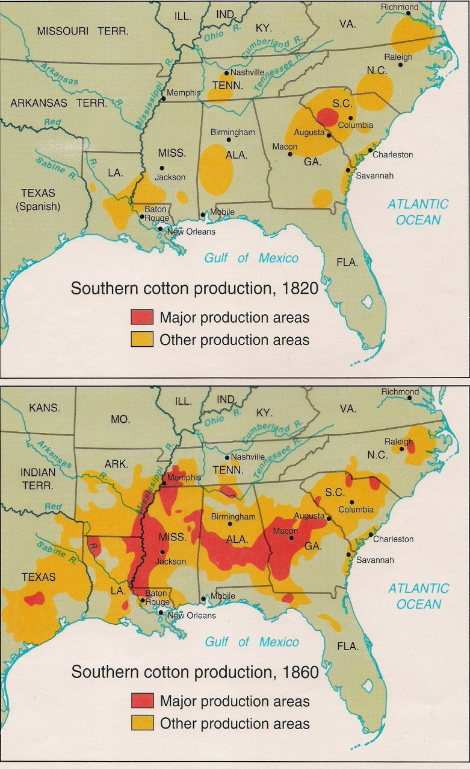
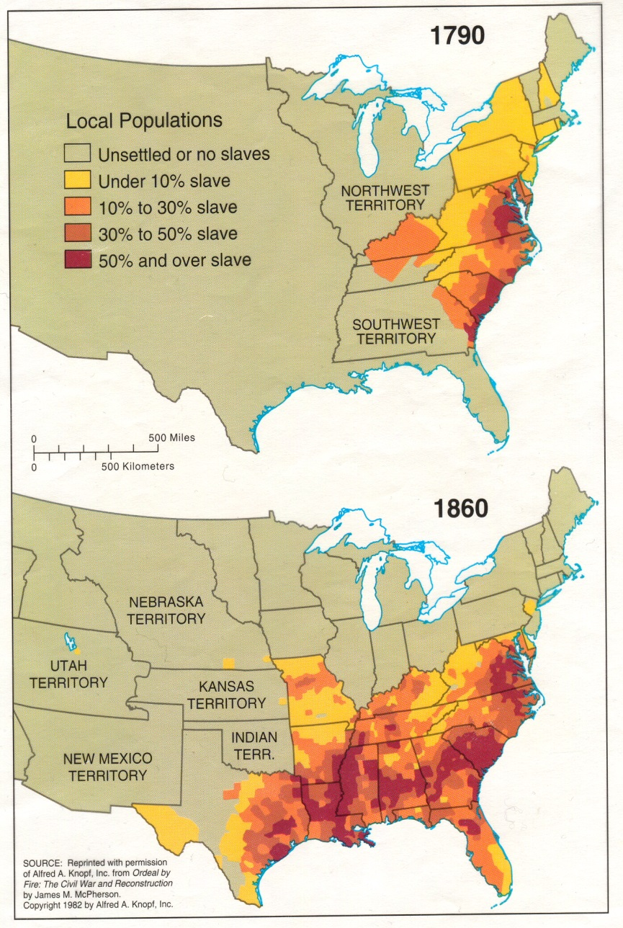
1. Slavery<<<< MAJOR CAUSE Examine the maps below. What happened to slavery? Why?

Slide 3
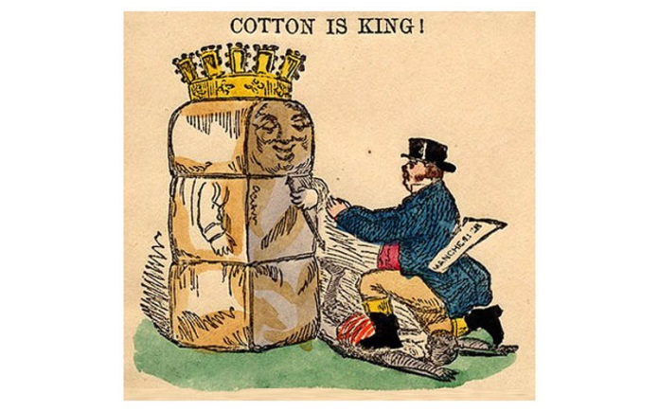
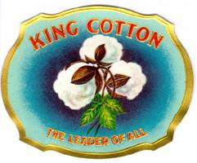
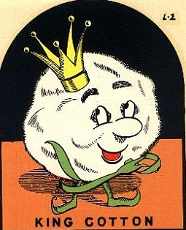
1. Slavery<<<< MAJOR CAUSE
Due to the rules of the Trustees, slavery was not allowed in Georgia until the early 1750’s. Once it was legalized, slavery grew quickly due to Georgia’s agriculture-based economy.
Slavery grew exponentially with the invention of the cotton gin. The South’s economic dependence on cotton led to a change of attitude about the evils of slavery.

Slide 4
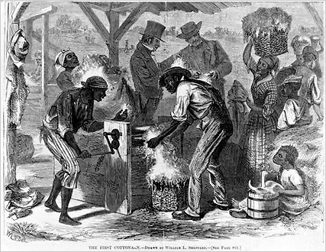
1. Slavery
While many of the nation’s founding fathers disliked slavery, and hoped that later generations would find a way to end it, their sons and grandsons began to defend slavery as a necessary good and began infringing on the rights of those who spoke out against it in the South.
Slaves preparing cotton for ginning

Slide 5
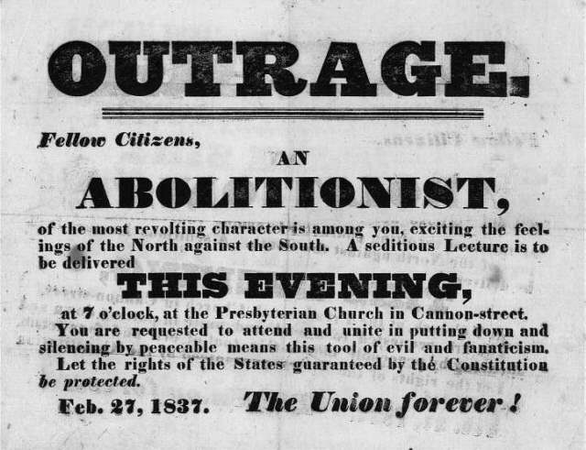
To what Northern feelings against the South is it referring? What is meant by “rights of the states”? What do you think are the beliefs of an abolitionist?

Slide 6
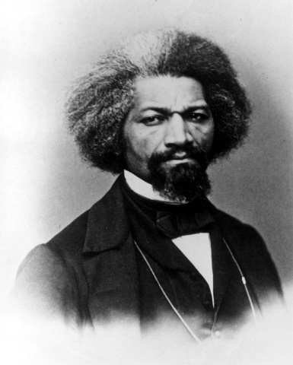
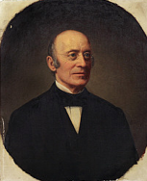
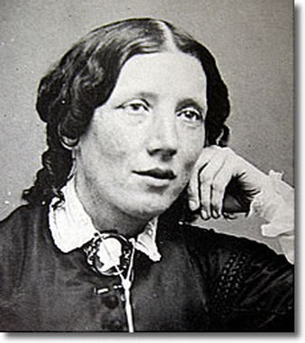
1. Slavery
Many in the North, led by abolitionists such as Frederick Douglass, William Lloyd Garrison, and Harriet Beecher Stowe, began to despise slavery and call for its end or the stop of expansion into new territories.

Slide 7
Abolitionists were against slavery.
Read the quotes on the following slides. Determine whether the person would be considered an abolitionist.

Slide 8
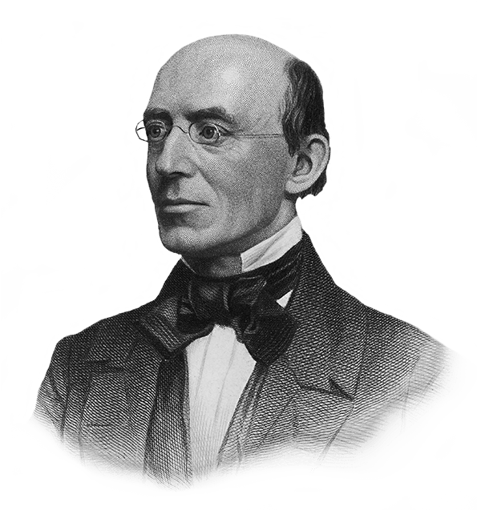
William Lloyd Garrison
“Wherever there is a human being, I see God-given rights inherent in that being, whatever may be the sex or complexion.”
Abolitionist

Slide 9
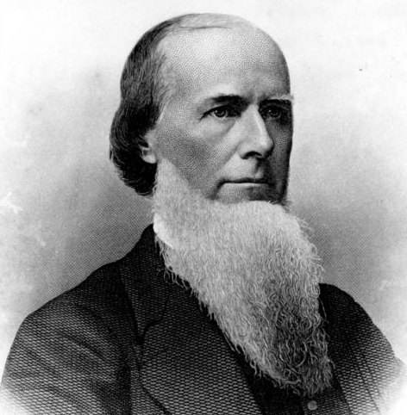
Joseph E. Brown
“What effect will the abolition of slavery have upon the interest and social position of the large class of non-slaveholders and poor white laborers in the South? Here would be the scene of the most misery and ruin. Probably no one is so unjust as to say that it would be right to take from the slaveholder his property without paying for it.”

Slide 10
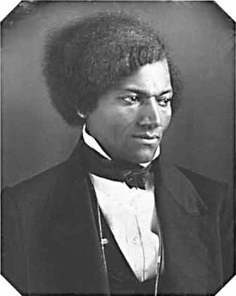
Frederick Douglass
“What to the American slave is your Fourth of July? I answer a day that reveals to him more than all other day of the year, the gross injustice and cruelty to which he is the constant victim. To him your celebration is a sham; your boasted liberty an unholy license; your national greatness, swelling vanity; your sound of rejoicing are empty and heartless; your shouts of liberty
and equality, hollow mock...”
Abolitionist
https://www.youtube.com/watch?v=wkH2Ck-gH0I

Slide 11
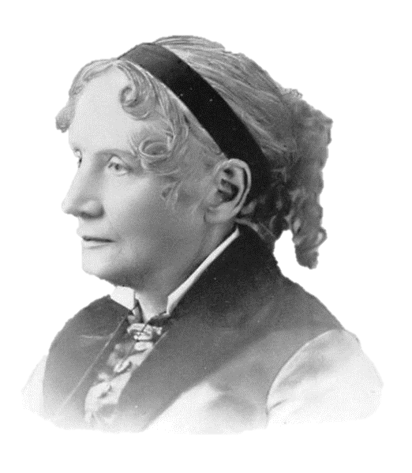
Harriet Beecher Stowe
“It’s a matter of taking the side of the weak against the strong, something the best people have always done.”
Abolitionist

Slide 12
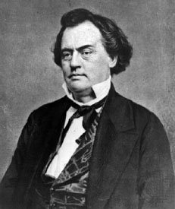
Robert Toombs
“The basis, the cornerstone of this government, was the perfect equality of the free, sovereign , and independent states which made it.”

Slide 13
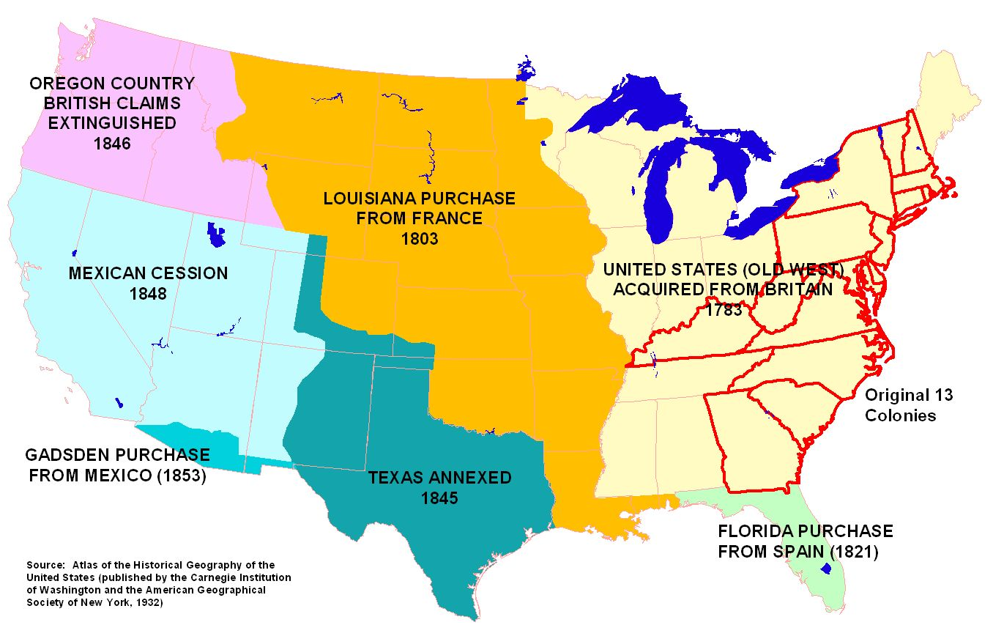
New territories
The South wanted slavery in new territories. The North wanted to contain slavery.

Slide 14
1. Slavery
The South hoped for slavery to expand into the new territories.
Many in the North wanted it, at the very least, to be contained to where it already existed.
As with the other slave states, Georgia wanted slavery to expand and was distrustful of the abolitionist movement taking place in the North.

Slide 15
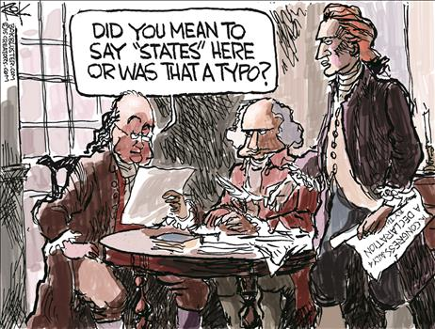
2. States’ Rights <<<< Major Issue

Slide 16
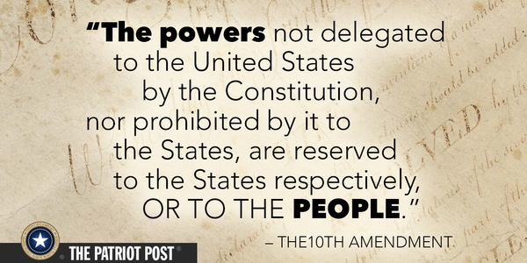
2. States’ Rights
States’ rights regard the amount of power a state government has in relation to the amount of power held by the federal government in making decisions.

Slide 17
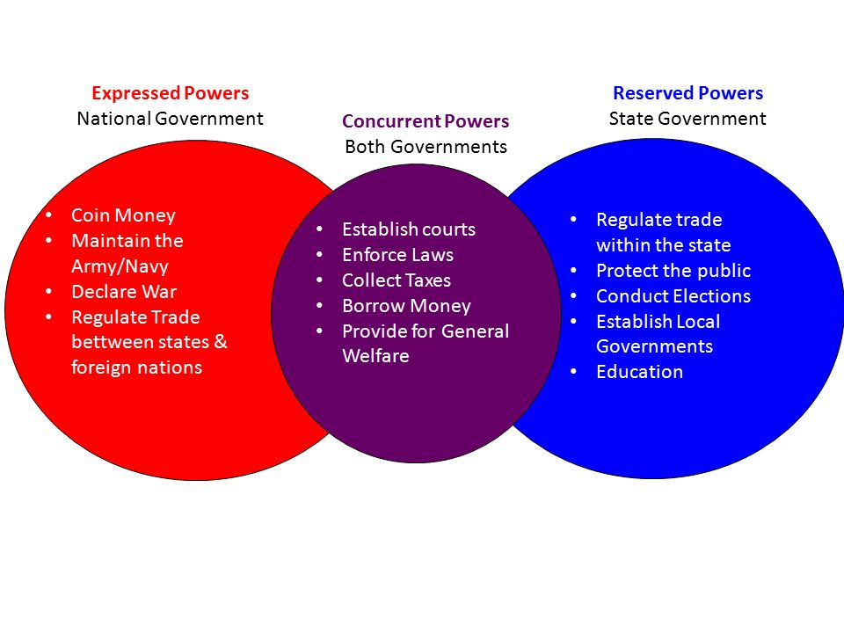

Slide 18
2. States’ Rights
Early in the United States’ history, the Articles of Confederation gave the individual states too much power and the nation could not even tax the states for revenue.
All of the signers of the U.S. Constitution knew that the federal government needed to have more power than it had under the Articles of Confederation to run the country effectively.

Slide 19
2. States’ Rights
Before and during the Civil War, states’ rights arguments were mostly based on the right to have slavery, although there were other issues.
For example, during the War of 1812 there was talk in New England about secession(Hartford Convention). Federalist party members in New England were unhappy about government regulation of economy, involvement in war (hurt trade), and wanted to prohibit election of two successive presidents from the same state- (“Virginia dynasty”)

Slide 20
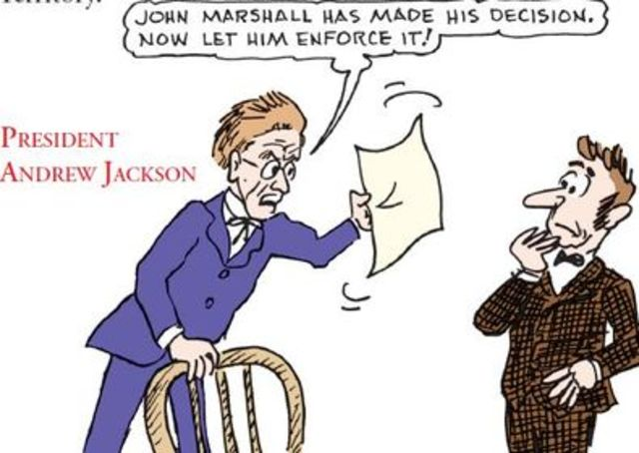
Another states’ rights issue occurred in Georgia. Georgia lost the Worcester v. Georgia (1832) case but refused to release the missionaries or stop pushing for Cherokee removal. This proved that a state could do as it pleased if there was not a unified attempt to by the federal government or other states to stop them.
“Defining Ideas in Context: States’ Rights” small group activity
https://app.discoveryeducation.com/learn/videos/37006fbf-350e-4e35-83c1-67eb0a6f48a5?hasLocalHost=true

Slide 21
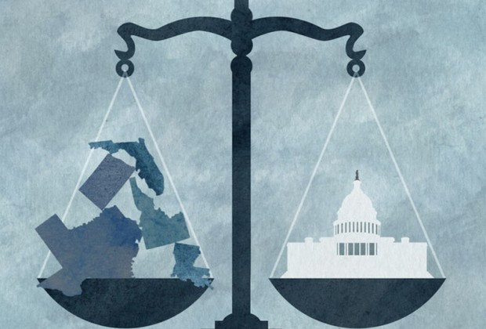
Current events Edition-
States’ rights vs. Federal rights
-Voter registration (Voting Rights Act- voting fraud in 2016)
-State insurance rules (health care)
-Marijuana legalization
-Same-sex bathrooms

Slide 22
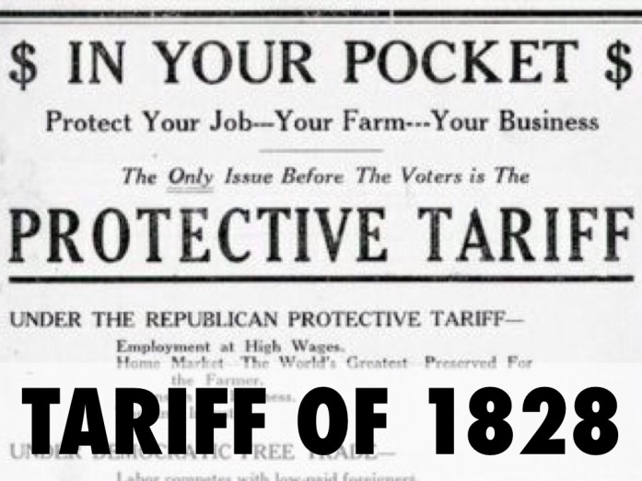
3. Nullification
Nullification meant that states could nullify, or void, any federal law thought to be unconstitutional
A states’ rights issue, the nullification crisis in the early 1830’s, was a dispute over tariffs (a tax or duty to be paid on imports/exports).
The "Tariff of Abominations" was a protective tariff passed by the Congress of the United States on May 19, 1828, designed to protect industry in the northern United States.
https://www.youtube.com/watch?v=VNgIUUD7i-A

Slide 23
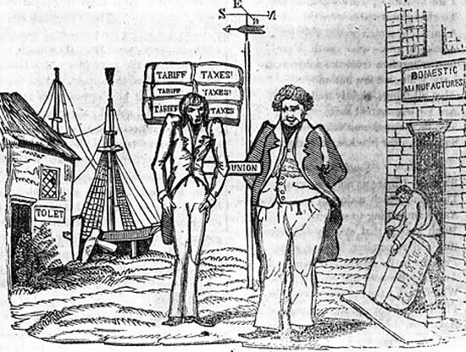
The North supported high tariffs that subsidize (support) their growing manufacturing industry against the cheaper products that could be sent to the U.S. by Britain.
The South opposed these tariffs because they took away profits from cotton farmers based on Britain’s retaliatory (revenge) tariff on cotton.
Cartoon drawn during the nullification controversy showing the manufacturing North getting fat at Southern expense.
https://www.youtube.com/watch?v=VNgIUUD7i-A

Slide 25
3. Nullification
When the Northern states, who dominated the House of Representatives, voted to renew the tariff, South Carolina threatened to nullify the tariff and even possibly secede.
However, Andrew Jackson’s threat to attack South Carolina if they attempted to leave the union worked well enough to keep the state in the fold for the time being.
https://www.youtube.com/watch?v=TK8PHLLdO2k
http://www.carolana.com/SC/1800s/antebellum/nullification_crisis.html
Political Cartoon and Further Reading)

Slide 26
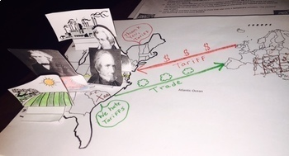
Nullification pop- up activity
Read all directions first. You will need to draw/write things on Jackson and Clay before you cut them out!
My sample is on the rolling cart.

Slide 27
Nullification Argument Cheat Sheet
States’ Rights
If the laws Congress passes violate our liberties and constitutional rights…
Then we have the right to ignore/invalidate the laws
Tariff of Abominations (1828)
This tax directly affects our ability to support ourselves and make money, which are basic rights….
Therefore, we should not have to pay it.
Slavery
IF the government does not allow slavery, They are attacking our economy and lifestyle, which are basic civil rights…
Therefore, we should not have to listen to the government if they want to take away our “right” to slavery

Slide 28
The issues of slavery, tied with the concept of states’ rights, left a huge rift in the country. Controversy after controversy widened this gap, and for almost 40 years, members of the U.S. Congress tried to close wounds with compromises and acts that amounted to temporary Band-Aids. Though these acts and compromises kept the country together in the short term, as Abraham Lincoln said “A house divided against itself cannot stand.” Over time, a physical war between the North and South appeared to be almost inevitable.

Slide 29
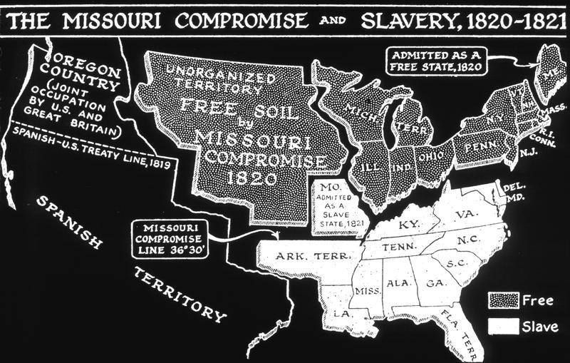
4. Compromises- Missouri Compromise (1820)
In an effort to preserve the balance of power in Congress between slave and free states, the Missouri Compromise was passed admitting Missouri as a slave state and Maine as a free state. Furthermore, with the exception of Missouri, this law prohibited slavery in the Louisiana Territory north of the 36° 30´ latitude line.

Slide 30
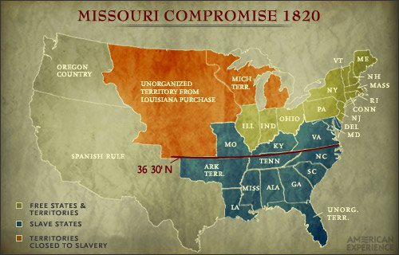
Color in map on worksheet

Slide 31
What is the difference between a free state and a slave state?
Why would it matter if new territories were admitted at slave or free states?

Slide 32
4. Compromises- Compromise of 1850
California, due to the Gold Rush, had a population large enough to apply for statehood in 1850. With no slave state available to balance the entry of a free one, major conflict ensued between the North and South.
The South, which had a smaller population than the North, was fearful that losing the balance of power in the Senate would one day give the North the opportunity to end slavery.
Talk of secession was prevalent in the South and the Civil War almost started a decade earlier than it did. However, Senators Henry Clay and Stephen A. Douglas wrote the Compromise of 1850, a bill that both groups grudgingly agreed to approve.

Slide 33
4. Compromise of 1850
California was admitted as a free state resulting in a power imbalance in both the House and Senate.
In turn, Northern Congressmen agreed to pass the Fugitive Slave Act, which guaranteed the return of any runaway slaves to their owners if they were caught in the North.
There was much protest in the North to this act but the southern leaders believed it would protect the institution of slavery.

Slide 34
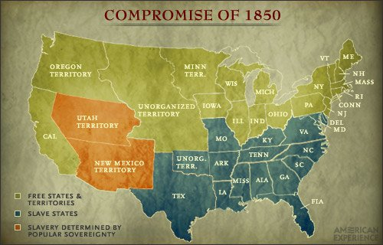
Color in map on worksheet and answer questions

Slide 35
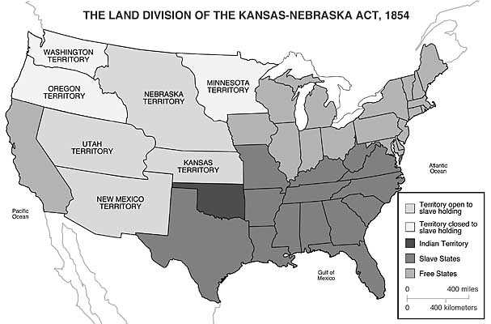
Compromise of 1850 https://www.youtube.com/watch?v=e_c_xpBaT2A

Slide 36
5. Georgia Platform
While debate over the Compromise of 1850 was raging in Congress, prominent Georgia politicians were deciding if the state should accept the terms of the Compromise.
If passed, it would give the free states more representation in the US Senate and end the balance of power that had been established for 30 years.

Slide 37
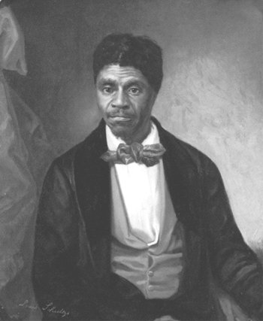
5. Georgia Platform
Led by Alexander Stephens, Robert Toombs, and the promise of the passage of the Fugitive Slave Act, Georgia provided a response to the Compromise of 1850, known as the Georgia Platform.
This document outlined southern rights as well as the South’s devotion to the Union. It established Georgia’s conditional acceptance of the Compromise of 1850. With Georgia leading the way, other southern states also accepted the Compromise preventing a civil war for 11 years
http://www.troup.org/userfiles/929/My%20Files/Social%20Studies/8SS/civil_war/policies_key_issues/Dred%20Scott%20Decision%20African%20American%20Voices.pdf?id=19529

Slide 38
4. Compromises: Kansas-Nebraska Act (1854)
The act repealed the Missouri Compromise and made it possible for slavery to be allowed above the 36° 30° parallel. This angered Northern states
Sen. Stephen Douglas believed in popular sovereignty- residents would vote on being a slave state.
Since Kansas was being considered for statehood, it was flooded by pro and anti-slavery supporters who came to the state to vote for or against slavery. Violence erupted between the two sides (“Bleeding Kansas”)
In the end, Kansas was admitted as a free state
The act greatly divided the nation and destroyed the other two attempts of compromise. It also allowed for the rise of the Republican Party (Former Whig Party)
https://www.youtube.com/watch?v=oWww0YIf-JE

Slide 39
6. Dred Scott Case (1857)
Dred Scott Trial Script 2018.pdf
The Dred Scott Case (1857) ended in a Supreme Court ruling that greatly favored the southern view of slavery and lead to a greater ideological divide between the North and South.
Dred Scott was a slave who was taken by his master to the free states of Illinois and Wisconsin. Upon his return to Missouri, Scott sued the state based on the belief that his time spent in the free states made him a free man. When the case made it to the Supreme Court, the court ruled on the side of Missouri (slavery).
http://www.troup.org/userfiles/929/My%20Files/Social%20Studies/8SS/civil_war/policies_key_issues/Dred%20Scott%20Decision%20African%20American%20Voices.pdf?id=19529

Slide 40
6. Dred Scott Case (1857)
https://www.youtube.com/watch?v=9j3lKSs2ZoA
The Court went on to declare that
Slaves and freed blacks were not citizens of the United States and could not legally sue.
Slaves were property
Congress could not ban slavery from territories
The Missouri Compromise (and other legislation limiting slavery) was unconstitutional
https://www.youtube.com/watch?v=OML9AVR10PQ

Slide 41
7. Lincoln’s Election in 1860
The final situation that plunged the United States into the Civil War was Abraham Lincoln’s election in 1860.
Due to the dramatic sectionalism that was dividing the country, four presidential candidates ran for office in 1860. These men were Abraham Lincoln, John Breckenridge, John Bell, and Stephen Douglas.
Because of the issue of slavery, Northern and Southern Democrats split into two parties with the nominee for the North being Stephen Douglas and the nominee for the South was John Breckenridge.
Lincoln election_1860_map_prediction.pdf
Lincoln election_1860_political_cartoon_webquest.docx

Slide 42
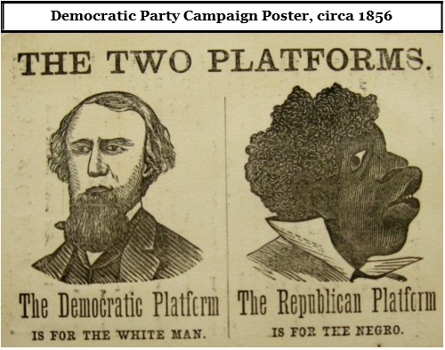
7. Lincoln’s Election in 1860
John Bell was the candidate for the Constitutional Union Party whose primary concern was to avoid secession.
Lincoln was the nominee of the Republican Party, a party that began in 1854 and whose primary goal was to prevent the expansion of slavery.

Slide 43
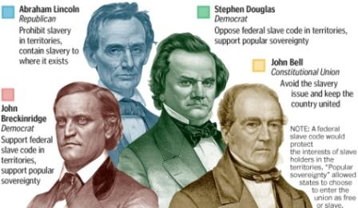
7. Lincoln’s Election in 1860
Georgia would ultimately stand with candidate John Breckenridge. Lincoln was not on the ballot in Georgia; this was seen in most southern states

Slide 44
Lincoln-Douglas Debates (1858) (not in notes)
These debates between Abraham Lincoln and Stephen Douglas, sponsor of the Kansas-Nebraska Act, were primarily over the issue of slavery. The debates forged Lincoln into a prominent national figure and solidified his Republican Party’s antislavery platform.

Slide 45
7. Lincoln’s Election in 1860
Lincoln won the election of 1860 with 180 electoral votes (152 electoral votes were needed to win at that time).
After the election, the southern states, believing that Lincoln’s ultimate goal was to end slavery, voted one by one to secede from the Union. Georgia, after a three-day debate, voted to leave the Union on January 19, 1861.

Slide 46
8. Secession Debate in GA
In 1861, there was a spirited debate over secession in the Georgia General Assembly to determine if Georgia should join its southern brethren in breaking away from the Union.
Though there were strong supporters for both sides of the issue, Georgia eventually seceded from the Union after several other southern states.
Georgia was part of the Confederacy from 1861-1865.

Slide 47
8. Secession Debate in GA
During the debate, there were those who did not want to leave the Union, including representatives from the northern counties, small farmers and non-slave holders, and most importantly Alexander Stephens, who gave an eloquent speech against secession.
Stephens was elected Vice President of the Confederacy in February 1861 and served until his arrest on May 11, 1865.

Slide 48
8. Secession Debate in GA
On the other side (pro-secession), were large farmers and slave holders, Georgia Governor Joseph E. Brown, and powerful and influential men such as Robert Toombs, who had a social and economic stake in the continuation of the institution of slavery.
In an early vote for secession, the Assembly was split 166 to 130 in favor of secession. However, in the end, the General Assembly voted 208 to 89 in favor of seceding from the union.

Slide 49
Other events- Uncle Tom’s Cabin
Harriet Beecher Stowe’s novel Uncle Tom’s Cabin (1852) Published in response to the Fugitive Slave Act of 1850, it had sold two million copies worldwide within two years of being published. After the Bible, Uncle Tom’s Cabin was the highest selling book of the 19th century. President Lincoln read Uncle Tom’s Cabin before announcing the Emancipation Proclamation in 1862, and when he met Stowe, he exclaimed, “So this is the little woman who started this great war!”

Slide 50
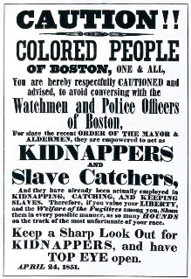
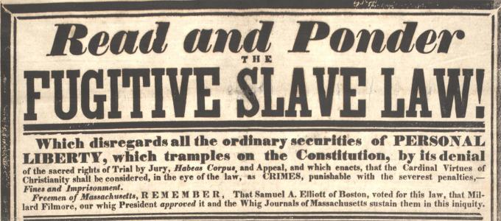
Other-Fugitive Slave Act (1850)
Included in Compromise of 1850
Slaves were not allowed a jury trial- couldn’t testify. Courts only needed a statement from slave owner
People who let slaves escape or helped them could be fined $1,000 and jailed- includes law enforecment
Slaves could be recaptured anywhere; angered North
Incentive: Judges received $10 for sending slaves back to their owners; $5 for freeing slaves

Slide 51
Other Events- John Brown’s Raid
John Brown’s Raid (1859) John Brown and 22 other men raided the town of Harpers Ferry, Virginia, hoping to arm and free slaves. Brown and his raiders captured many of the town’s most important citizens and held them hostage. Within 24 hours, Brown was captured and convicted of treason, murder, and conspiracy to incite slave rebellion. He was hanged that December.

