Slide 1
Georgia’s History:
Civil
Rights
SS8H11

Slide 2
Civil Rights
Throughout the US’ history, many African Americans were treated like second-class citizens, especially in the South.
They were forced to live in segregated housing, attend segregated movies, and use segregated facilities such as restrooms, water fountains, and waiting rooms.
During the Civil Rights Movement, African Americans fought against racial discrimination and segregation.

Slide 3
1940s & 1950s:
Civil
Rights
SS8H11a

Slide 4
Brown v. Board of Education
1954
Unanimous decision by U.S. Supreme Court
Racial segregation violates the equal protection clause of the U.S. Constitution
Segregationist politicians vowed NOT to integrate Georgia’s schools
Georgia General Assembly supported massive resistance.

Slide 5
1956 Flags Controversy
1956 – Georgia adopts flag with Confederacy symbol as a reaction to Brown decision. Many tried to get this flag changed, especially at height of civil rights movement.
This 1956 flag represented Georgia from 1956 to 2001 (including the 1996 Olympics) when a new flag was finally adopted; still contained small scale of Confederate flag.
Current flag adopted in 2004.

Slide 6
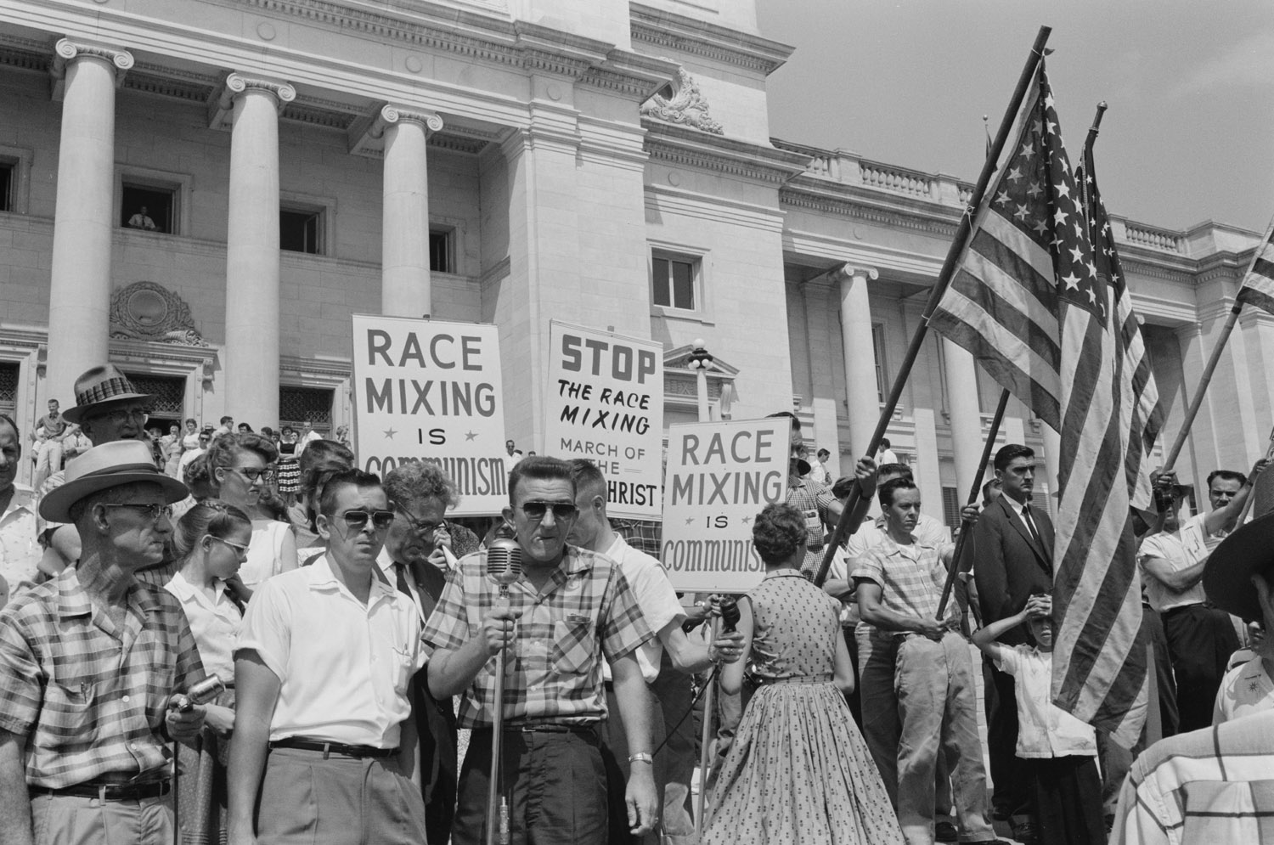
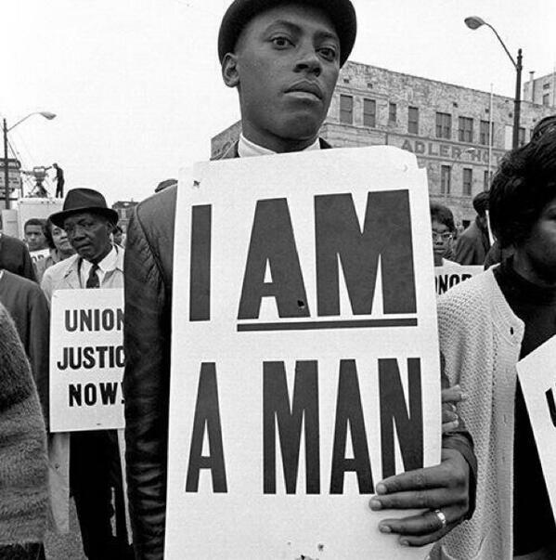
© 2015 Brain Wrinkles

Slide 7
Sibley Commission
1960: Sibley Commission formed (by governor) to ask citizens for input about desegregation.
John Sibley (led commission) wanted segregation BUT felt that fighting desegregation was a hopeless cause.
Commission’s findings: 60% of Georgians would rather close the schools than integrate.
In spite of the results, Sibley pushed for limited desegregation.
Legislature was set to vote but federal order to desegregate UGA happened.

Slide 8
Martin Luther King, Jr.
Most well-known Georgian for his tireless leadership in the Civil Rights Movement.
His work and devotion to non-violent protest against unfair laws earned him the Nobel Peace Prize and led to the national holiday created in his honor.
Graduated from Morehouse (historically black college) with a Ph.D. and became an ordained minister.
Believed that African Americans could gain their rights by protesting, but that the protests should be peaceful.

Slide 9
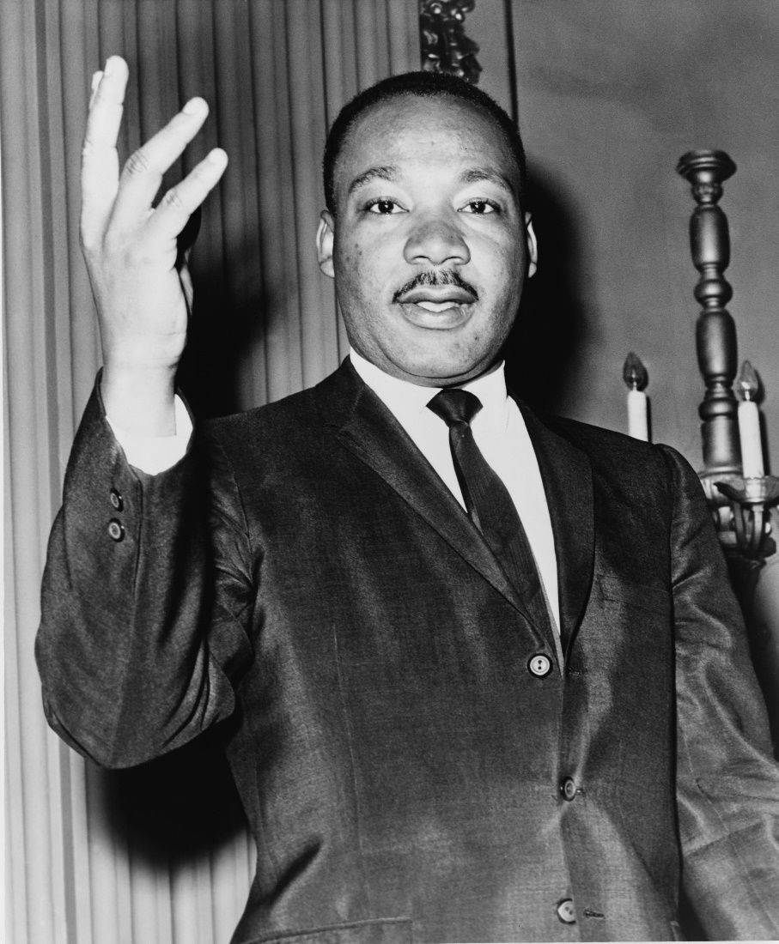
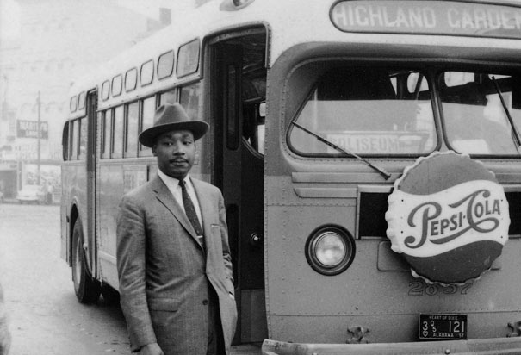

Slide 10
Martin Luther King, Jr.
Became a national hero and the recognized leader of the Civil Rights Movement after leading the Montgomery Bus Boycott.
The Boycott ended when the Supreme Court ordered Montgomery to desegregate their public transportation.
After the success in Montgomery, King attempted a similar process in Albany, GA that was less successful

Slide 11
Nonviolent Protests
King believed that African Americans would win their rights quicker if they refused to engage in violence.
Many African Americans and some whites held nonviolent marches and boycotts across the country.
At times, the nonviolent actions from civil rights workers received violent reactions from white people.
As people around the nation saw peaceful protestors being beaten by angry mobs and policemen, the movement gained support.

Slide 12
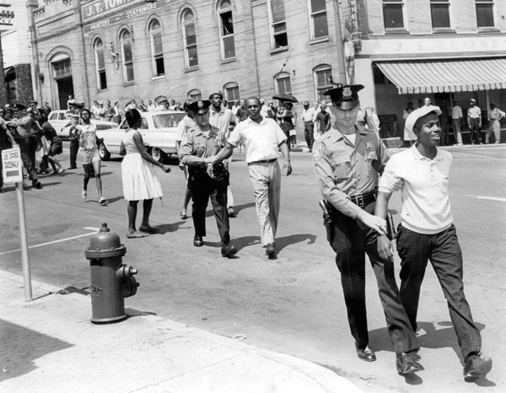
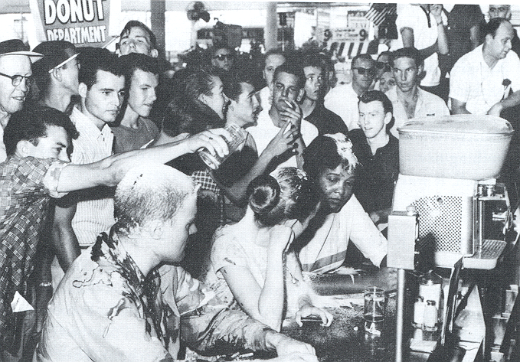

Slide 13
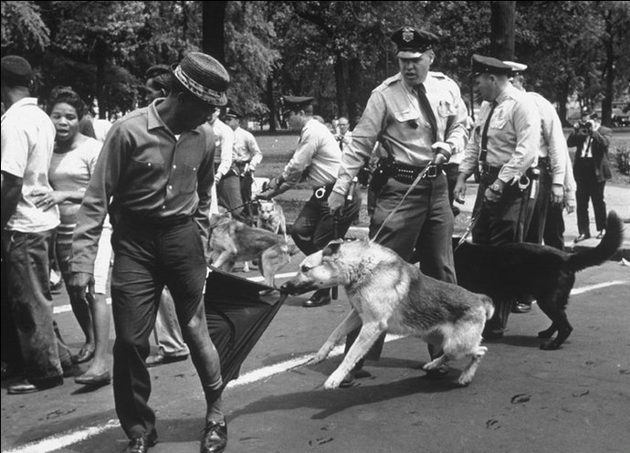
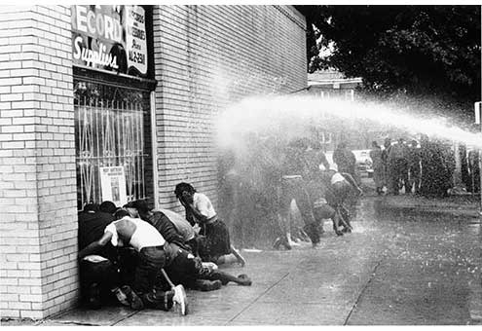

Slide 14
1960s & 1970s:
Civil
Rights
SS8H11bc

Slide 15
U.S. Rep. John Lewis
Civil Rights leader; Chairman of the Student Nonviolent Coordinating Committee (SNCC)
1960’s: Participated in sit-ins and Freedom Rides (to protest Jim Crow laws)
Spoke with MLK at 1963 March on Washington for Jobs and Freedom
1965: led 600 marchers in Selma, Alabama and was met with violence by state troopers (“Bloody Sunday”)

Slide 16
U.S. Rep. John Lewis
POLITICS: Promoted voter registration, volunteer programs, ethics in gov’t, community preservation
Elected to Atlanta City Council in 1981
1986-present, Serves in Congress

Slide 17
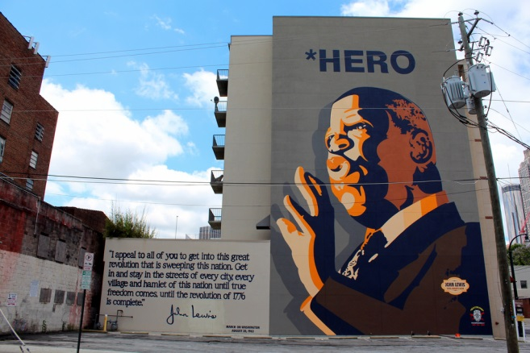
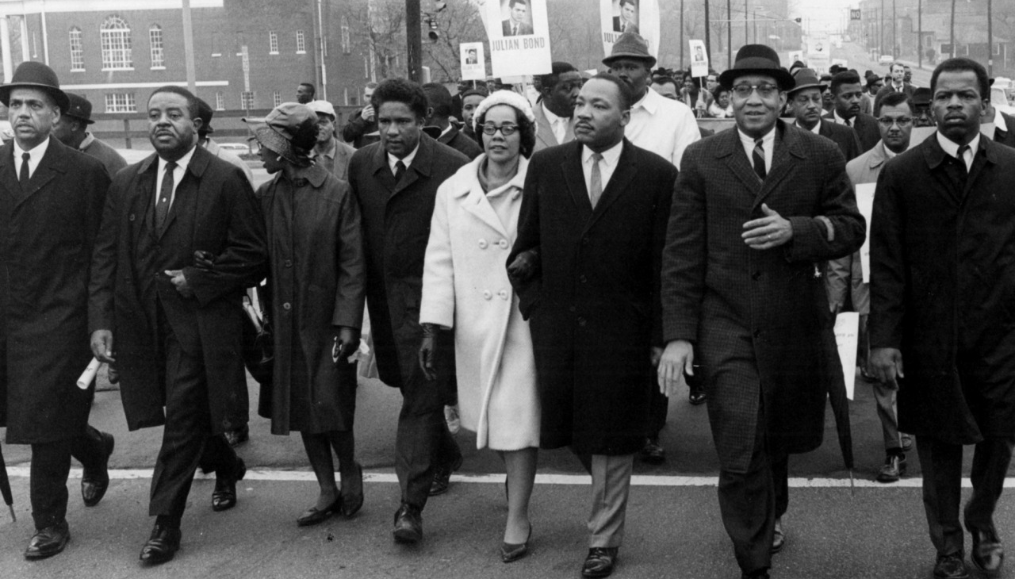
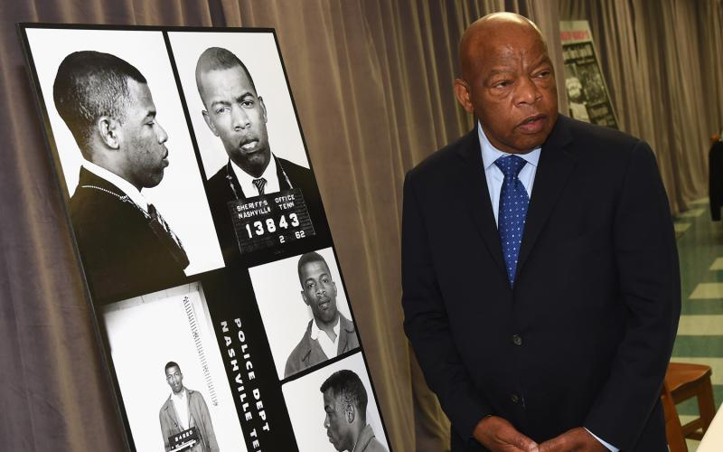
“Atlanta - John Lewis, (far right), Dr. Martin Luther King Jr. (third from right), his wife Coretta Scott King, Ralph David Abernathy (second left), lead march from Atlanta University (now Clark Atlanta U., ed.) to the Georgia state Capitol. (Hugh Stovall/AJC staff) 1966.”
Although not in the caption information this photo was shot on January 14, 1966, a cold day in Atlanta. The marchers were protesting the Georgia House of Representatives’ refusal to seat newly elected Representative Julian Bond because of his views on the Vietnam War and the draft. Bond was not seated until the following year

Slide 18
SNCC (snick)
King’s strategy of peaceful protest was adopted by a group of college students who formed the Student Non-Violent Coordinating Committee (SNCC) in 1960; John Lewis acted as chairman
Worked with Southern Leadership Conference and known for orchestrating peaceful, non-violent protests: lunch counter sit-ins, freedom rides, and the “freedom summer” in Mississippi
SNCC was known for leading the “Albany Movement” in Georgia
Promoted voting rights and helped African Americans gain seats in the General Assembly reapportionment election

Slide 19
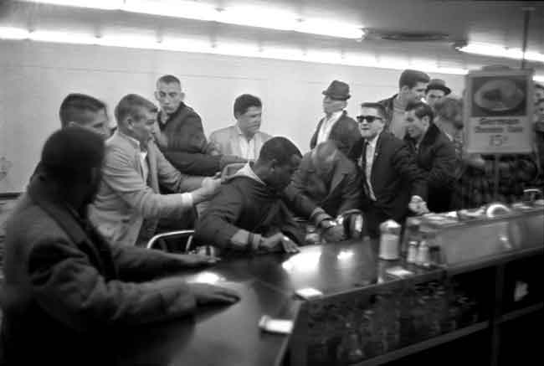
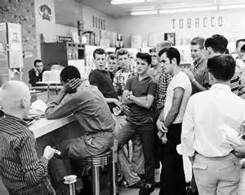

Slide 20
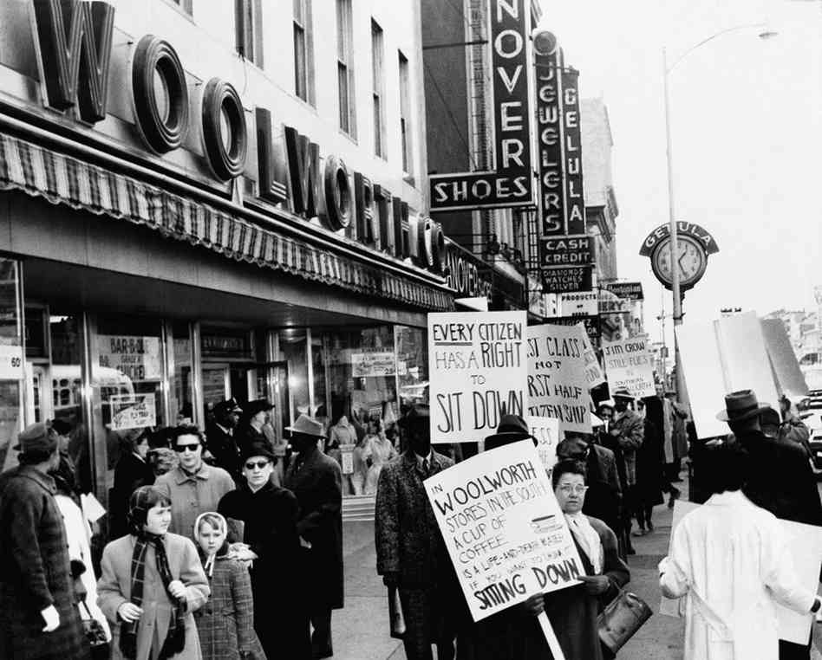
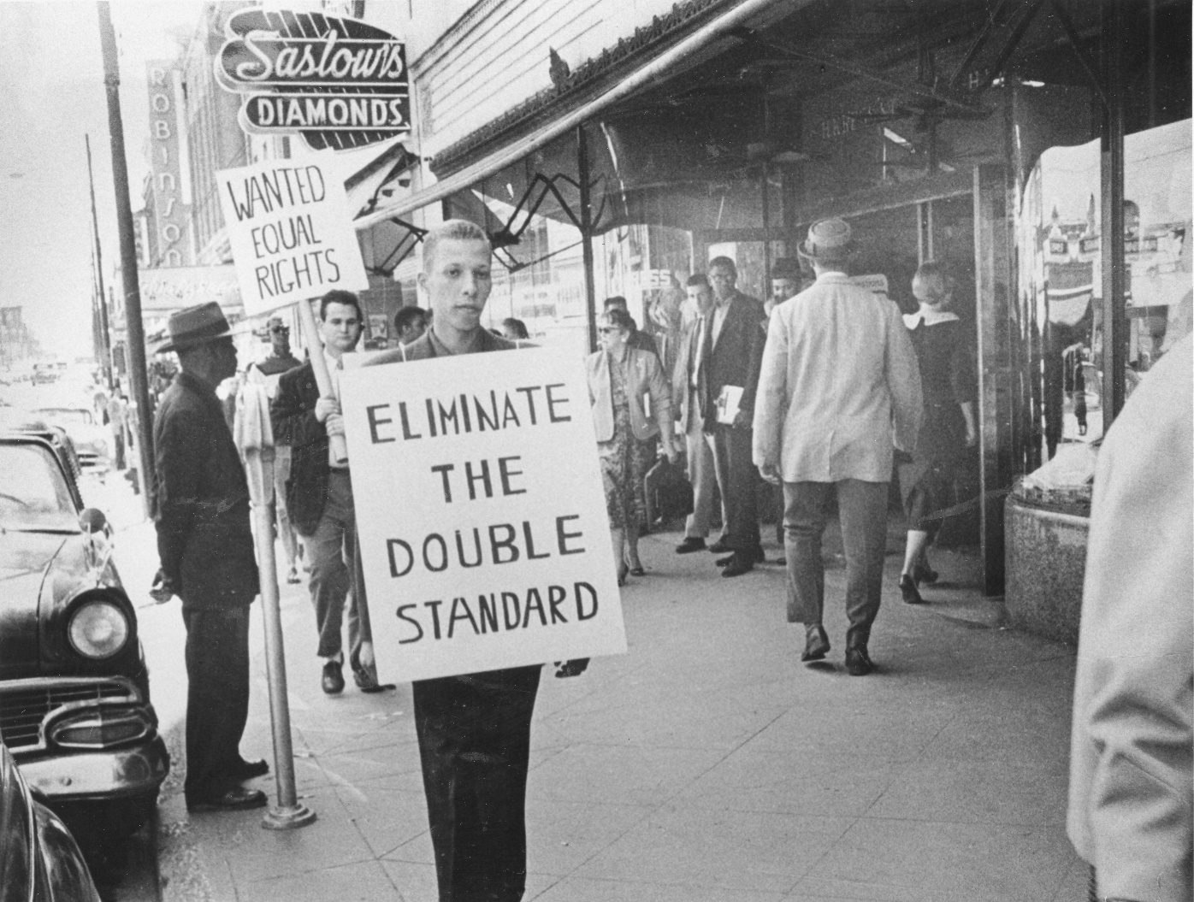

Slide 21
Southern Christian Leadership
Conference (SCLC)
Led by MLK and created in 1975 in response to the Montgomery Bus Boycott; supported by religious leaders and headquartered in Atlanta
To end segregation, SCLC filed class-action lawsuits against the federal government, planned rallies, marches, and boycotts.
Organized protests (Albany Movement) and opportunities for economic improvement of African Americans
Today, the SCLC focuses on healthcare, prison reform, fair treatment of refugees, and job site safety

Slide 22
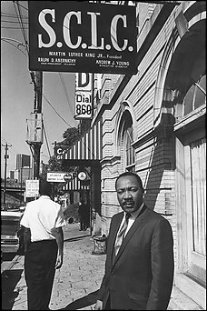
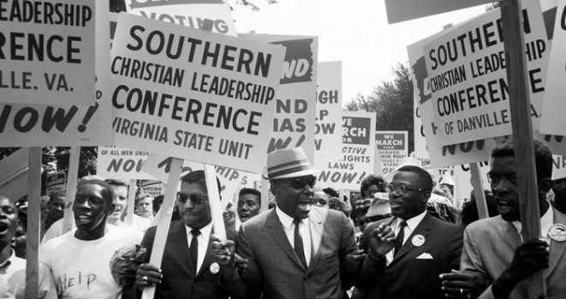
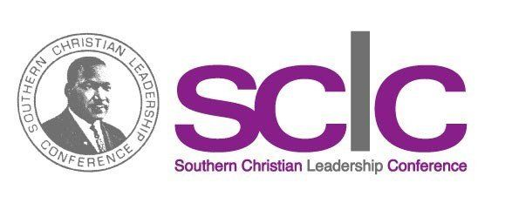

Slide 23
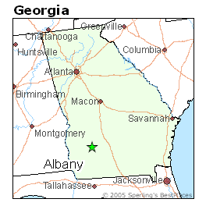
Albany Movement
From fall 1961 to summer 1962, a desegregation movement involving the NAACP and SNCC took place in Albany, Georgia.
The movement’s goal was to end all types of segregation in Albany (transportation, schools, libraries, hospitals, restaurants, juries, etc.) through mass protests, sit-ins, and boycotts.
The police wanted to avoid negative publicity, so they over 500 protestors.

Slide 24
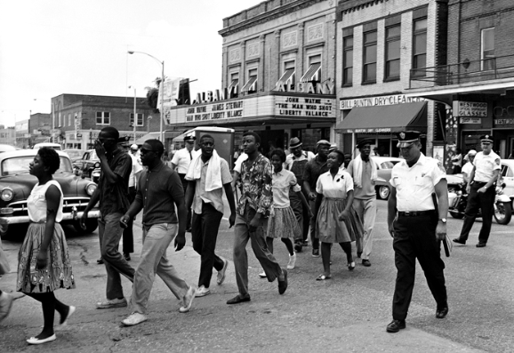
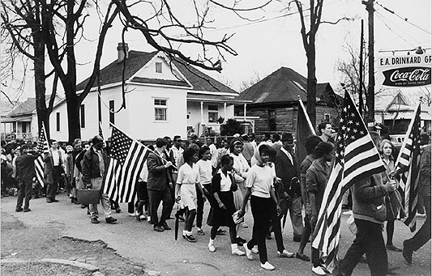

Slide 25
Albany Movement
MLK, Jr. came to Albany to lend his support and bring national attention to the cause; however, he was also arrested.
Desegregation efforts failed in Albany, and King said it was because the groups tried to do too many things, instead of focusing on one aspect of segregation.
It was considered more of a learning experience than a success, but the city did eventually desegregate.

Slide 26
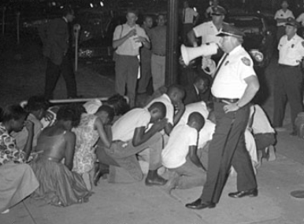
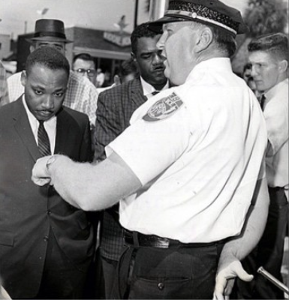

Slide 27
March on Washington
In 1963, Martin Luther King, Jr. led more than 250,000 people on a civil rights march in Washington, D.C.
They called on President Kennedy and Congress to pass a law that guaranteed equal rights and quality education for all citizens.
King gave his famous “I Have a Dream” speech at the gathering, inspiring Americans to strive for a world where black and white children could play together in peace.
Civil Rights Act was passed in 1964 because of this protest.

Slide 28
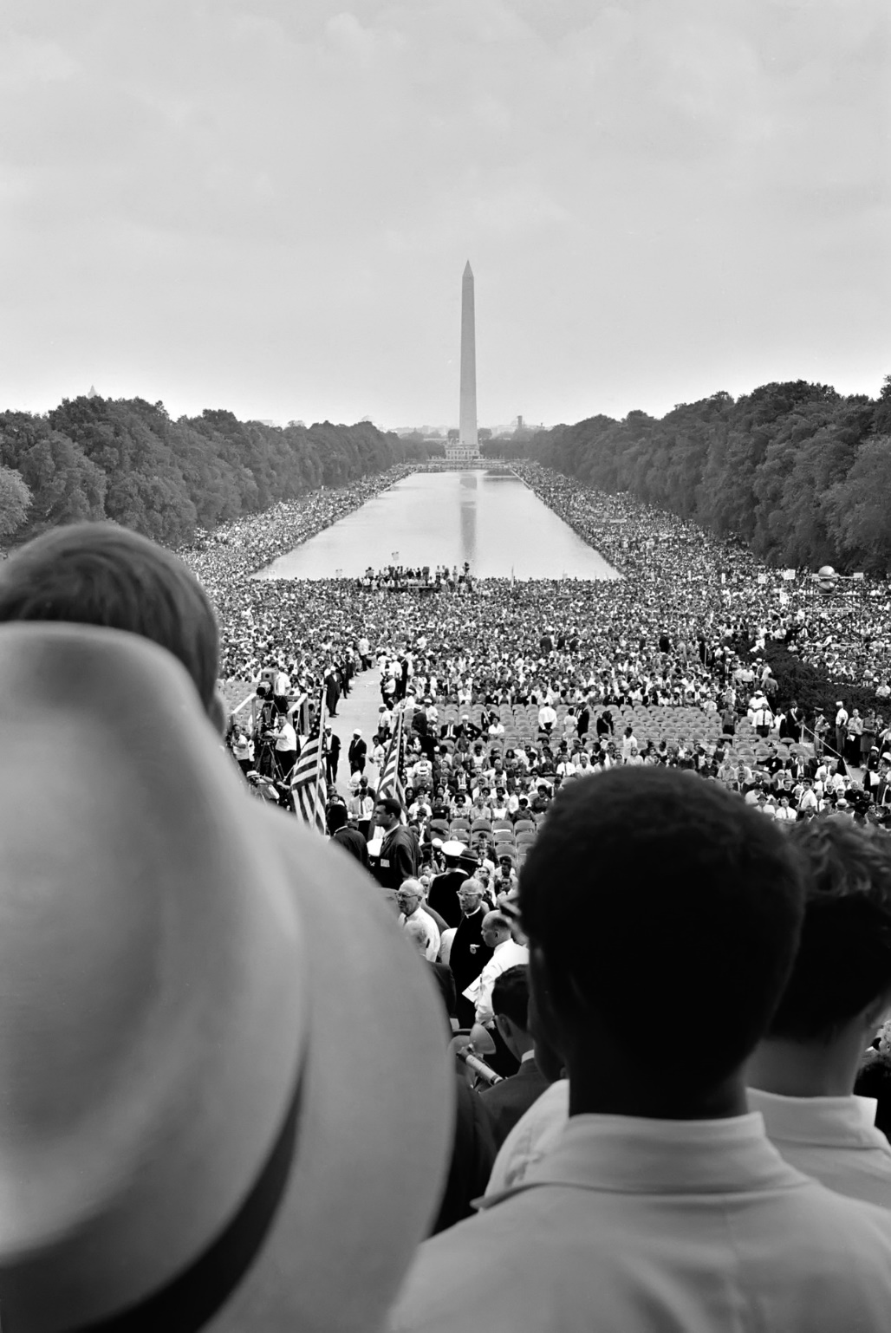
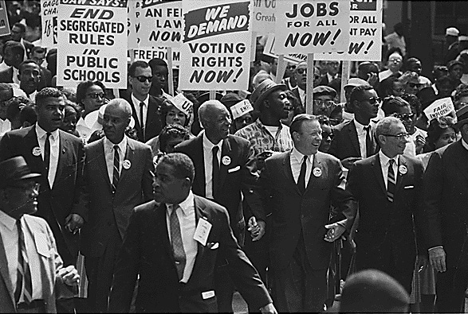

Slide 29
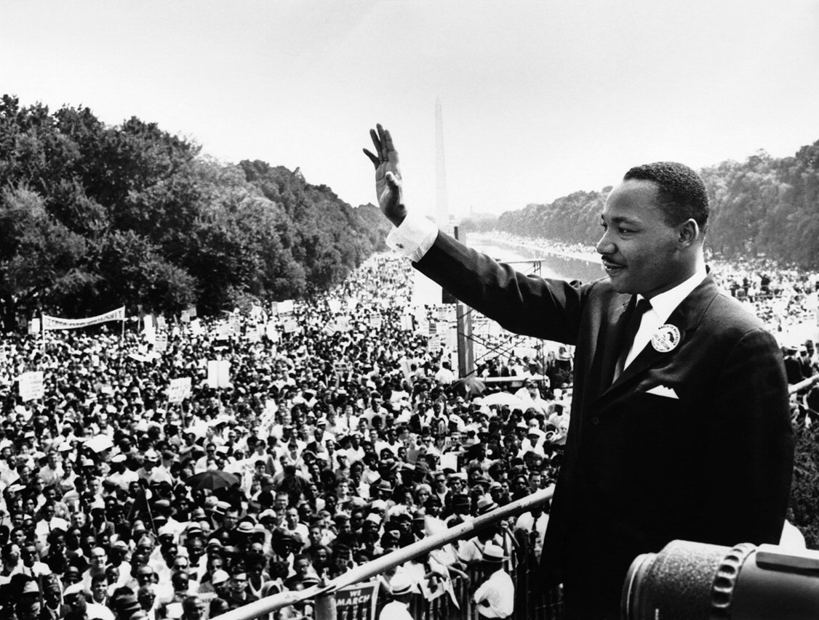
“I have a dream that my four little children will one day live in a nation where they will not be judged by the color of their skin but by the content of their character.”
Martin Luther King, Jr.

Slide 30
Civil Rights Act
The March on Washington got the government’s attention and Congress soon passed the Civil Rights Act in 1964.
This law banned discrimination against any American because of that person’s race, color, or religion.
The law enforced the desegregation of public places.
It also said that people of all races, male and female, should have the equal opportunity to get a job.
Voting Rights Act of 1965:aimed to overcome legal barriers at the state and local levels that prevented African Americans from exercising their right to vote

Slide 31
Civil Rights Act
Voting Rights Act of 1965:aimed to overcome legal barriers at the state and local levels that prevented African Americans from exercising their right to vote; considered one of the most sweeping laws to protect civil rights.

Slide 32
Lester Maddox
Strong segregationist
Opened the Pickrick Cafeteria near Georgia Tech; refused to serve African-Americans
Openly defied the Civil Rights Act of 1964; caused him national exposure when he chased three African-Americans out of his restaurant with a gun
Closed the restaurant rather than integrate as ordered by a federal court

Slide 33
Lester Maddox
Became governor of Georgia in 1966
Ironically, Maddox appointed more African-Americans to government positions than all prior Georgia governors combined.
Received support of both whites and blacks alike due to his “little people’s days.”
Criticized for not allowing flags at state buildings to be flown at half-mast after the death of Martin Luther King, Jr.
Due to term limits, he ran, and won, the office of Lieutenant Governor, serving with Jimmy Carter.

Slide 34
Civil Rights Era Choice Board
D
Choose ONE activity. Illustrations must have color. Don’t forget about the 3 Governors or Flag controversies!
A. Design a time capsule on your paper. Inside, draw 10 items that would help someone in the future learn about the Civil Rights Movement. On the back, summarize the importance of the items. | B. Write a series of 3 journal entries as if you were an African American student living through the historical events of this time period. Describe your thoughts and feelings of the events that are occurring around you. | C. Write 20 test review questions about the Civil Rights Movement. Be sure to write their answers on the back of your paper. | D. Write a poem or song about any major event or significant person from the Civil Rights Movement. (at least 4 stanzas and one repeated refrain)
E. Create an illustrated timeline of the significant events of the Civil Rights Movement. (include at least 10 events, stick people OK but include relevant details) | F. Fold a piece of paper into 8 different sections. Design 8 frames to depict the historical events that occurred during this time period. Color your storyboard! | G. Conduct an interview with one of the leaders of the Civil Rights Movement. Include at least 5 good, thought-provoking questions and the person’s responses .. | H. Create trading cards for the important people of the Civil Rights Era . Include a picture (stick people OK-but include relevant details!) and 2-3 bullet points explaining the person’s importance to Georgia and the Civil Rights Movement

