Slide 1
Activating Strategy
Describe a technological development that has occurred in your lifetime. Explain how this technological development positively or negatively impacted your life or society.

Slide 2
Activating Strategy
What could be considered a technological development in Georgia in the time period after the American Revolution? Why?

Slide 3
How did technological developments after the American Revolution impact the growth of Georgia?

Slide 4
SS8H4c. Explain how technological developments, including the cotton gin and railroads, had an impact on Georgia’s growth.

Slide 5
Use your graphic organizer to summarize key information from the lesson.

Slide 6
During the late 1800s, tobacco was one of Georgia’s most important crops. However, it was destroying the soil.
Georgia was looking for alternative ways to make growing cotton profitable.

Slide 7
Until that point, cotton had to be, for lack of a better word, “deseeded” by hand.
This process took a long time to accomplish, and most farmers could not “clean” more than one pound of cotton a day.
https://www.youtube.com/watch?v=uXp-O6SIeyg

Slide 8
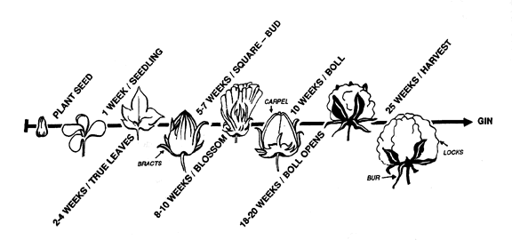
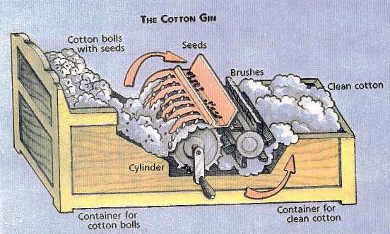
Until…the Cotton Gin

Slide 9
Invention of the Cotton Gin
According to some, the idea for the cotton gin was conceived by Eli Whitney, a northerner who moved to Georgia in 1793
The cotton gin was capable of removing the seeds from up to 50 pounds of cotton a day

Slide 10
Cotton Gin [select 1-2 videos]
Bill Nye's Greatest Inventions: The Cotton Gin (approximately 4 minutes)

Slide 11
Invention of the Cotton Gin
Due to the machine’s efficiency, the growth of cotton became profitable in Georgia and the rest of the South
This led to westward expansion as farmers began to seek out land capable of producing the crop

Slide 12
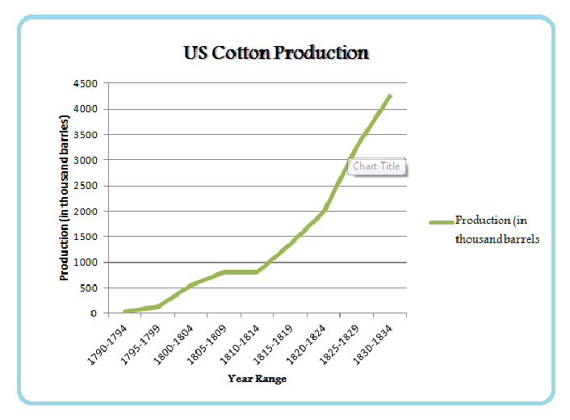

Slide 13
Think, Pair, Share
Describe a positive effect of the invention of the cotton gin on the development of Georgia.
What might be a negative effect of the invention of the cotton gin on the development of Georgia.

Slide 14
Negative Effects of the Cotton Gin
It made the South overly dependent on one crop
Due to its effectiveness, slavery increased in the South. Due to cotton’s profitability more slaves were needed in its production

Slide 15
Cotton Gin
The Growth of Slavery (approximately 7 minutes)

Slide 16
How did the cotton gin lead to the South’s defense of slavery?
Through the use of the cotton gin, cotton production became very profitable in Georgia. This led to an increase in slavery. Getting rid of slavery would cut into people’s profits and affect the state’s economy.

Slide 17
Think, Pair, Share
The phrase “King Cotton” is often used to describe Georgia’s agriculture during this time period. Turn to a partner and discuss why it is referred to as “King Cotton”?

Slide 18
Cotton Gin [select 1-2 videos]
The Invention of the Cotton Gin, 1793 (approximately 2 minutes)

Slide 19
Cotton Gin [select 1-2 videos]
Bill Nye's Greatest Inventions: The Cotton Gin (approximately 4 minutes)
The Invention of the Cotton Gin, 1793 (approximately 2 minutes)
The Growth of Slavery (approximately 7 minutes)

Slide 20
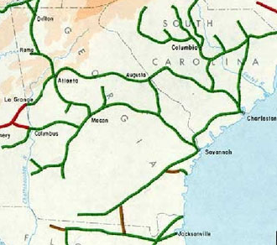
Think, Pair, Share
What do Atlanta, Augusta, Columbus, Macon, and Savannah all have in common?
Railroads

Slide 21
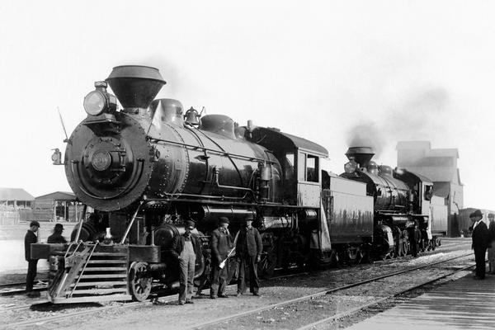
Railroads in Georgia
An important technological development that had a major impact on the state of Georgia was the invention of the railroad.
Many of Georgia’s cities and towns were created due to the railroad.

Slide 22
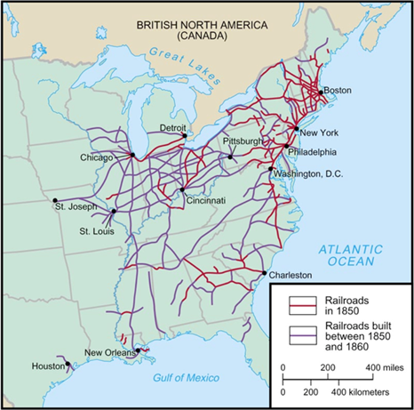
Railroads in Georgia
The first Georgia railroad was created to provide a better way to transport cotton to Augusta due to poor road conditions.
In the 1840s and 1850s, railroads had spread across much of the state
Georgia had the most miles of track in the Deep South

Slide 23
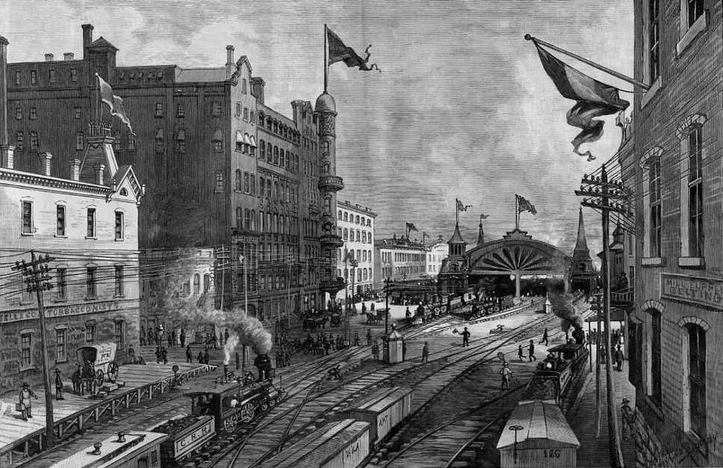
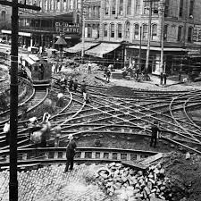
The city of Atlanta was created as a railroad hub for the Western and Atlantic Railroad.
The track ran from Chattanooga, Tennessee to a small hub called “Terminus”. Terminus changed its name to Marthasville and then finally to Atlanta in 1845.
Later two other railroad lines combined with this hub, causing the city to grow even more.

Slide 24
Chattanooga
“Terminus”
Atlanta

Slide 25
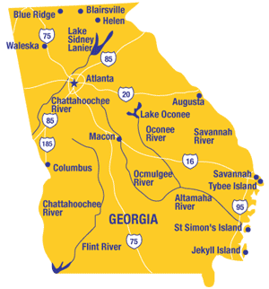
Due to the invention of the railroad, Atlanta became the first major American city to be built on a location without a navigable river.

Slide 26
Quick Review
___________________ were the means to transport cotton faster.
_____________________ was the center of railroad traffic in the South.
The cotton gin made little impact on Georgia’s economy. (T/F) Explain your answer.
Railroads were an important factor in Georgia’s growth in the 1800s. (T/F) Explain your answer.

Slide 27
Writing Prompt
Analyze and explain the relationship between the cotton gin, the introduction of railroads, and a booming economy in Georgia. Use textual evidence from your notes to support your response.
CC6-8RH1; CC6-8RH3; CC6-8WHST2

Slide 28
Price
Advertisement:
Write an article that could be found in a magazine during this time period. The purpose of the article is to explain how the state has grown economically and in population size with the development of the railroad and cotton industries.
.
Draw an picture to go along with the advertisement.
Create an advertisement for either Georgia’s railroad or cotton industry that entices foreign companies to move to Georgia. Write about why the company should move here & invest its money in these industries.
Draw an illustration that corresponds with the article.

Slide 29
Advertisement:

