Slide 1
Unit 5 SS8H8b Explain economic factors that resulted in the Great Depression. (e.g. boll weevil and drought)
Roaring Twenties to the Great Depression

Slide 2
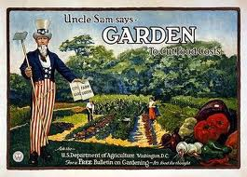
What was going on…
WWI had created a huge demand for agricultural products to feed the military, benefiting farmers.

Slide 3
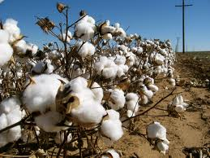
What was going on…
Soldiers needing uniforms created a great demand for cotton, skyrocketing cotton prices.

Slide 4
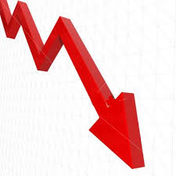
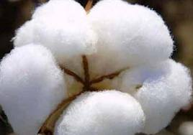
What was going on…
When WWI ended, cotton dropped from 35 cents/lb to 17 cents/lb.
Hard times were coming for Georgia farmers

Slide 5
Roaring Twenties
For the middle and upper classes, the 1920s in the United States had been a time of excitement and for many prosperity. “THE ROARING 20’s”

Slide 6
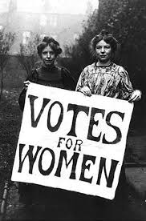
Roaring Twenties
Stock Market was booming
1920: 19th Amendment gave women the right to vote.
Electricity became more available.

Slide 7
Roaring Twenties
Other inventions included gas stoves, toasters, sliced bread, baby food.
Radio: WSB started in Atlanta.
1927: first talking motion picture
Walt Disney creates Mickey Mouse

Slide 8
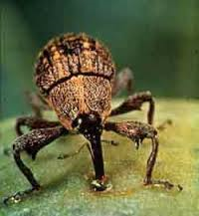
Boll Weevil
Migrated to the U.S. from Mexico
Introduced in Georgia in 1915
Destroyed Georgia’s cotton fields
Greatly affected Georgia’s long history of cotton production
Damage occurs when female boll weevils deposit eggs inside the cotton buds
When the eggs hatch, the larvae feed on the bud.

Slide 9
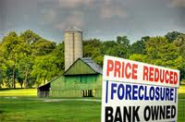
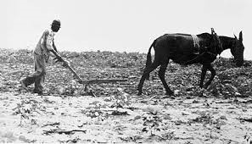
Boll Weevil (cont’d)
Robbed many small farmers of any prospect of making a living.
Some abandoned their farms and moved to cities or out of the state.
Others forced off of their land by foreclosure became sharecroppers on terms dictated by large landowners.

Slide 10
Boll Weevil (cont’d)
Eliminated as an economic pest in the 1990’s
Since elimination of the boll weevil as a pest,
Insecticide use in cotton has been reduced by approximately 75%
And yield losses associated with insects have been reduced by 50%

Slide 11
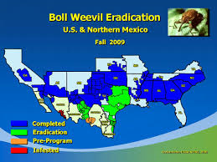
Boll Weevil (Cont’d)
Today, all cotton growers in Georgia are required to participate in the Boll Weevil Eradication Program(BWEP
Cotton growers pay an annual fee on each acre of cotton planted to monitor for and eliminate infestations if they occur
BWEP: has been a tremendous success from both an environmental and an economic perspective.

Slide 12
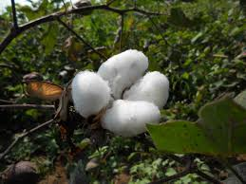
Leading up to the Drought
1920s: continued dependence on cash-crop agriculture.
Placed enormous pressure on the farmers to plant every available acre of land with cotton
Eventually depleted the soil

Slide 13
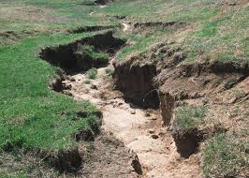
Leading up to the Drought
Removal of much of the state’s natural forestland contributed to erosion.
Georgia’s land, economy and farmers were already wearing out

Slide 14
Drought in Georgia
Lasted from 1924 - 1927.
U.S. Weather Bureau reported in 1925 that the drought was especially severe in late summer when rivers in some places reached the lowest levels ever known and had a profound impact on industrial and agricultural conditions.
Over 375,000 farm workers left Georgia between 1920 and 1925.
Number of working farms fell from 310, 132 to 249,095.
When farms failed, banks that had loaned the farmers money took huge losses.
Many farm related businesses closed.
This caused Georgia to go into a deep depression.

Slide 15
Drought in Georgia (cont’d)
Things improved a little, but the worst drought in Georgia history would occur in 1930.
The drought, along with the impact of the boll weevil, led to the Great Migration: southern black tenant famers leaving the South to migrate north for work.

Slide 16
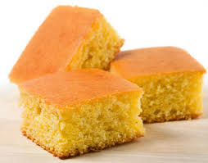
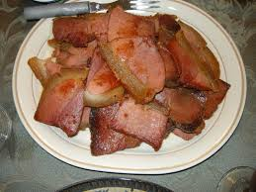
Another Drought
Worst drought on record in 1930-1931
The typical Georgia family farm had:
No electricity
No running water
Diets were inadequate, consisting mainly of molasses, fatback and cornbread.

Slide 17
Another Drought
The poverty of the state’s most rural counties made the support of even minimal education standards impossible.
Few rural clinics, hospitals, or health care workers.
Some counties had no health facilities at all

Slide 18
How Agriculture Woes Affected Georgia (1920s)
Cause
Effect
______
______________
______
______________
______________
______________
Overall effect on Georgia:

Slide 19
Writing Prompt
Georgia farmers depended heavily on their cotton crop. Why do you think agricultural experts urge farmers to grow more than one crop?

